Slide 1
Economics of Pollution
J2$
pollution and
government responses

Slide 2
Pollution
J2$
An externality
“Load” a.k.a. emissions
Absorptive capacity: a measure of damage/externalities
Stock pollutants: little or no absorptive capacity in the environment (e.g., non-biodegradable trash, PCBs)
Fund pollutants: emissions < absorptive capacity = no accumulation (e.g., C0₂)
Zone of influence relative to the point source: horizontal (local, regional, global) vs vertical (ground-level concentrations vs upper-atmosphere)

Slide 3
Costanza, R., June 2001. Bioscience, Vol. 51, No. 6
Model of An Ecological Economic System
J2$
Positive Impacts on Human Capital Capacity
Well Being
(Individual & Community)
Ecological Services / Amenities
Solar Energy
Complex Property Rights Regimes
Consu mption
(Based on Changing, Adapting Preferences)
Individual | Common | Public
Natural Capital
Human Capital
Social Capital
Manufactured Capital
Restoration,
Conservation
Wastes
Education, Training, Research
Evolving Cultural Norms & Policy
Limited Substitutability Between Capital Forms
Economic Production Process
Goods & Services
Institutional Rules, Norms, etc.
GNP
Building
Inves tment
Negative Impacts on All Forms of Capital
Decisions about taxes, community spending, education, science and technology, etc., based on complex property rights regimes
Waste Heat

Slide 4
Costanza, R., June 2001. Bioscience, Vol. 51, No. 6
Model of An Ecological Economic System
J2$
Positive Impacts on Human Capital Capacity
Well Being
(Individual & Community)
Ecological Services / Amenities
Solar Energy
Complex Property Rights Regimes
Consu mption
(Based on Changing, Adapting Preferences)
Individual | Common | Public
Natural Capital
Human Capital
Social Capital
Manufactured Capital
Restoration,
Conservation
Wastes
Education, Training, Research
Evolving Cultural Norms & Policy
Limited Substitutability Between Capital Forms
Economic Production Process
Goods & Services
Institutional Rules, Norms, etc.
GNP
Building
Inves tment
Negative Impacts on All Forms of Capital
Decisions about taxes, community spending, education, science and technology, etc., based on complex property rights regimes

Slide 5
Efficient allocation of pollution
J2$
Stock pollutants (persistence, Carbon monoxide, sulpher dioxide, diesel exhaust)
Maximize benefit − cost: benefit from consumption at any point in time minus the damage caused by the pollutant
Efficient quantity declines over time as the marginal cost of the damage rises
Price of the good rises over time as the amount of resources committed to pollution control rise
Steady state: additions to the stock pollutant stop as additional emissions are ‘controlled’ (e.g., recycling)
Price and quantity consumed remain constant, but the damage persists (e.g., mercury contamination)
Technology can alter the efficient allocation
Much of the following material is adapted from Chapter 14 of Environmental & Natural Resource Economics by Tietenberg and Lewis

Slide 6
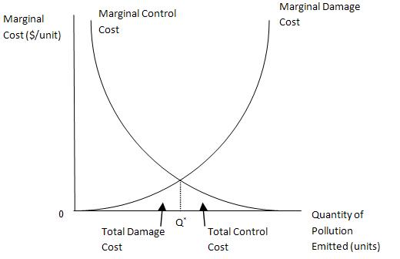
Efficient allocation of pollution
J2$
Fund pollutants (assimilation, CO₂)
Static versus dynamic analysis
Low-levels of emissions: no link between current and future emissions/damages
Small amounts of pollution are more easily diluted in the environment
Marginal costs of mitigation increase with the amount controlled
Note: Q* ≠ 0

Slide 7
Efficient allocation of pollution
J2$
For some pollutants Q* might equal 0 (or close to it) [e.g., plutonium]
Upward shift of the marginal damage curve
Equivalently for ‘environmentally-sensitive’ areas
Alternatively, low population density areas may see a downward shift of the marginal damage curve and Q* would be larger

Slide 8
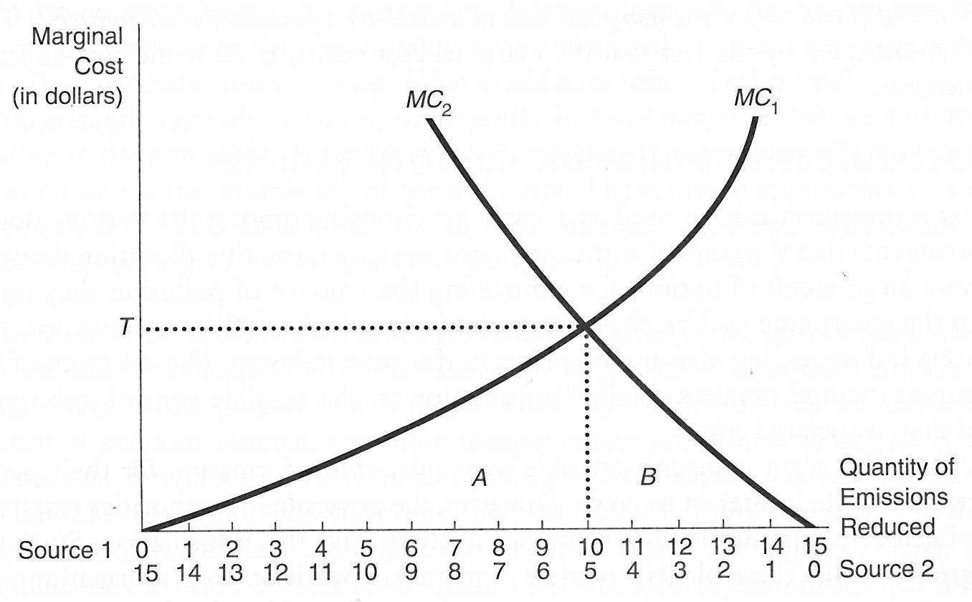
Marginal Abatement Costs
J2$
Consider two firms
Total emissions = 30 units
Each emits 15 units
Goal: reduce emissions to 15 units
Uniformly mixed fund pollutants
Relative point sources are less important
Find the cost-effective allocation of control responsibility
[Variable] cost of control for firm 1 is A
Cost of control for firm 2 is B

Slide 9
Marginal Abatement Costs
J2$
Minimized when the marginal costs of control are equalized for all point sources
How can we achieve the optimal solution?
Emissions standards: set a global standard and apply it evenly (e.g., each firm must reduce emissions by 7.5 units); inefficient since firm 1 has lower MC of abatement
Cap-and-Trade: each firm faces a limit on how much pollution they can emit and are allocated ‘allowances’ to pollute; exactly enough emissions are allocated necessary to meet the target reduction; allowances are tradeable; ‘dirty’ firms can buy allowances; ‘clean’ firms sell

Slide 10
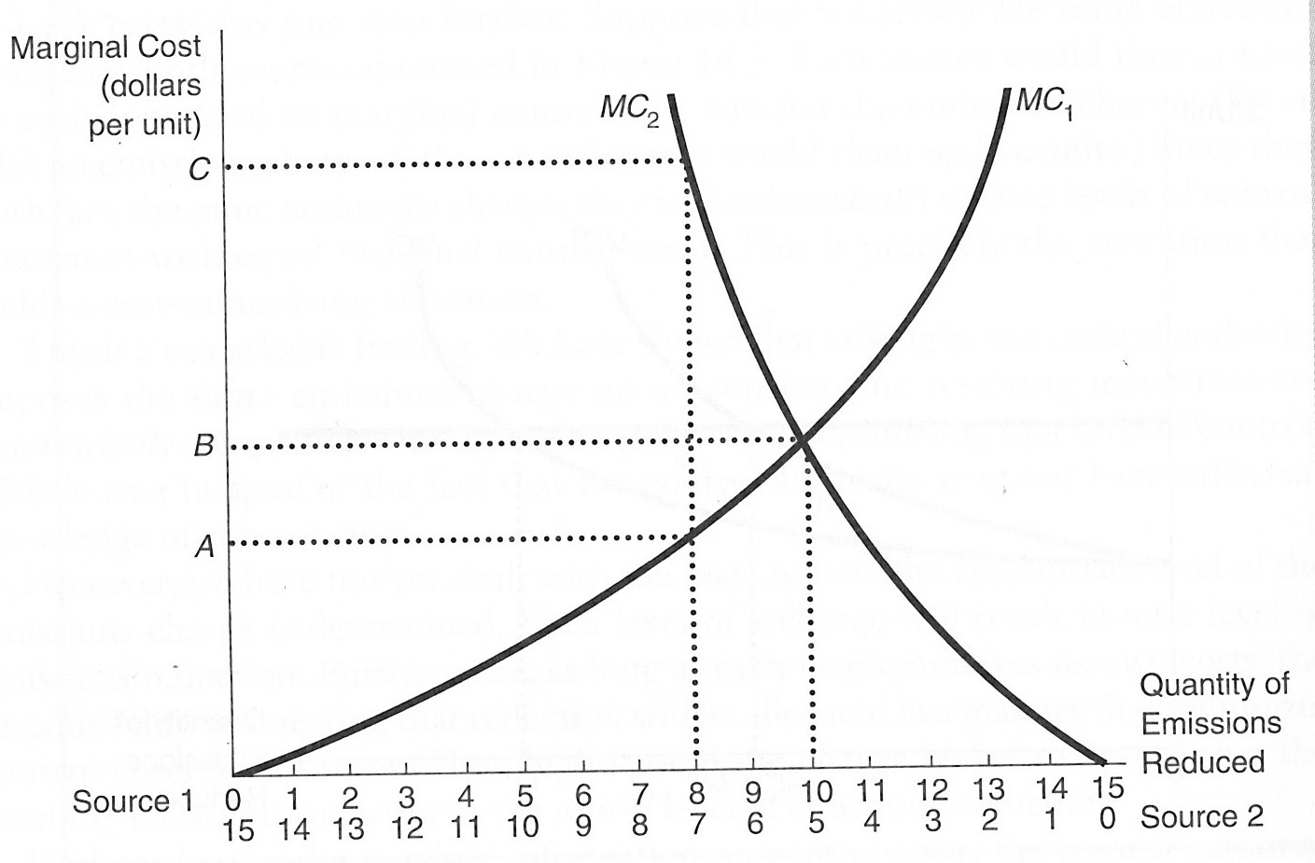
Marginal Abatement Costs
J2$
Firm 1 is emitting 15 tons and suppose it is allocated permits in the amount of 7 tons, i.e., it must clean up 8 tons of emissions
Firm 2 is also emitting 15 tons and suppose it is allocated permits for 8 tons, i.e., it must reduce emissions by 7 tons (at a cost of C)
C is a lot higher than the MC for firm 1 (A) so both firms are better off by trading
Firm 2 buys two units from firm 1 so it only has to clean up 5 units and firm 1 sells 2 units so it now reduces emissions by 10 units
Efficient outcome

Slide 11
Regional Greenhouse Gas Initiative (RGGI)
J2$
January 2009 a new approach was implement among 10 states in the northeastern US
Rather than ‘gifting’ CO₂ emissions allowances they were auctioned off in a sealed-bid auction with the revenue given to the states
Most states used the money for energy efficiency incentive programs
Result: lower abatement costs due to reduction in energy usage (less carbon emitted) and because of reduced energy demand

Slide 12
Carbon Pricing in Principle and Practice
Adapted from a presentation earlier this semester by Tom Tietenberg
Mitchell Family Professor of Economics, Emeritus
Colby College
Notes:
Earlier in my career I was privileged to attend one of the Conference of Party or (COP) meetings. These are the gatherings where the representatives of all countries get together to try to cooperate and find a way to manage the risks from a changing climate.
At these meetings they also have side events where groups stage presentations to educate and/or to lobby. One I attended was by Munich Re a reinsurer. Insurance companies of course are experts in managing risk so I was curious about what they had to say about the risk s from climate change.

Slide 13
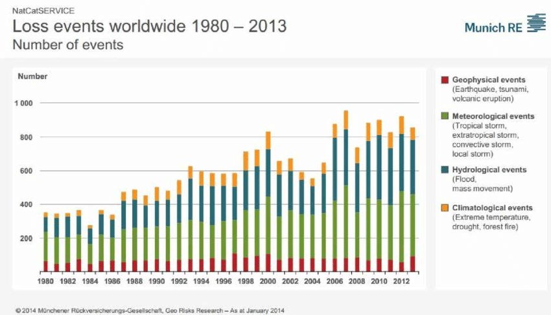
Munich Re Insurance Data
According to re-insurance firm Munich Re, storms, floods, earthquakes and other natural catas­trophes caused damages worth $ 160 billion in 2012. (According to NASA in 2017 it was $306 billion just for the U. S.) Their corporate risk experts say that climate change is making disasters more likely.
Notes:
Munich Re is a reinsurance company, that its their clients are insurance companies.
With potentially high loss risks they can partner with more local companies to assume some of that risk for a price. they are able to do this because of their geographic diversity and their large capital base.
Their message was that the risks from climate change are already occurring( $306 billion in U. S. alone in 2017), they are large and will get larger and it is imperative for the countries of the world to manage this risk because the economic consequences of inaction are large and growing.
Today I want to share with you an overview of carbon pricing, one of the most widely recognized ( if not the most widely recognized) I 'll include a mix of climate science, economics research, some history and a deep dive into one particular carbon priding program, the Regional Greenhouse Gas Initiative to see how it is working.
To get at the challenge of how to mange the risk, we need to understand the challenge.

Slide 14
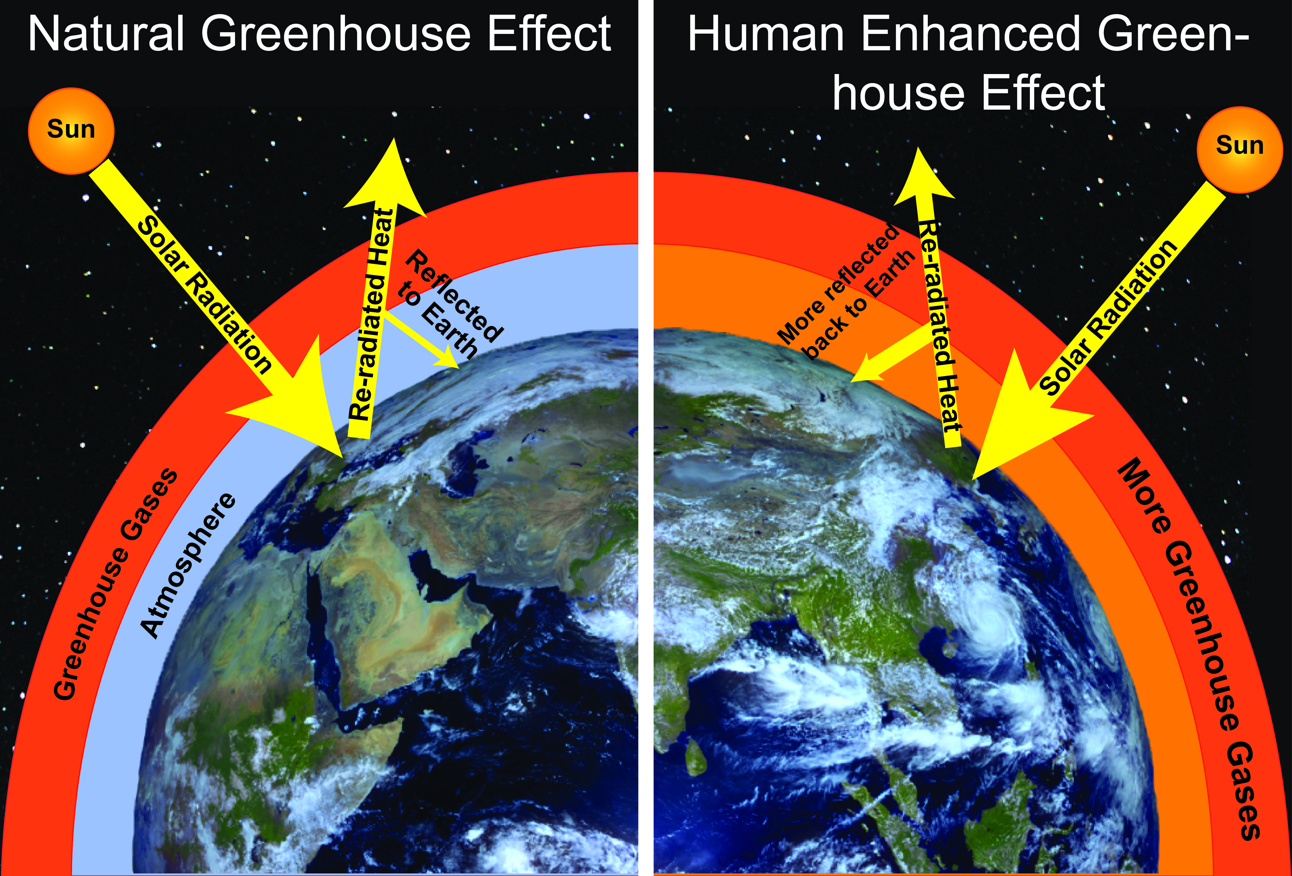
The Basics of Climate Change
The basics have been known since the mid 1800s.
Notes:
Everyone is this room may already know about the basics of climate change, but I want be sure everyone is on the same page. The the basic knowledge of climate change is pretty simple and has been known since the mid to late 1800s.
So we have to reduce the emissions that are trapping the heat. How much and how soon?

Slide 15
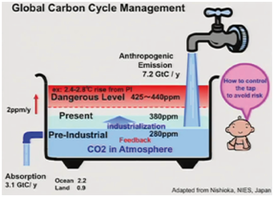
Setting the Scene: The Buildup of Greenhouse Gases
The Bathtub Metaphor
  Inputs: emissions
  Outflow: the long residence time of some greenhouse gases means small outflow.
  Result: buildup of CO₂ concentrations in the atmosphere
The emissions-concentration-temperature relationship allows us to derive for a chosen temperature target a specific maximum amount of CO₂ equivalent (CO₂-e) that can be emitted into the environment without exceeding the target level.
That amount is called the carbon budget
Notes:
To answer the question of how much and how soon Ralph Cicerone, the former President of the National Academy of Sciences suggested that we rely on a metaphor--in this case a bathtub.
From this notion we can derive a concept of a carbon budget
Start from a temperature target derive from that the Co2-e concetration that would produce that temperature.
Derive from that the amount of emissions that would lead to that concetration.
the difference between that aggregate level of emissions and the current level is the carbon budget--what is left to emit until we run into that target.

Slide 16
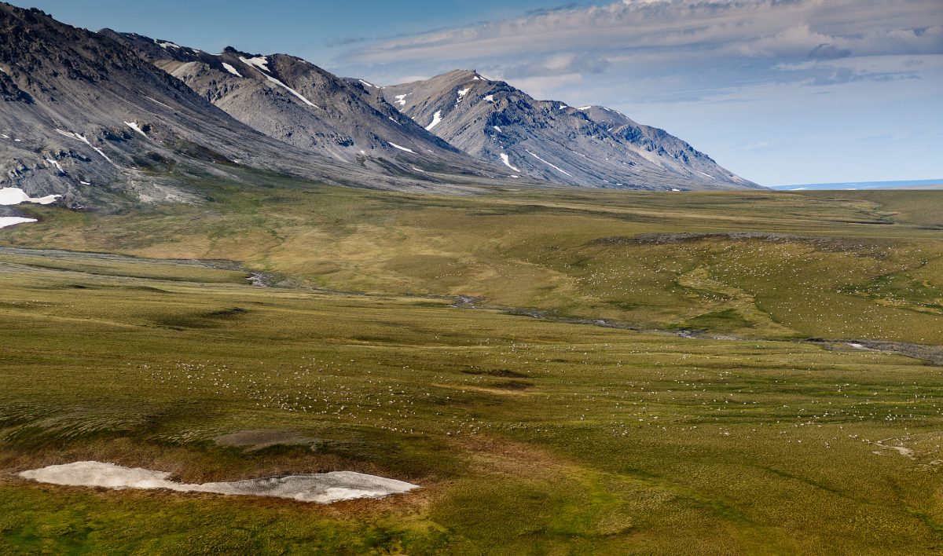
The Choice of the Temperature Target
Motivation: Avoid or lessen effects of “Tipping Points” Example: thawing of the permafrost
Wanted 1.5⁰ Celsius increase target (compared to preindustrial levels), but that now seems impossible to meet.
Settled on a 2⁰ Celsius increase target.
Notes:
The next step was to pick the temperature target.

Slide 17
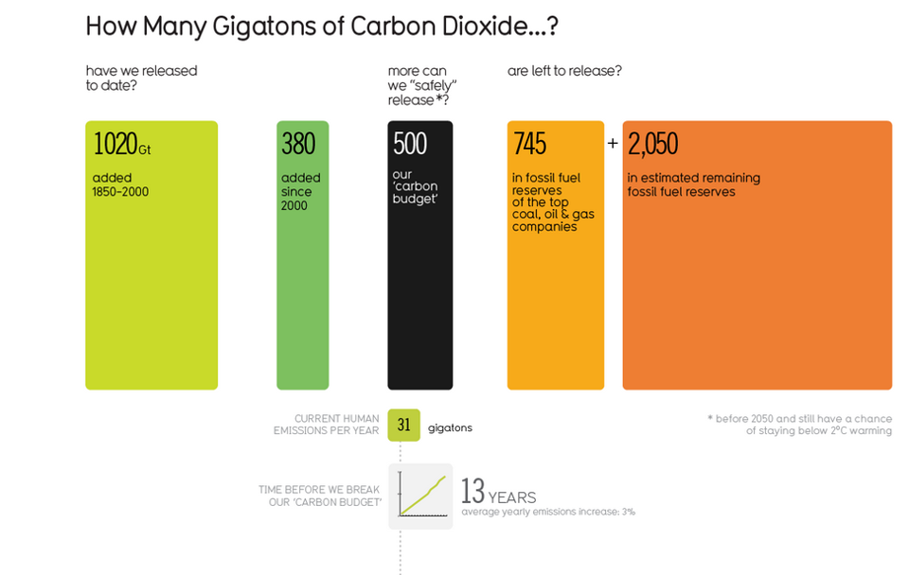
Notes:
So once we have calculated the carbon budget what does it tell us.
It tells us that unless we change our emissions trajectories soon, we will exceed the 2 degree Celsius target. ( in this case 13 years). The newest calculation reported on a continuous base in the Guardian newspaper makes it about 18 years.
Don't pay too much to the specifics except that it is a surprisingly short period of time and that would mean we have to leave a lot of fossil fuels in the ground to achieve it.

Slide 18
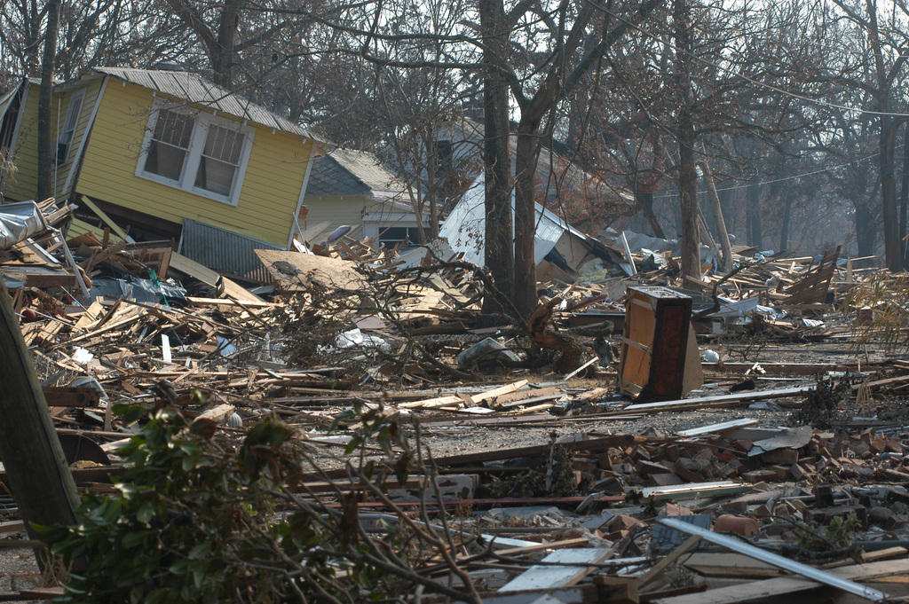


Setting the Scene: Economic Principles
Managing the risk (reducing emissions) is clearly cheaper than bearing the consequences of those unmanaged risks (the resulting increased damages).
Taking action now is cheaper than waiting. (The studies indicate that each delay of ten years raises the cost by 40%.)
Economists are in near unanimity, regardless of their personal political persuasions, that carbon pricing is the most cost-effective comprehensive action we can take to reduce emissions.
Notes:
No on to economics. What do we know from studies that would be helpful?
Adage Ben Franklin “An ounce of prevention is worth a pound of cure.”
1st principle we know that the efficient level of control sets the MCC=MD.
Estimates of the marginal damage runs in the 30-40$/ton range while the marginal cost of control is typically currently less than $10/to. Why? Falling prices for solar and wind, investments in energy efficiency ( more efficient lighting and heating for example cut homeowner and business costs while they cut emissions.
Why carbon pricing
cost-effectiveness principle MC=MC=MC
firms set p=MC to maximize profits given a price on carbon. When all face the same price on carbon this means everyone is reducing emissions such that MC=MC=MC. We have not discovered any other comprehensive policy that can achieve cost=-effectiveness.

Slide 19
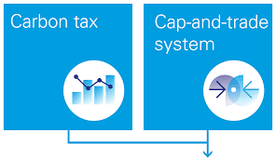
The Two Forms of Carbon Pricing
Carbon Tax
Places an administratively determined price on carbon emissions from all covered sources and lets the emissions level be determined by the market.
Cap-and-Trade
Sets an administratively determined cap on aggregate emissions from all covered sources and lets the market determine the price.
Notes:
Economists refer to these forms of carbon pricing as mirror images of each other.
Does it matter which one you choose? In theory no, but there are some importatnt difference in practice. I don't have time to go into them here but I would be happy to go into that in the question period of you are interested in pursing the further.

Slide 20

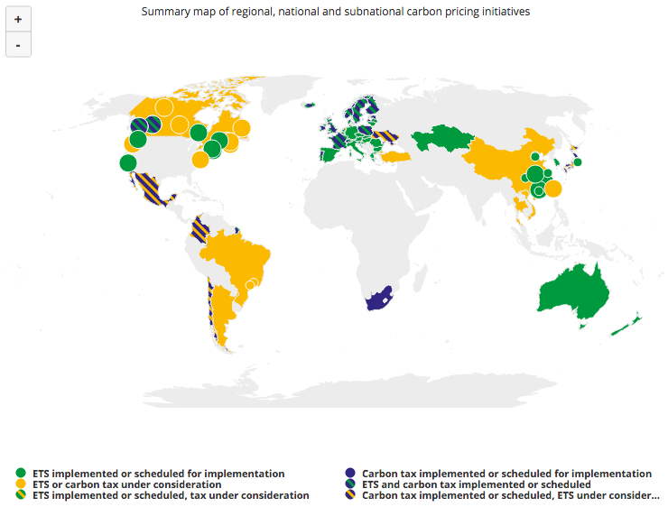
The Spread of Carbon Pricing
The status of carbon pricing policy.
Internal carbon pricing is increasing.
Current programs are not enough to stay within the carbon budget.
Notes:
Since 2012 the number of implemented or scheduled carbon-pricing instruments has nearly doubled. Today 42 national and 25 sub-national jurisdictions put a price on carbon emissions. China, Canada two regions of U. S. European countries, South Korea, Mexico
A rapidly increasing number of companies are preparing for a world with a higher cost of carbon emissions—in 2017 nearly 1,400 companies disclosed the use of an internal carbon price, including more than 100 Fortune Global 500 companies with collective annual revenues of $7 trillion.
It is clear that stronger action is needed on the carbon pricing front. Current carbon price initiatives only cover 15 percent of global emissions, and 75 percent of these emissions are priced at under $10 per ton. More progress is needed to help achieve the Paris Agreement goals.
Now lets take a closer look at RGGI, the carbon pricing program tht exists in the northeastern United States.

Slide 21
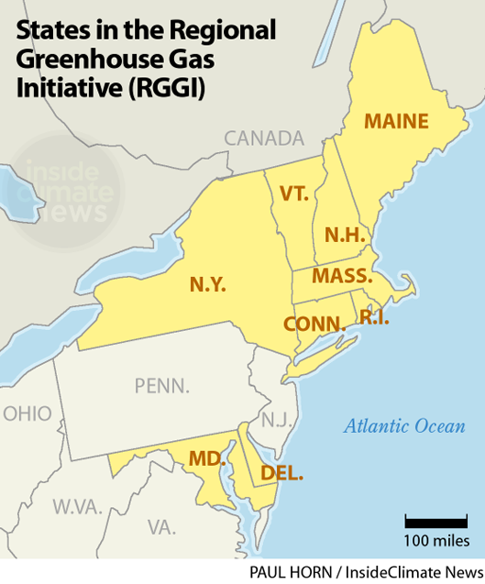
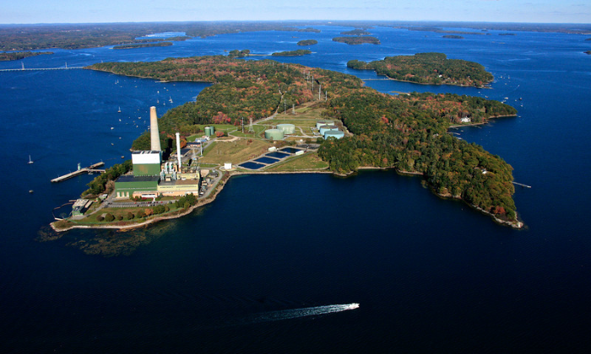
RGGI:The Origins
The Impetus: Gov. George Pataki (R, NY)
Source Coverage: Fossil fuel-fired power plants 25 megawatts or greater in size (currently 209 facilities region-wide). Maine has six.
Wyman unit #4 610 megawatts Yarmouth
Notes:
RGGI is a cap-and-trade form of carbon pricing.
Interestingly the idea for its formation came from a Republican governor of New Your State
Started with An MOU to get everyone on the same page.
States: NJ once belonged but pulled out.
Note that Penn is not a member. That will be of interest later in the talk.

Slide 22
Cap-and-Trade RGGI Style
  Timing of Mandated CO2 Reductions: Initial cap set at 188 million tons of carbon emissions annually (adjusted to 165million tons when NJ left); 2015-2020, cap declines by 2.5 percent per year.
  Allowances: Creates “allowances”, each authorizing one ton of emissions such that the number of allowances equal the number of tons authorized by the cap. Every covered source must turn in one allowance for each ton they emit during the covered period or pay a large financial penalty per excess ton.
  QuarterlyAuctions: These allowances are auctioned off to the highest bidders. Each bidder states how many allowances they want at stipulated prices. The available allowances are allocated until the demand equals supply. Everyone pays the same market-clearing price.
  Price Floor: $2.20/ton. Latest auction price was $3.79/ton.
Notes:
Timing of Mandated CO2 Reductions: Initial cap set at 188 million tons of carbon emissions annually (adjusted to 165million tons when NJ left); 2015-2020, cap declines by 2.5 percent per year.
Allowances: Creates “allowances”, each authorizing one ton of emissions such that the number of allowances equal the number of tons authorized by the cap. Every covered source must turn in one allowance for each ton they emit during the covered period or pay a large financial penalty per excess ton.
QuarterlyAuctions: These allowances are auctioned off to the highest bidders. Each bidder states how many allowances they want at stipulated prices. The available allowances are allocated until the demand equals supply. Everyone pays the same market-clearing price.
Price Floor: $2.20/ton. Latest auction price was $3.79/ton.

Slide 23
Allowance Sales Proceeds
(as of February, 2018)
Virtually all revenue (minus administrative costs) goes back to the participating states from whence it came. So states with many emitting plants get more back than states with fewer plants.
So how much do they get?
Coverage | Cumulative Proceeds
Maine | $93,893,930.64
All RGGI States | $2,887,234,068.02
Notes:
Manie about 94 million and all RGGI states about 2.9 billion
Next lets look at Maine spends it.

Slide 24
Use of RGGI Revenue
RGGI states are currently investing:
64 percent of CO2 cumulative allowance proceeds in energy efficiency;
14 percent in renewable energy;
14 in energy bill payment assistance, and
7 percent in a variety of additional greenhouse gas emissions reduction programs.
Notes:
RGGI states are currently investing:
64 percent of CO2 cumulative allowance proceeds in energy efficiency;
14 percent in renewable energy;
14 in energy bill payment assistance, and
7 percent in a variety of additional greenhouse gas emissions reduction programs.

Slide 25
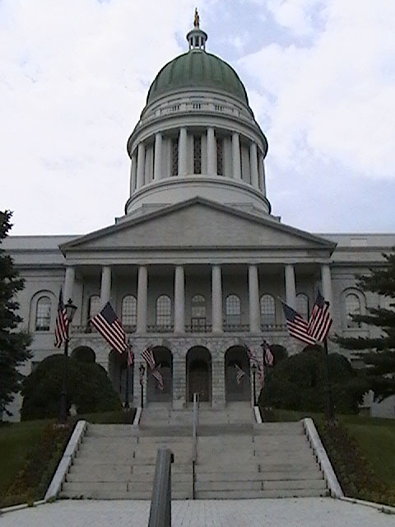
The Political Economy of RGGI in Maine
Passed by a grand coalition of environmental and business groups.
Why? What were the Incentives for Businesses and Environmental Groups?
Notes:
Didn’t used to think how money was used was important it is.
Explains passage of this bill.

Slide 26
Uses of Revenue In Maine
Revenue is given to Efficiency Maine, the independent administrator for energy efficiency programs in Maine--directed at both businesses and homeowners.
Efficiency Maine’s mission is to lower the cost and environmental impacts of energy in Maine by promoting cost-effective energy efficiency and alternative energy systems.
Efficiency Maine does this primarily by delivering rebates on the purchase of high-efficiency lights and equipment to help customers save electricity, natural gas and heating fuels throughout the Maine economy.
Efficiency Maine is governed by a stakeholder Board of Trustees with oversight from the Maine Public Utilities Commission.

Slide 27

The National Semiconductor (Now Texas Instruments) Case: An Example
National Semiconductor in South Portland, Maine
Manufactures chips used in phones, autos and lighting systems
Combined a $300,000 grant from Efficiency Maine (funded by money from RGGI) with it’s own $750,000 investment to replace its traditional wafer fabrication tool chillers with new high efficiency, solid state units.
Saved 1.75 million kW-hrs per year in energy use as well as reduced greenhouse gas emissions from conventional refrigerants.
When National Semiconductor was forced to shut down a plant, the plant in Texas was chosen, not the one in Maine, despite Maine’s high per kilowatt-hour cost of electricity.

Slide 28
The Macroeconomic Effects
Energy efficiency investments lowered energy costs to participating businesses and made them more competitive.
  Tex Tech example
    Make the outer covering of tennis balls. Were being forced to outsource their production abroad due to high energy costs.
    With a grant from Efficiency Maine their investments lowered energy costs enough to keep production in Maine.
Energy efficiency investments reduced the outflow of local funds to pay for energy supplies from foreign suppliers (e.g. oil) or suppliers in other states (e.g. coal).
Keeping this money in the local economy had a multiplier effect, meaning more jobs in region.

Slide 29
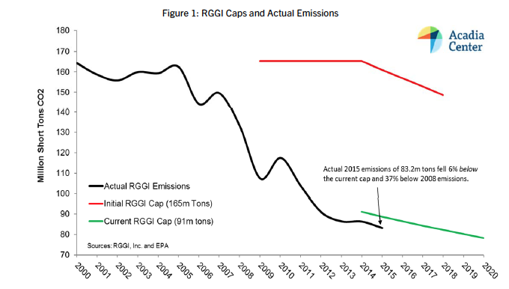
RGGI Cap and Annual Emissions
(Hundreds of Millions of Short Tons of CO2)
What has Happened to RGGI Emissions?
RGGI Cap and Annual Emissions
(Hundreds of Millions of Short Tons of CO2)
Note: Although the program enforcement began in 2009, it was announced in 2005.
Notes:
The British ton is the long ton, which is 2240 pounds, and the U.S. ton is the short ton which is 2000 pounds.
There is also an third type of ton called the metric ton, equal to 1000 kilograms, or approximately 2204 pounds. The metric ton is officially called tonne. The SI standard calls it tonne, but the U.S. Government recommends calling it metric ton.

Slide 30
Why have Emissions Decreased so Much for RGGI Plants?
The most important source is fuel substitution with energy efficiency next.
From 2005 to 2017:
  Kilowatt-hours generated from high carbon fossil fuels (mainly coal and oil) experienced a sharp decline.
  Electricity generated from natural gas--a cleaner fossil fuel—increased.
  Kilowatt hours generated from wood, wind and solar increased.
  Energy efficiency lowered emissions per unit output.

Slide 31
Are all these emissions reductions due to RGGI?
No. Not all of this reduction can be attributed solely to RGGI (the wider availability of cheaper natural gas due to fracking, for example) played a role.
There is a published study that tries to sort this out is by Brian Murray and Peter Maniloff of Duke University published in the journal Energy Economics.
They find (by comparing the RGGI states with others and trying to control for other policies and natural gas via an econometric analysis) that RGGI is responsible for about half of the reduction.
Source: Brian C. Murray and Peter T. Maniloff “Why have greenhouse emissions in RGGI states declined? An econometric attribution to economic, energy market, and policy factors” Energy Economics, Volume 51, (September 2015): 581-589

Slide 32
What about Leakage in RGGI?
When RGGI was initiated, concern about leakage was high.
What is leakage?
  It is the amount of emissions reduction from generation in the regulated region that is actually due to shifting generation to plants outside the region, which are not covered by the regulation.
Why does it matter?
  The concern is that imports from dirtier plants would be cheaper (due to their ability to avoid the RGGI regulation) and hence more attractive than in-region generation.
  Leakage from dirtier plants would make the actual emissions reduction (that counted the shifting) less than the reported emissions reduction (that didn’t count it).

Slide 33
RGGI Leakage: The Evidence
Net imports into the region have increased since the program was initiated.
However, the bulk of the imports have come from Canadian power sources (including hydro) that have LOWER emissions than the RGGI per kilowatt-hour average. (A relatively small amount did come from Pennsylvania and it did have higher emissions per kilowatt-hour).
Hence in RGGI the imports have overall caused emissions to be lower than they would have if all the power had been generated within the RGGI region.
Source: CO2Emissions from Electricity Generation and Imports in the Regional Greenhouse Gas Initiative, Published, August, 2016

Slide 34
The Future of RGGI
Recently two new states have announced they are preparing to join RGGI.
  One Virginia, is preparing to enter for the first time. In November of 2017 Virginia regulators unanimously approved a draft proposed rule that would enable joining RGGI by capping emissions from Virginia's electricity sector beginning in 2020 and reducing them by 30 percent over a decade.
  New Jersey intends to rejoin RGGI. Recently elected Gov. Phil Murphy has begun the process for New Jersey to re-enter the Regional Greenhouse Gas Initiative, six years after former Gov. Chris Christie made the controversial decision to leave it.

Slide 35
The RGGI Bottom Line
Emissions are down a lot and the program seems to remain politically popular. Some of that emissions reduction is due to RGGI and some is due to other factors.
Using the revenue to promote energy efficiency has proved to be a popular choice.
The carbon reductions from energy efficiency have been achieved at a negative cost.
The cap was weaker than expected so less revenue than possible was collected.

Slide 36
The Carbon Pricing Bottom Line
Carbon pricing is the only comprehensive, cost-effective approach to reducing emissions we know of.
Current carbon pricing programs and current prices are lower than necessary to meet the 2⁰ Celsius target.
Taking action is cheaper than not taking action.
Delay in taking action raises the costs.
How the revenue is used matters politically as well as economically.

