Slide 1
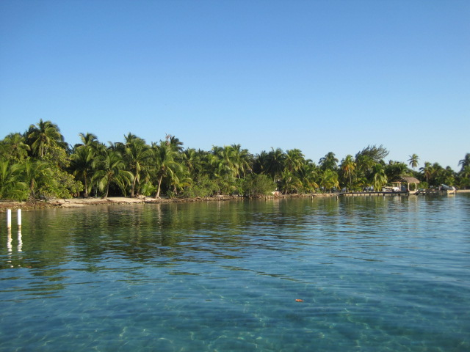
The Ostracods/Barnacles of Bermuda
By Clara Bicher

Slide 2
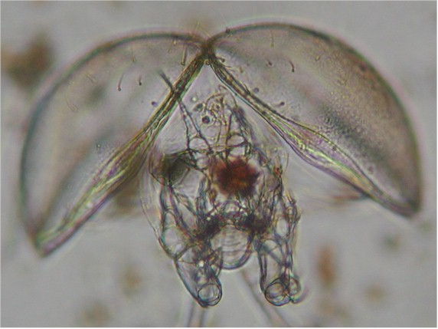
What is an ostracod?
A.k.a. “mussel shrimp”
  Kingdom Animalia, Subkingdom Metazoa, Phylum Arthropoda, Subphylum Crustacea, Class Ostrocoda
Tiny crustaceans with a bivalved carapace and an unsegmented body
Has 5-7 pairs of appendages that can be drawn in completely inside the carapace when the valves are closed by an adductor muscle
Have diverse eating habits: some scavenge for dead plants or animals & some eat living plants and animals
Their main predators are fish and other invertebrates

Slide 3
Characteristics
Carapaces are usually 0.5-20 mm long; they are shed with each molt
Dull colors: brown, occasionally yellow or red
Moves by jerky swimming, or scuttling and plowing over & through the sediment
The ostracods of Bermuda are relatively unknown, compared to other crustacean groups
  Of over 2000 described living species of ostracods, at least 120 are known to occur in the waters of Bermuda

Slide 4
Occurrence
Marine and freshwater—only a few species inhabit moist terrestrial areas
  Marine species live in or on all types of substrates—mud, sand, vegetation, and hard bottom—at abyssal to intertidal depths
Depending on the species and whether or not the carapaces are strongly calcified (lest they break down), living animals may be more abundant than empty shells
An ostracod can live for several years at best

Slide 5
Identification
Internal examination of the carapace and examination of the appendages to determine the species
external appearance of the carapace can be used to determine Orders, and many of the Families and Genera of ostracods
Females are more abundant than males, since in many species males die soon after copulation

Slide 6
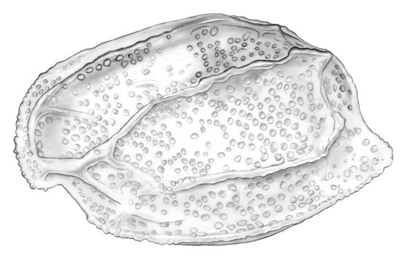
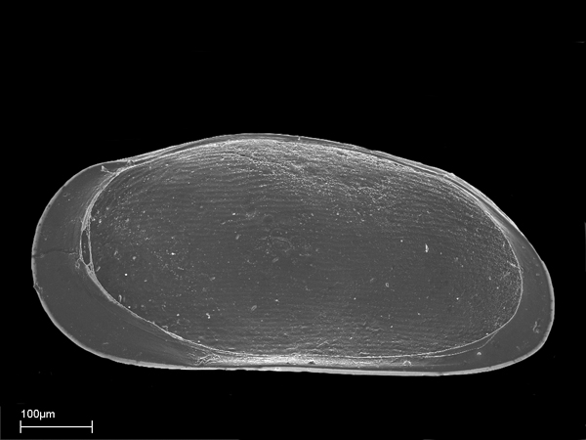
Bermuda Ostracoda
Rutiderma sterreri: lives on algae, sea grasses and sediments; common (see top right)
Cytherella lata: Fairly common in inshore and lagoon sediments
Thalassocypria sp.: abundant in brackish inland ponds (see bottom right)

Slide 7

FACT!
Ostracods have the most complete fossil record of any of the crustaceans!

Slide 8
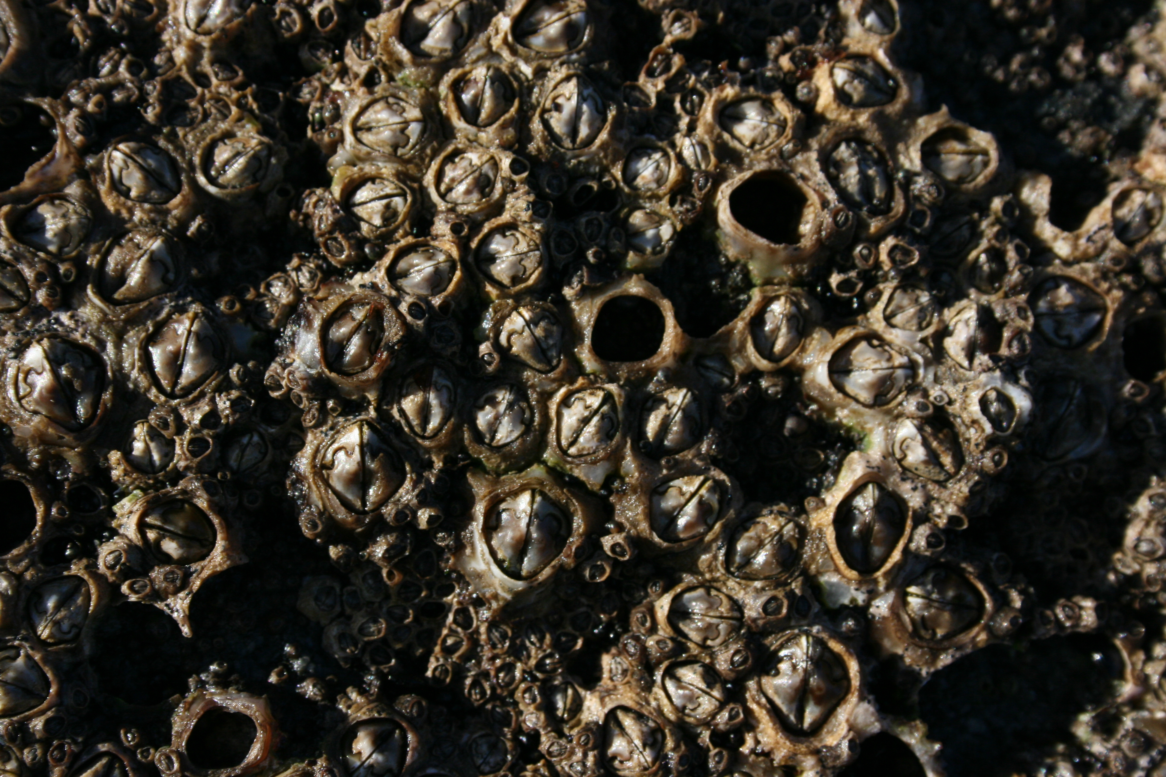
What is a barnacle?
Kingdom Animalia, Subkingdom Metazoa, Phylum Arthropoda, Subphylum Crustacea, Class Cirripedia
Crustaceans that are sedentary and are either amorphous parasites, or enclosed in a carapace with appendages that are modified to filter water
Size ranges from 0.5 cm to 5 cm

Slide 9
Characteristics
Out of the 600 known barnacle species, only 19 have been definitely recorded from Bermuda
All species are marine although some occasionally live out of water, if they prefer the intertidal zone
They live attached to hard surfaces: rocks, pilings, or floating objects; some burrow into calcareous rocks or embed themselves in corals or sponges; some even latch onto crustaceans, turtles, or whales

Slide 10
Miscellaneous
Most species are cross-fertilizing hermaphrodites
  One specimen just has to act as a male & inseminate another that has removed its exoskeleton to lay eggs
Can live from 1 to 20 years
They feed on plankton and detritus by reaching into the water column with their appendages
Most common predators are gastropods, crabs, and shallow-water fish, such as wrasses and parrot fish

Slide 11
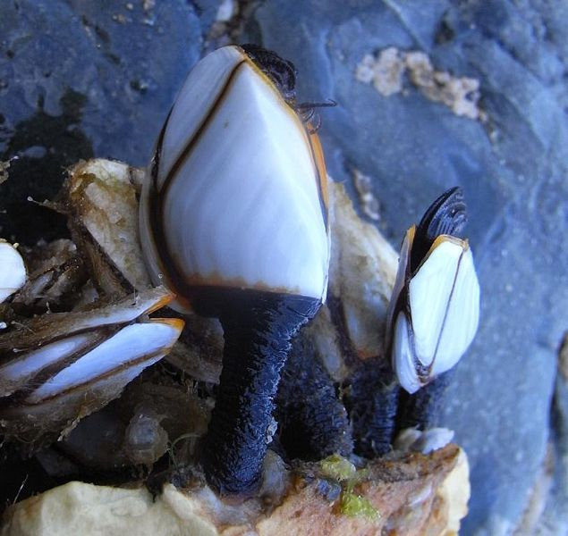
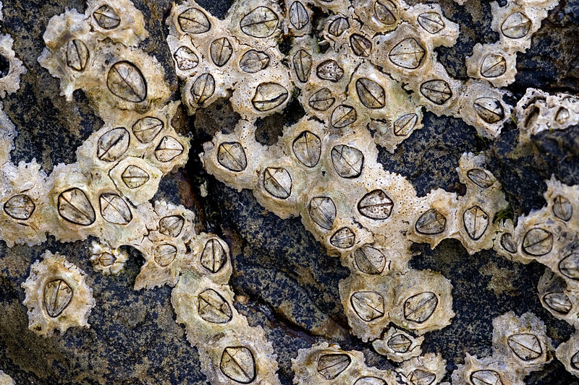
Which barnacles are common in Bermuda?
Lepas anatifera: commonly found on drifting objects (wood, bottles, buoys, etc.) (see top right)
L. pectinata: the most common goose barnacle on Sargassum
Chthamalus angustitergum thompsoni: one of the commonest intertidal species; possibly a recent immigrant (see bottom right)

Slide 12
Resources Used:
Marine Fauna and Flora of Bermuda: A Systematic Guide to the Identification of Marine Organisms, edited by Wolfgang Sterrer
http://www.ucmp.berkeley.edu/arthropoda/crustacea/maxillopoda/ostracoda.html
http://www.neotropical-paleobioindicators.com/?page_id=326
http://www.buildingthepride.com/faculty/microaquarium/Crustaceans.htm
http://ketenewplymouth.peoplesnetworknz.info/site/images/show/4382-brown-barnacle
http://en.wikipedia.org/wiki/Lepas_anatifera
http://en.wikipedia.org/wiki/Chthamalus

