Slide 1
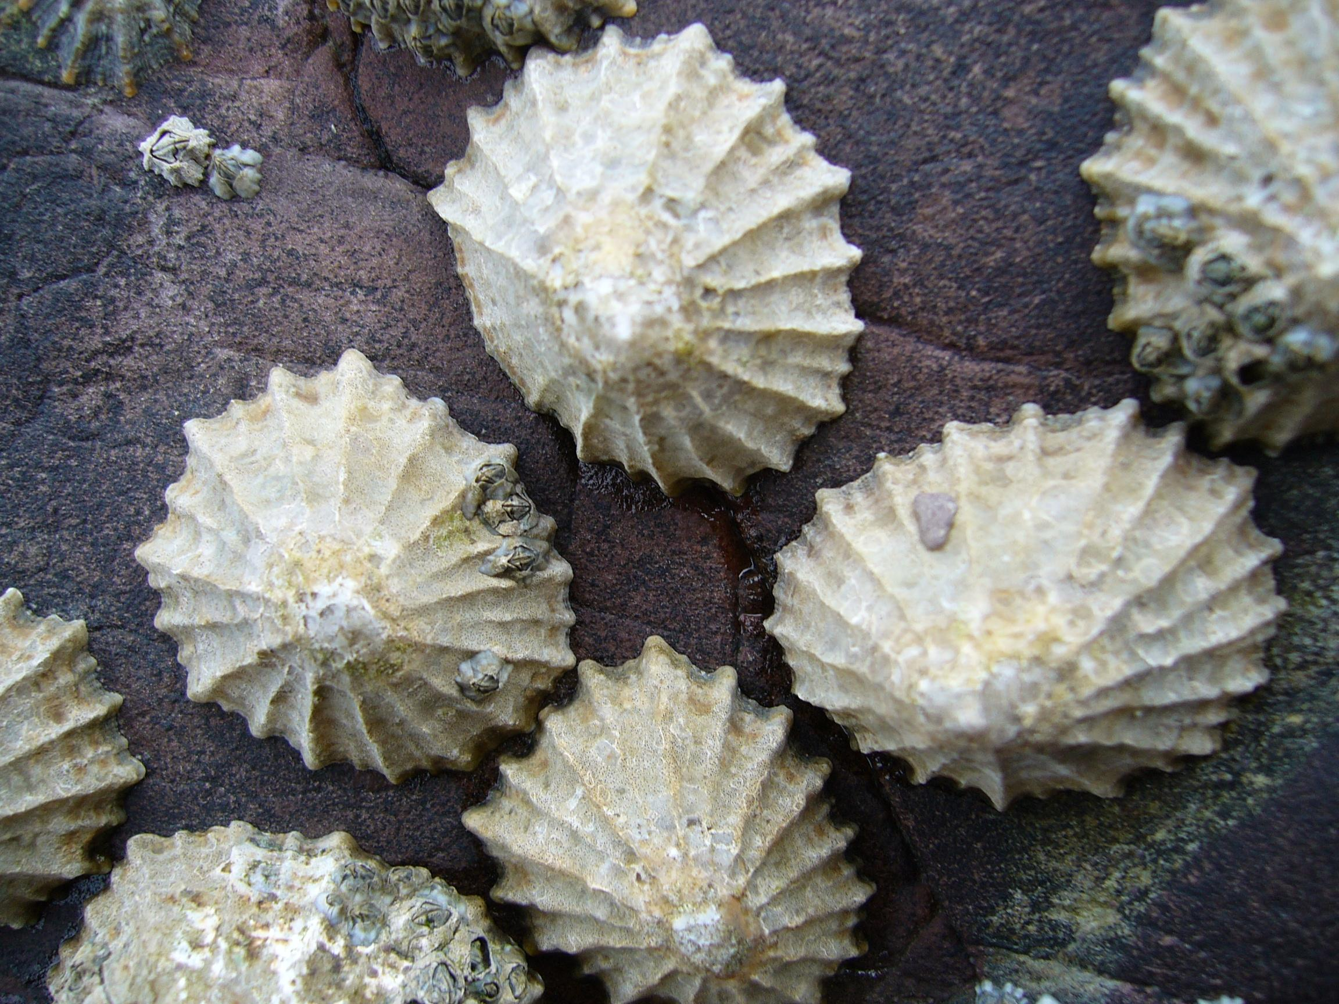
Limpets and Chitons

Slide 2
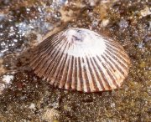
Limpets
Limpets are aquatic gastropod mollusks
Name limpet applied to snails that have a conical shaped shell that is not spirally coiled

Slide 3
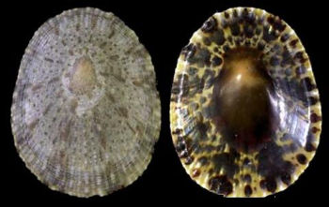
True Limpets (patellogastropoda)
Both nutrient and waste streams enter under the shell through separate grooves in the shell
Shells typically less than 3 inches in length
Flatter the shell is, the more resistant it is to incoming waves
Live throughout the inter-tidal zone, but certain species have also been found to live in the deep sea, around hydrothermal vents, whale-falls, and sulfide seeps

Slide 4
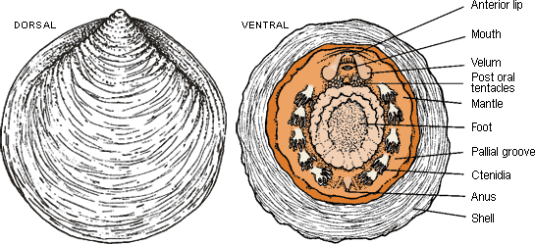
True limpets

Slide 5
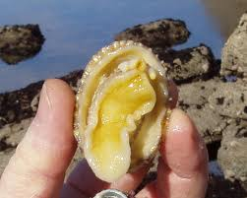
Movement
Wavelike movement of the foot

Slide 6
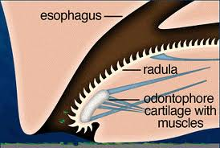
Feeding
Graze primarily on algae
Use radula to scrape algae

Slide 7
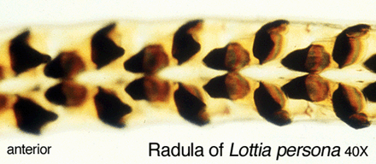
Radula
Ribbon-like tongue
Many “teeth” or cusps on radula
Radula composed of chitin and protein
Cusps hardened with silicon and iron oxide

Slide 8
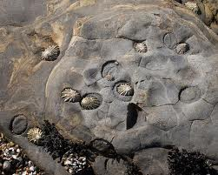
Home site
Limpet clamp onto rock surface with foot
Grow to fit perfectly in surrounding rock
Shell of limpet sometimes worn down by the rock
Never stop clinging
Leave scars in rock

Slide 9
Homing
Leave home site at night to feed
Follow chemicals left in the mucus trail back to the home site
Clamp down when tide recedes to maintain moisture
http://www.youtube.com/watch?v=ohe71rvOM6g

Slide 10
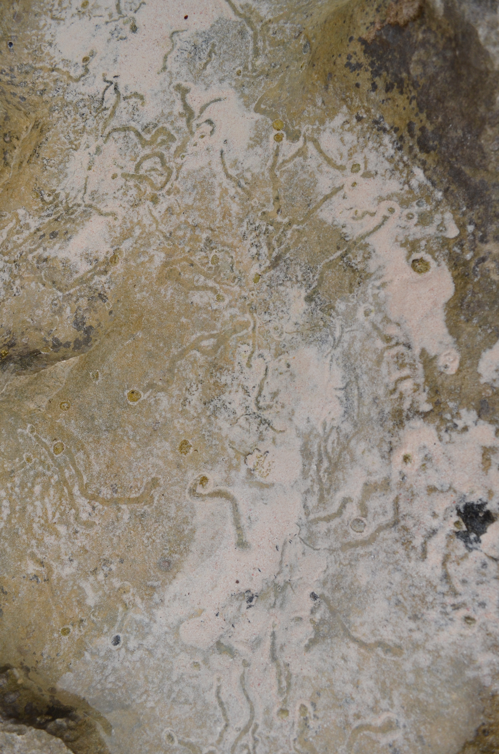

Slide 11
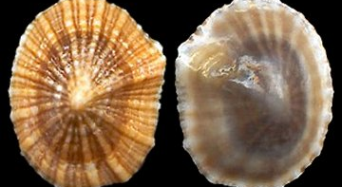
Siphonaria Alternata

Slide 12
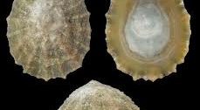
Patella Vulgata (common limpet)

Slide 13
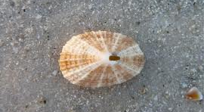
Diadora Bermudensis (Bermuda Keyhole Limpet)

Slide 14
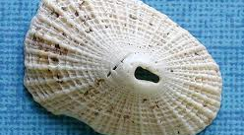
Diodora Cayenensis

Slide 15
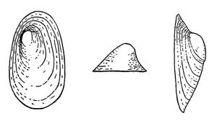
Ancylus Bermudensis
Freshwater Limpet
Inhabits freshwater ditch of Pembroke Marsh
Has a lung and false gill (pseudobranch)
Unique to Bermuda

Slide 16
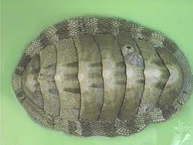
Chitons
Belong to class Polyplacophora
Large marine mollusks

Slide 17
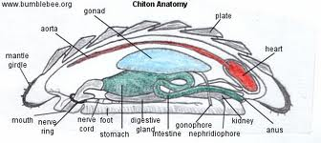
Anatomy

Slide 18
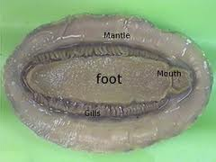
Chiton

Slide 19
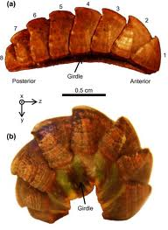
Shell
Consists of 8 aragonite plates, also called valves
The separate plates are held together by girdle

Slide 20
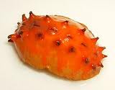
Girdle ornament
Spicules and scales mineralized from aragonite

Slide 21
Feeding habits
graze on algae as well as bryozoans, diatoms and sometimes bacteria
Uses radula similar to limpet’s to scrape algae off of rocks
  Cusps are tipped with magnetite
  Magnetite may be associated with magnetoception or the ability to sense the earth’s polarity

Slide 22
Chitons of Bermuda

