Slide 1
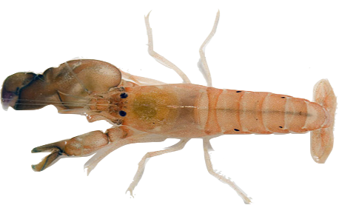
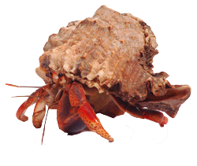
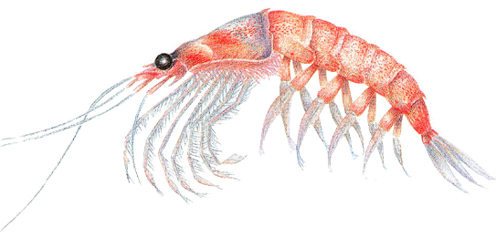
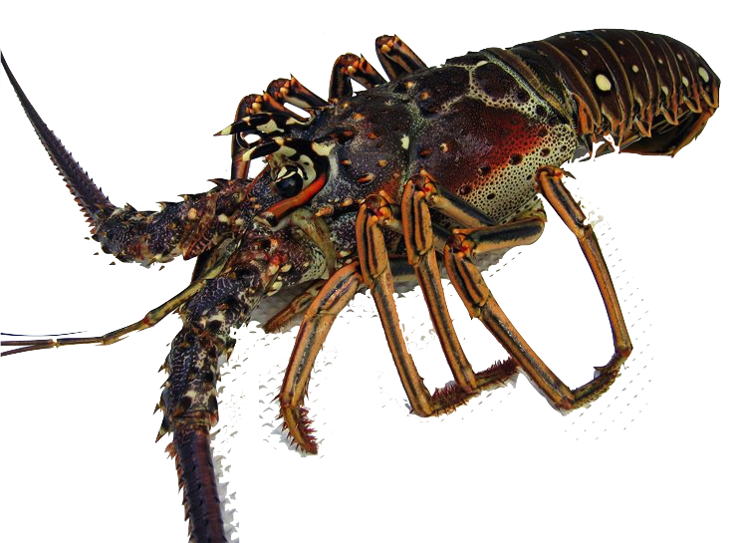
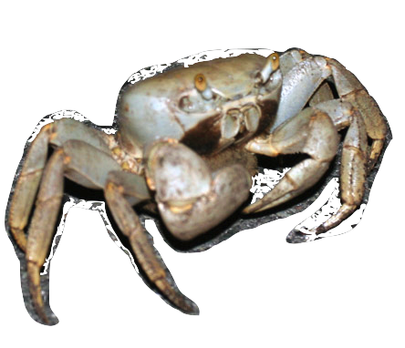
Decapods on Bermuda
Sarabeth George

Slide 2
Decapod Characteristics
Order of crustaceans: class Malacostraca
Mostly marine; some terrestrial
Ten legs
  Front 3 pairs = Mouthparts = Maxillipeds
  Hind 2 Pairs = Walking/Swimming = Pereiopods
  Some decapods have chelae/chelipeds = Pincers
Classification within Order Decapoda depends on structure of gills & legs, and the way larvae develop

Slide 3
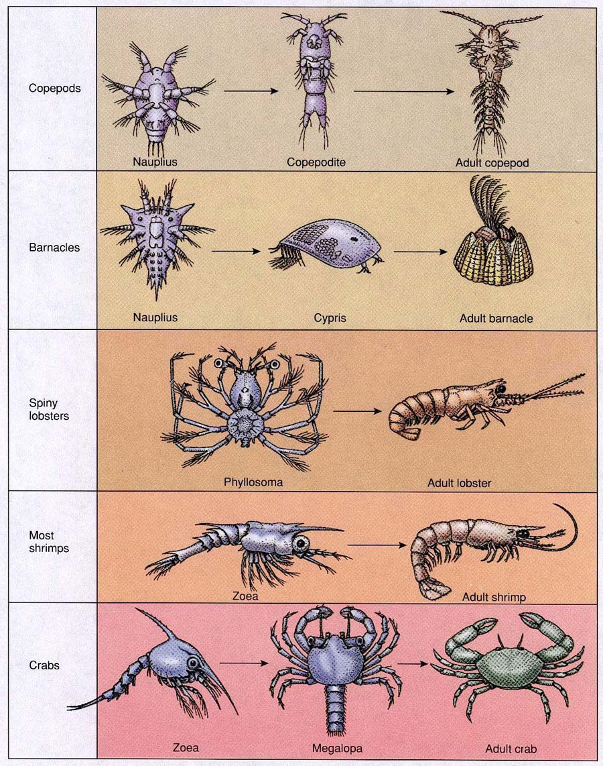
Life Cycle of Decapods
Most decapods pass through a number of intermediate stages between the egg and adult
  In between each stage, they shed their exoskeleton in a molt
  For decapods that live on land, the need to mold limits their maximum potential size
  Decapods in Bermuda are generally 2-20cm
Young are usually planktonic

Slide 4
Decapods of Bermuda
Marine
Terrestrial
Shrimp + Snapping Shrimp
Krill
Lobster
Crabs
Hermit Crabs (Paguroidea)
Giant land crabs
Hermit crabs (Coenobita)

Slide 5
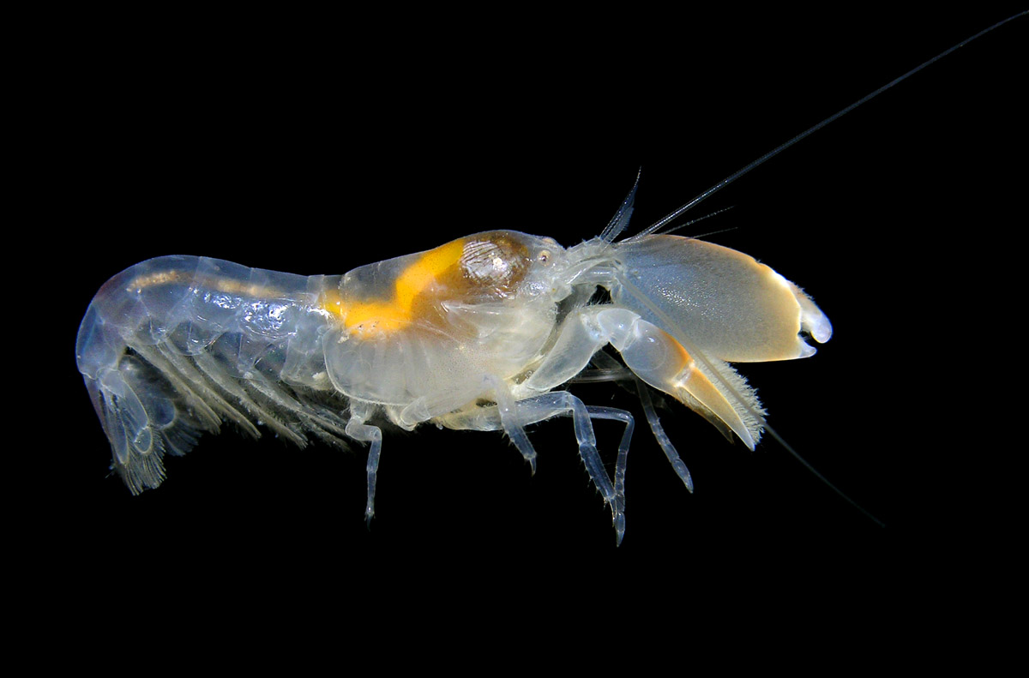
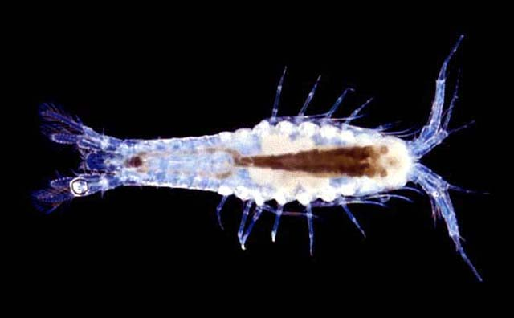
Shrimp
Snapping shrimp (Alpheus heterochaelis)
  Found in shallow waters
  Snapping large claw shut produces loud popping noise that deters predators and stuns prey
Bermuda cave shrimp (Mitocaris halope)
  Only lives in caves in Bermuda
    Crystal
    Green Bay
    Roadside
    Tucker’s town
  Feeding habits unknown

Slide 6
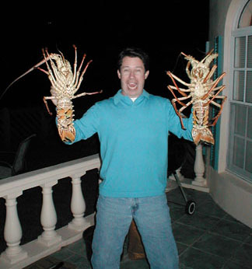
Lobster
  Carribean spiny lobster (Panilirus argus)
  Found in shallow waters ranging from low tide to 90m
  Many spines cover its body
  Chemoreceptive setae and complex nervous system are used to scavenge food
  Popular as seafood, but overfishing has greatly reduced the population

Slide 7
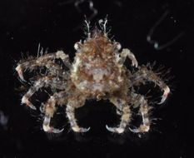
Marine Crabs
Decorator Crab (Macrocoeloma tripsinosum nodipes)
  Found in shallow water areas
  Uses pieces of its environment such as algae, coral, bryozoans, sea squirts, and sponges for camouflage

Slide 8
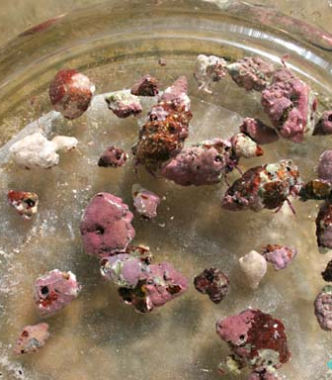
Marine Hermit Crabs
Verrilli’s Hermi Crab (Calcinus verrilli)
  Found in intertidal areas
  Protect soft abdomen inside gastropod shells, corals, etc.
  There are no laws governing C. verilli because they are of no commercial importance

Slide 9
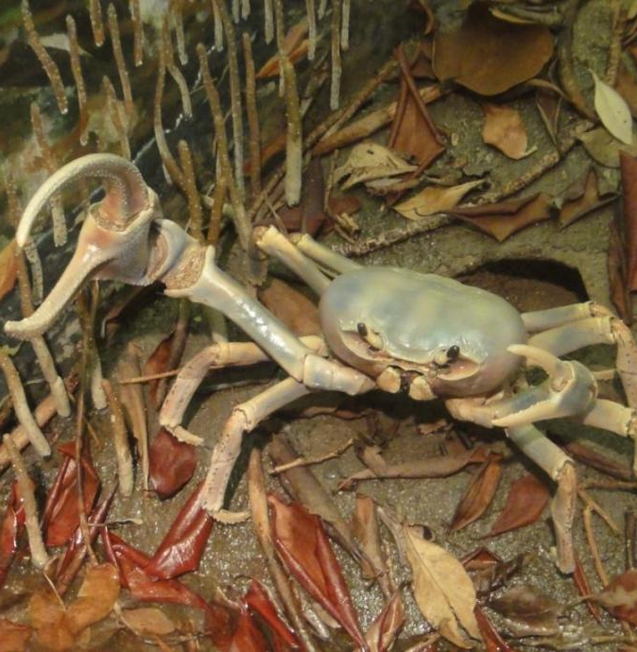
Terrestrial Crabs
Giant land crab (Cardisoma guanhumi)
  Travel far inland, but return to sea to deposit eggs
  Large claw can reach 15cm (5.9in) in male crabs
  Can weigh over 500g (18oz)
  Prefer to feed at night, and are occasionally cannibalistic

Slide 10
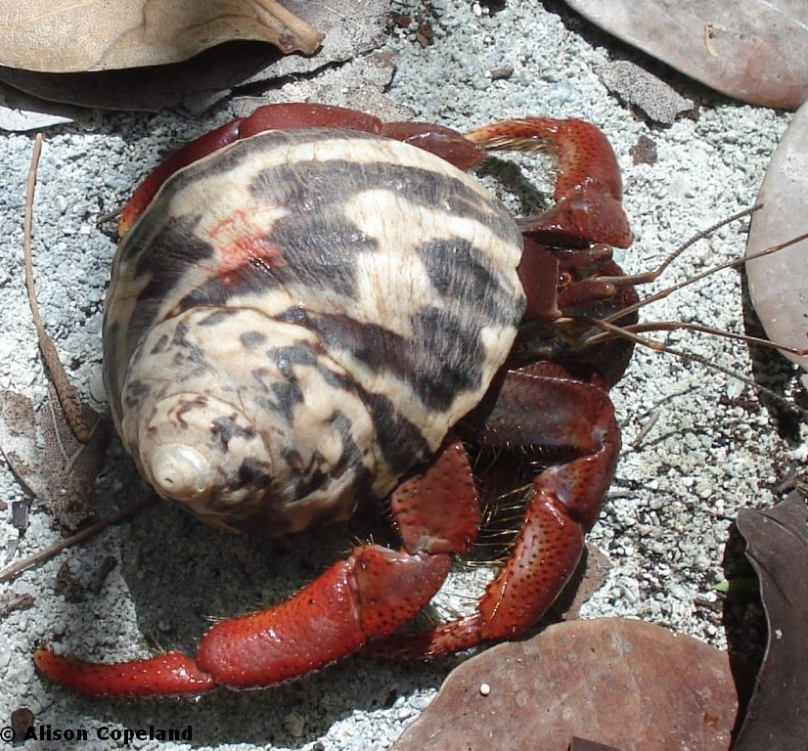
Terrestrial Hermit Crabs
Land hermit crab (Coenobita clypeatus)
  Travel far inland but are mostly found near Hungry Bay
  Now rare in Bermuda due to a lack of suitable shells
    Often resort to using fossil West Indian Topshell (Cittarium pica)
  Can grow up to the size of a softball

Slide 11
