Slide 1
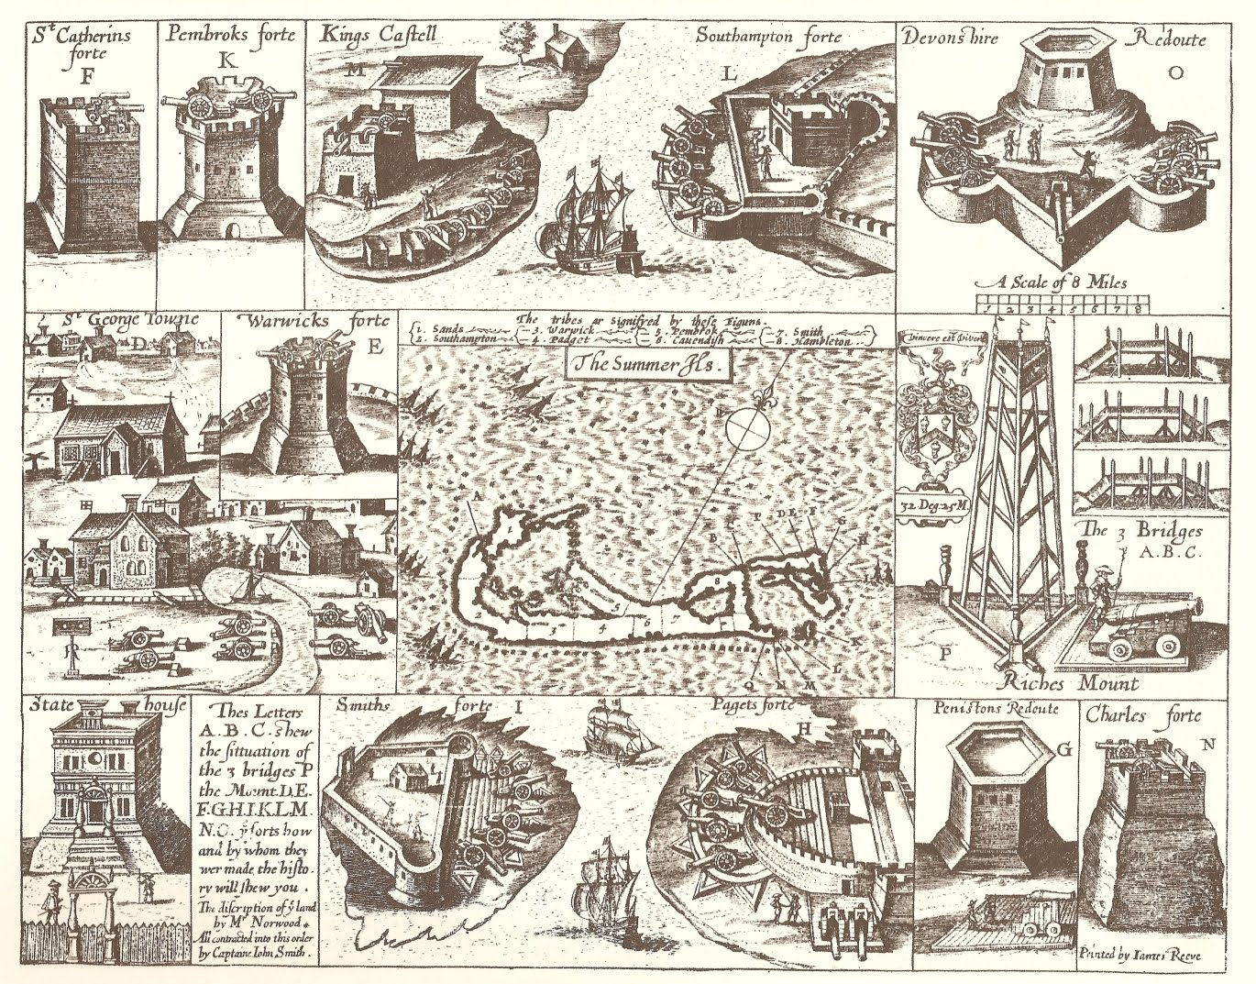
A Bit of Bermuda’s Maritime History
Ariana Boyd
GE297A, Rueger
http://1.bp.blogspot.com/_heIr8hFFuYg/S_GhCkX7mWI/AAAAAAAAADg/NMV8xslhcIk/s1600/John_Smith_1624_Bermuda_map_with_Forts.jpg

Slide 2
First Mentions
Juan de Bermudez: 1505, landed on Bermuda
  Spanish navigator
Chronicled in Legatio Babylonica as “La Bermuda”
Only known for being shipwreck-prone

Slide 3
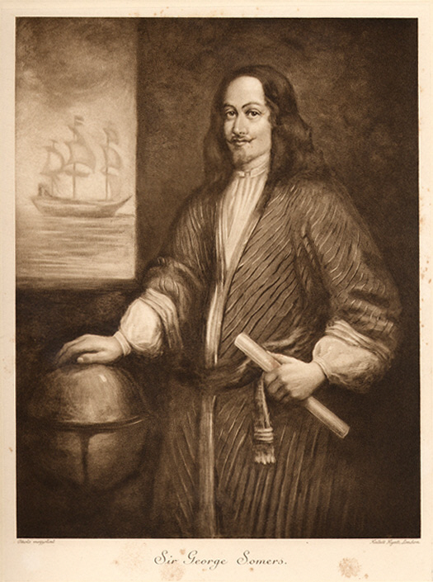
1609, a dark and stormy night
Sea Venture, with Captain Christopher Newport and Admiral Sir George Somers, docked at Bermuda
Remained on Bermuda for 10 months, mapped island, categorized flora and fauna
(Fun fact: Admiral Sir George Somers died of excess of pork)
http://freepages.genealogy.rootsweb.ancestry.com/~mainegenie/SirGeorgeSomers.jpg
Notes:
Shipwreck in 1609: Sea Venture and the initial settling.
Terrible storm, and Sea Venture was on verge of sinking. Crew broke into liquor to get hammered before they died.
Captain Christopher Newport and Admiral Sir George Somers saw strip of land on horizon, recognized it as Bermuda! Docked on some rocks, no losses of life… end location was Jamestown, Virginia.s
Began remaking Bermuda by christening landfall St. George’s Island in honor of England’s patron saint…
Mapped all 20 miles and categorized all natural resources
Ex: fish, lobsters, turtles, mangroves, palms, cedar trees, hogs (from an earlier shipwreck), and cahow birds (ones that made all the noise, one reason ppl called it “Isle of Devils”)
Jamestown settlers: dying, at war with Powhatan Indians, etc.
Jamestown saved by Fourth Supply Fleet!

Slide 4
Continued colonization
Began with overpopulation dilemma
Early conservation laws- two acts, 1616 and 1620
Trouble with maritime trades vs. agricultural trades
  Somers Isles Company vs. colonists; eventually led to disintegration of Somers Isle Co.
Notes:
Overpopulation: relied on emigration to manage population
Maybe earliest conservation laws ever
Beheading of king Charles I (1649) → civil war in Bermuda, ended by military
Forced allegiance to crown

Slide 5
Looking to the sea
After breakup of Somers Isle Co. (1684), Bermuda turned to the sea
Began increasing fleet size
With company out of the way, Bermudians could embrace trading opportunities that had been forbidden under the company
Notes:
AFTER 1684:
Before: exported close to half million lbs tobacco but possessed only 14vessels, relied heavily on outside shipping
After: fleet tripled (42 vessels by 1687), launched nine sloops in that year
Good time for privateering: Spain, France, etc. – series of wars. Left Bermuda w/ large crews, seized other vessels.
American War of Independence: Bermuda turned on Americans.. Required part of all crews to be black slaves.. One ship captured, all 70 crewmembers were black; all offered freedom but requested POW status

Slide 6
Vying for maritime power
After 1684, Bermuda rose in maritime ranks
  Massachusetts broken up; Bermuda expanded trading
Crown had wanted power over Somers Island Co.; upon its dissolution, found themselves in power
History continues through War of 1812…
Notes:
Post 1684:
The Crown stripped Massachusetts and sister colonies of colonial charters.

Slide 7
References
Jarvis, Michael, in The Eye of All Trade
http://en.wikipedia.org/wiki/History_of_Bermuda

