Slide 1
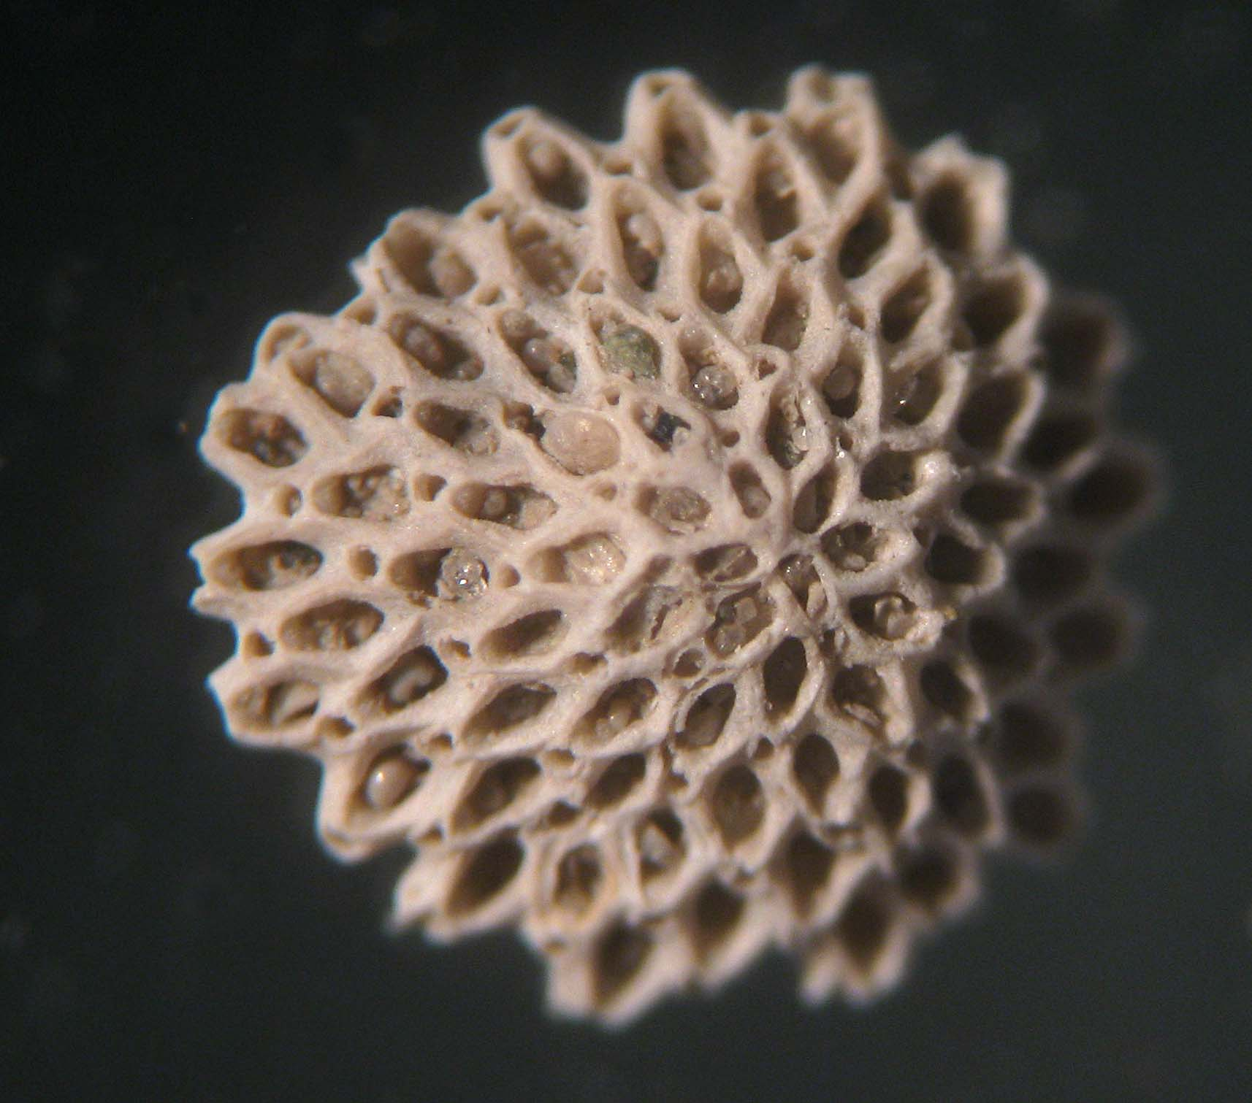
Foraminifera
Ariana Boyd
GE297 A, Rueger
http://www.flickr.com/photos/14833125@N02/6687576483/in/pool-596088@N24

Slide 2
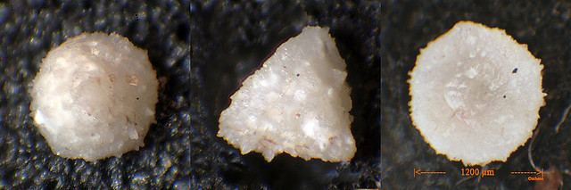
Forams: What are they?
Phylum/subphylum: Protista
Calcium carbonate shells/tests
Found oceanwide
  Planktonic vs. benthic
Marssonella oxycona
http://www.flickr.com/photos/jakmi/2178253380/sizes/z/in/pool-596088@N24/
Notes:
Marssonella: benthic

Slide 3
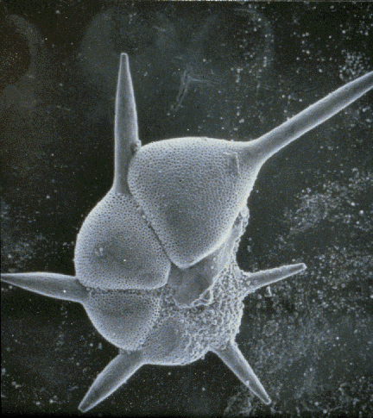
Foram basics
4000+ known species
Planktonic: reside in the water column
  ~40 species
Benthic: reside on the seafloor
  ~3960 species
Hantkenina alabamensis
http://ocean.fsu.edu/courses/sp04earthsys/AA/forams/Forams.html
Notes:
Hantkenina: planktonic

Slide 4
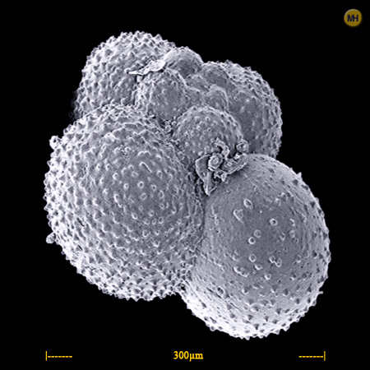
Planktonic forams
Forams that reside in the water column (from shallow to deep water)
Relative percentage of planktonic forams (vs. benthic forams) increases with water depth
Generally globular
Globigerina sp.
http://www.foraminifera.eu/singimg/globigerina-sp1-stirone.jpg

Slide 5
Benthic forams
Shells are either agglutinated or calcareous
Agglutinated: particles cemented together
Calcareous shells:
  Hyaline: translucent
  with small perforations
  Porcelaneous: white,
  opaque, no perforations
Notes:
Benthic forams:
Agglutinated
Calcareous
Hyaline: clear or translucent appearance with little perforations
Porcelaneous: white, opaque, no perforations
Proportions of three types of walls (agglutinated vs hyaline vs porcelaneous):
Lots of agglutinated taxa = intertidal marshes
Lots of porcelaneous species: shallow tropical environments
err

Slide 6
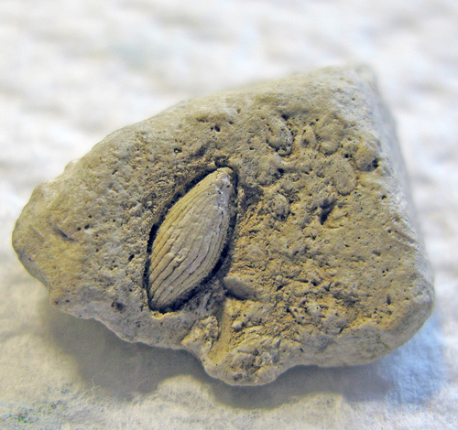
What are forams useful for?
Biostratigraphy
Paleoclimatology
Paleooceanography
Fusilinid foraminifera
http://farm3.static.flickr.com/2169/2318097733_43514ee9f8.jpg
Notes:
Biostratigraphy: the branch of stratigraphy concerned with fossils and their use in dating rock formations.
Paleoclimatology: a climate prevalent at a particular time in the geological past.
Paleooceanography: the branch of science that deals with the physical and biological properties of oceans in the past.

Slide 7
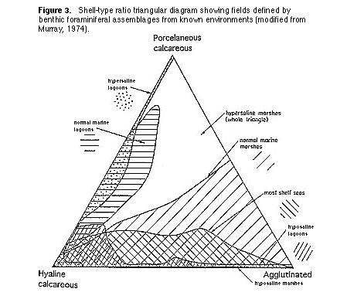
Biostratigraphy/Paleooceanography
Complex morphologies + abundance + diversity = easy to determine environment!
Example:
benthic shell types →
High proportion of
planktonic = deep
water
http://www.ucmp.berkeley.edu/fosrec/Culver.html
Notes:
Biostratigraphy: the branch of stratigraphy concerned with fossils and their use in dating rock formations.
Paleooceanography: the branch of science that deals with the physical and biological properties of oceans in the past.

Slide 8
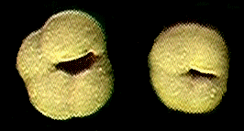
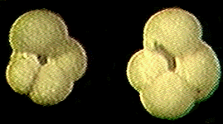
Paleoclimatology
Common stable oxygen isotope ratios:
¹⁶O and ¹⁸O
¹⁸O preferred isotope in cold conditions; ¹⁶O preferred in warm conditions
Neogloboquadrina pachyderma: changes coiling direction at 8°C
Left coiling
Right coiling
http://www.ldeo.columbia.edu/res/fac/CORE_REPOSITORY/RHP4fossils.html
Notes:
Paleoclimatology: a climate prevalent at a particular time in the geological past.

Slide 9
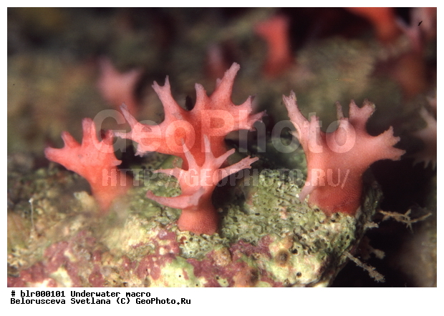
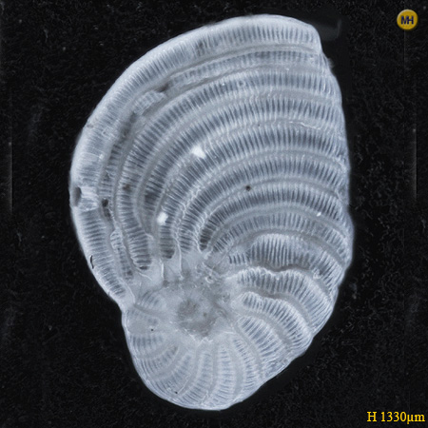
Common in Bermuda…
Shallow water/intertidal forams
Known for Homotrema rubrum → pink sand
Homotrema rubrum
Peneroplis planetus
http://geophoto.ru/large/blr000101l.jpg
http://foraminifera.eu/singimg/peneroplis-planatus1-socotra.jpg

Slide 10
References
http://ocean.fsu.edu/courses/sp04earthsys/AA/forams/Forams.html
http://www.ucmp.berkeley.edu/fosrec/Culver.html
http://ethomas.web.wesleyan.edu/ees123/forams.htm
http://bprc.osu.edu/geo/projects/foram/whatarefor.htm
Notes:
Paleooceanography: the branch of science that deals with the physical and biological properties of oceans in the past.

