Slide 1
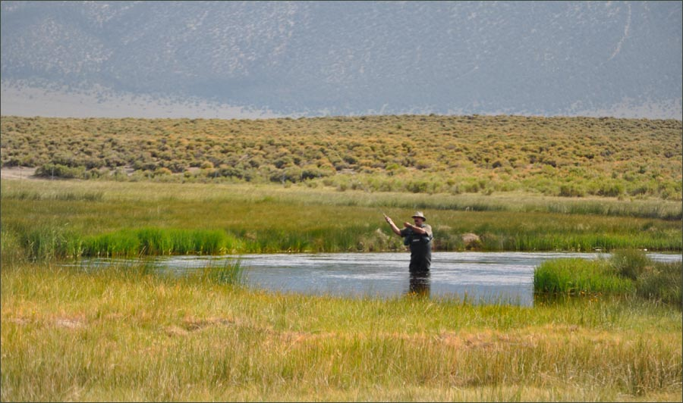
The Art of Fly Fishing
English 238JA
Professor David Suchoff

Slide 2
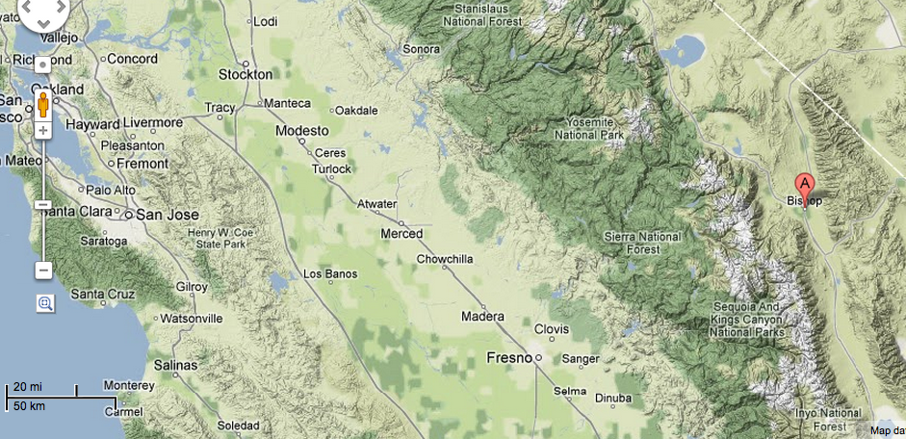

Slide 3
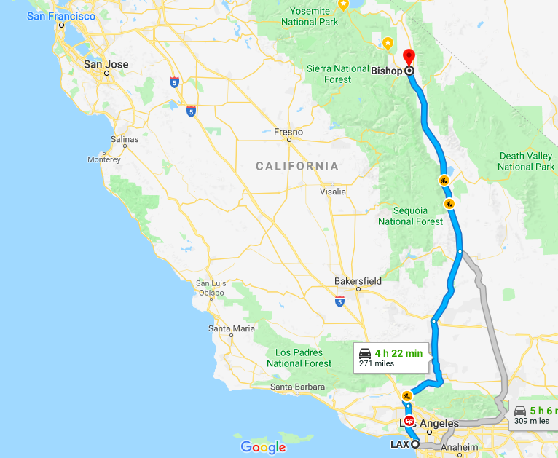

Slide 4
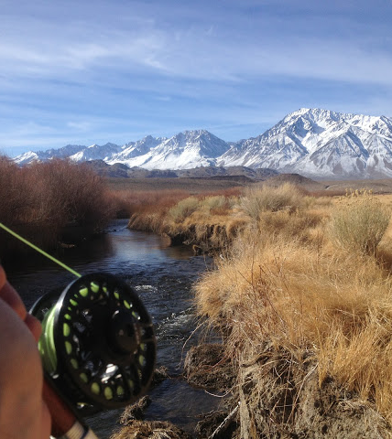
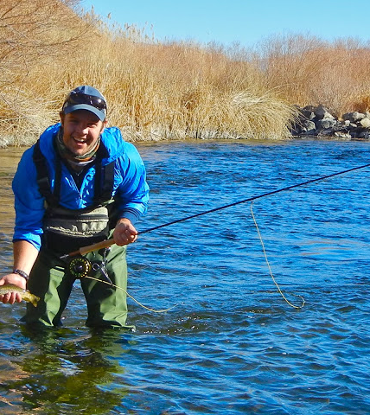
Lower Owens River Bishop CA

Slide 5
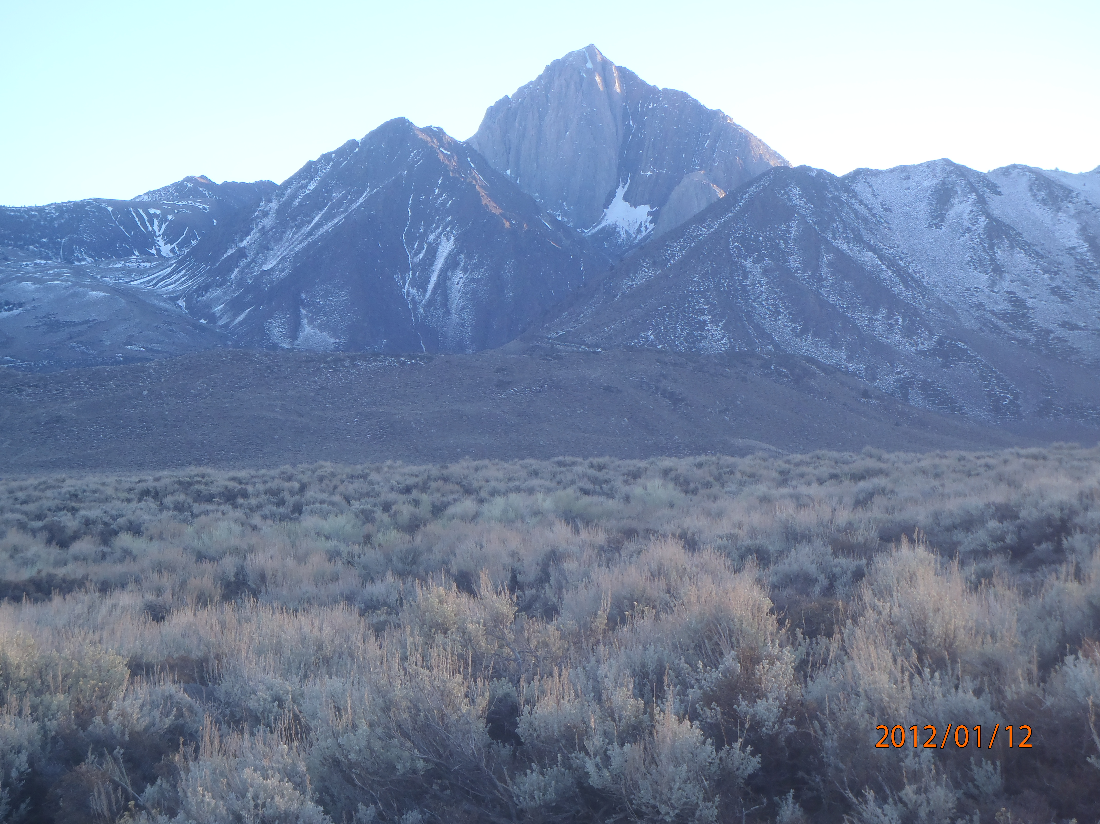
Requirements for Course
1.Interest in fly fishing
2. Winter Outdoor experience (week 3)
3. Reading fishing literature.
4. Writing about Literature and Blogging.
5. $2050 Basic Cost, $2,500 Maximum (gear depending).

Slide 6
Week One—Getting Ready
Thinking Like a Fish:
“How Trout Feed,” “Reading the Water,” Nymphs,” “Streamers” and “Dry Flies,” from The Orvis Guide to Prospecting for Trout: How to Catch Fish When There’s No Hatch to Match.
Literature—Hemingway, “Big Two Hearted River, Thoreau, Walden (“Brute Neighbors and “The Ponds” and The Maine Woods , A.P Luce Fishing and Thinking, Izzak Walton, The Compleat Angler, John Gierach, Trout Bum. Topics include catch and release, fly selection, and the ethos of fly fishing as art.

Slide 7
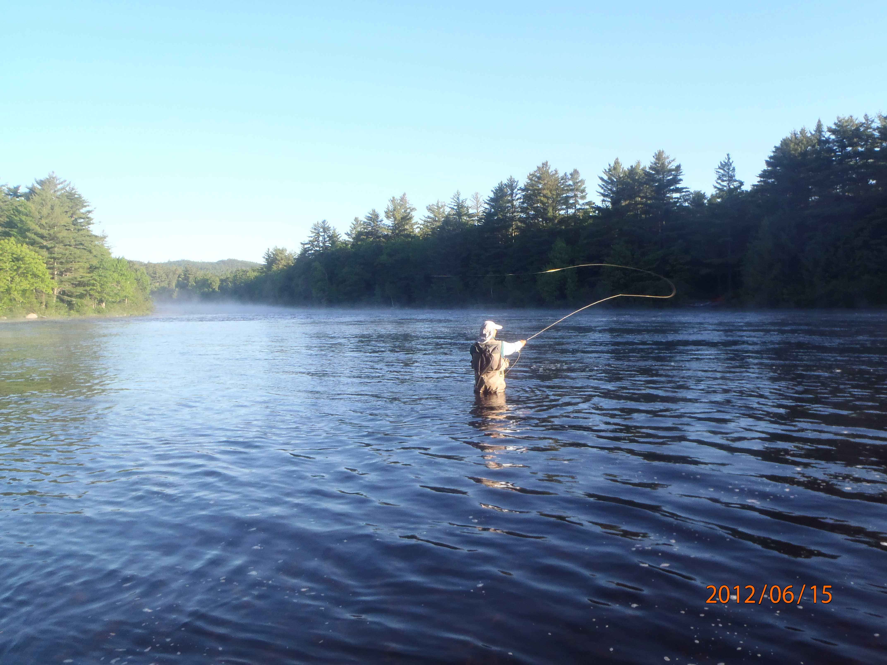
Week Two—Hands On
LL Bean Casting Instruction (Fieldhouse)
Learning to Tie Flies (equipment provided)
Setting Up Your Blog
Selecting Your Gear, Basic Nymphing, and Getting Ready for the Owens Valley in January—Gear Prep

Slide 8
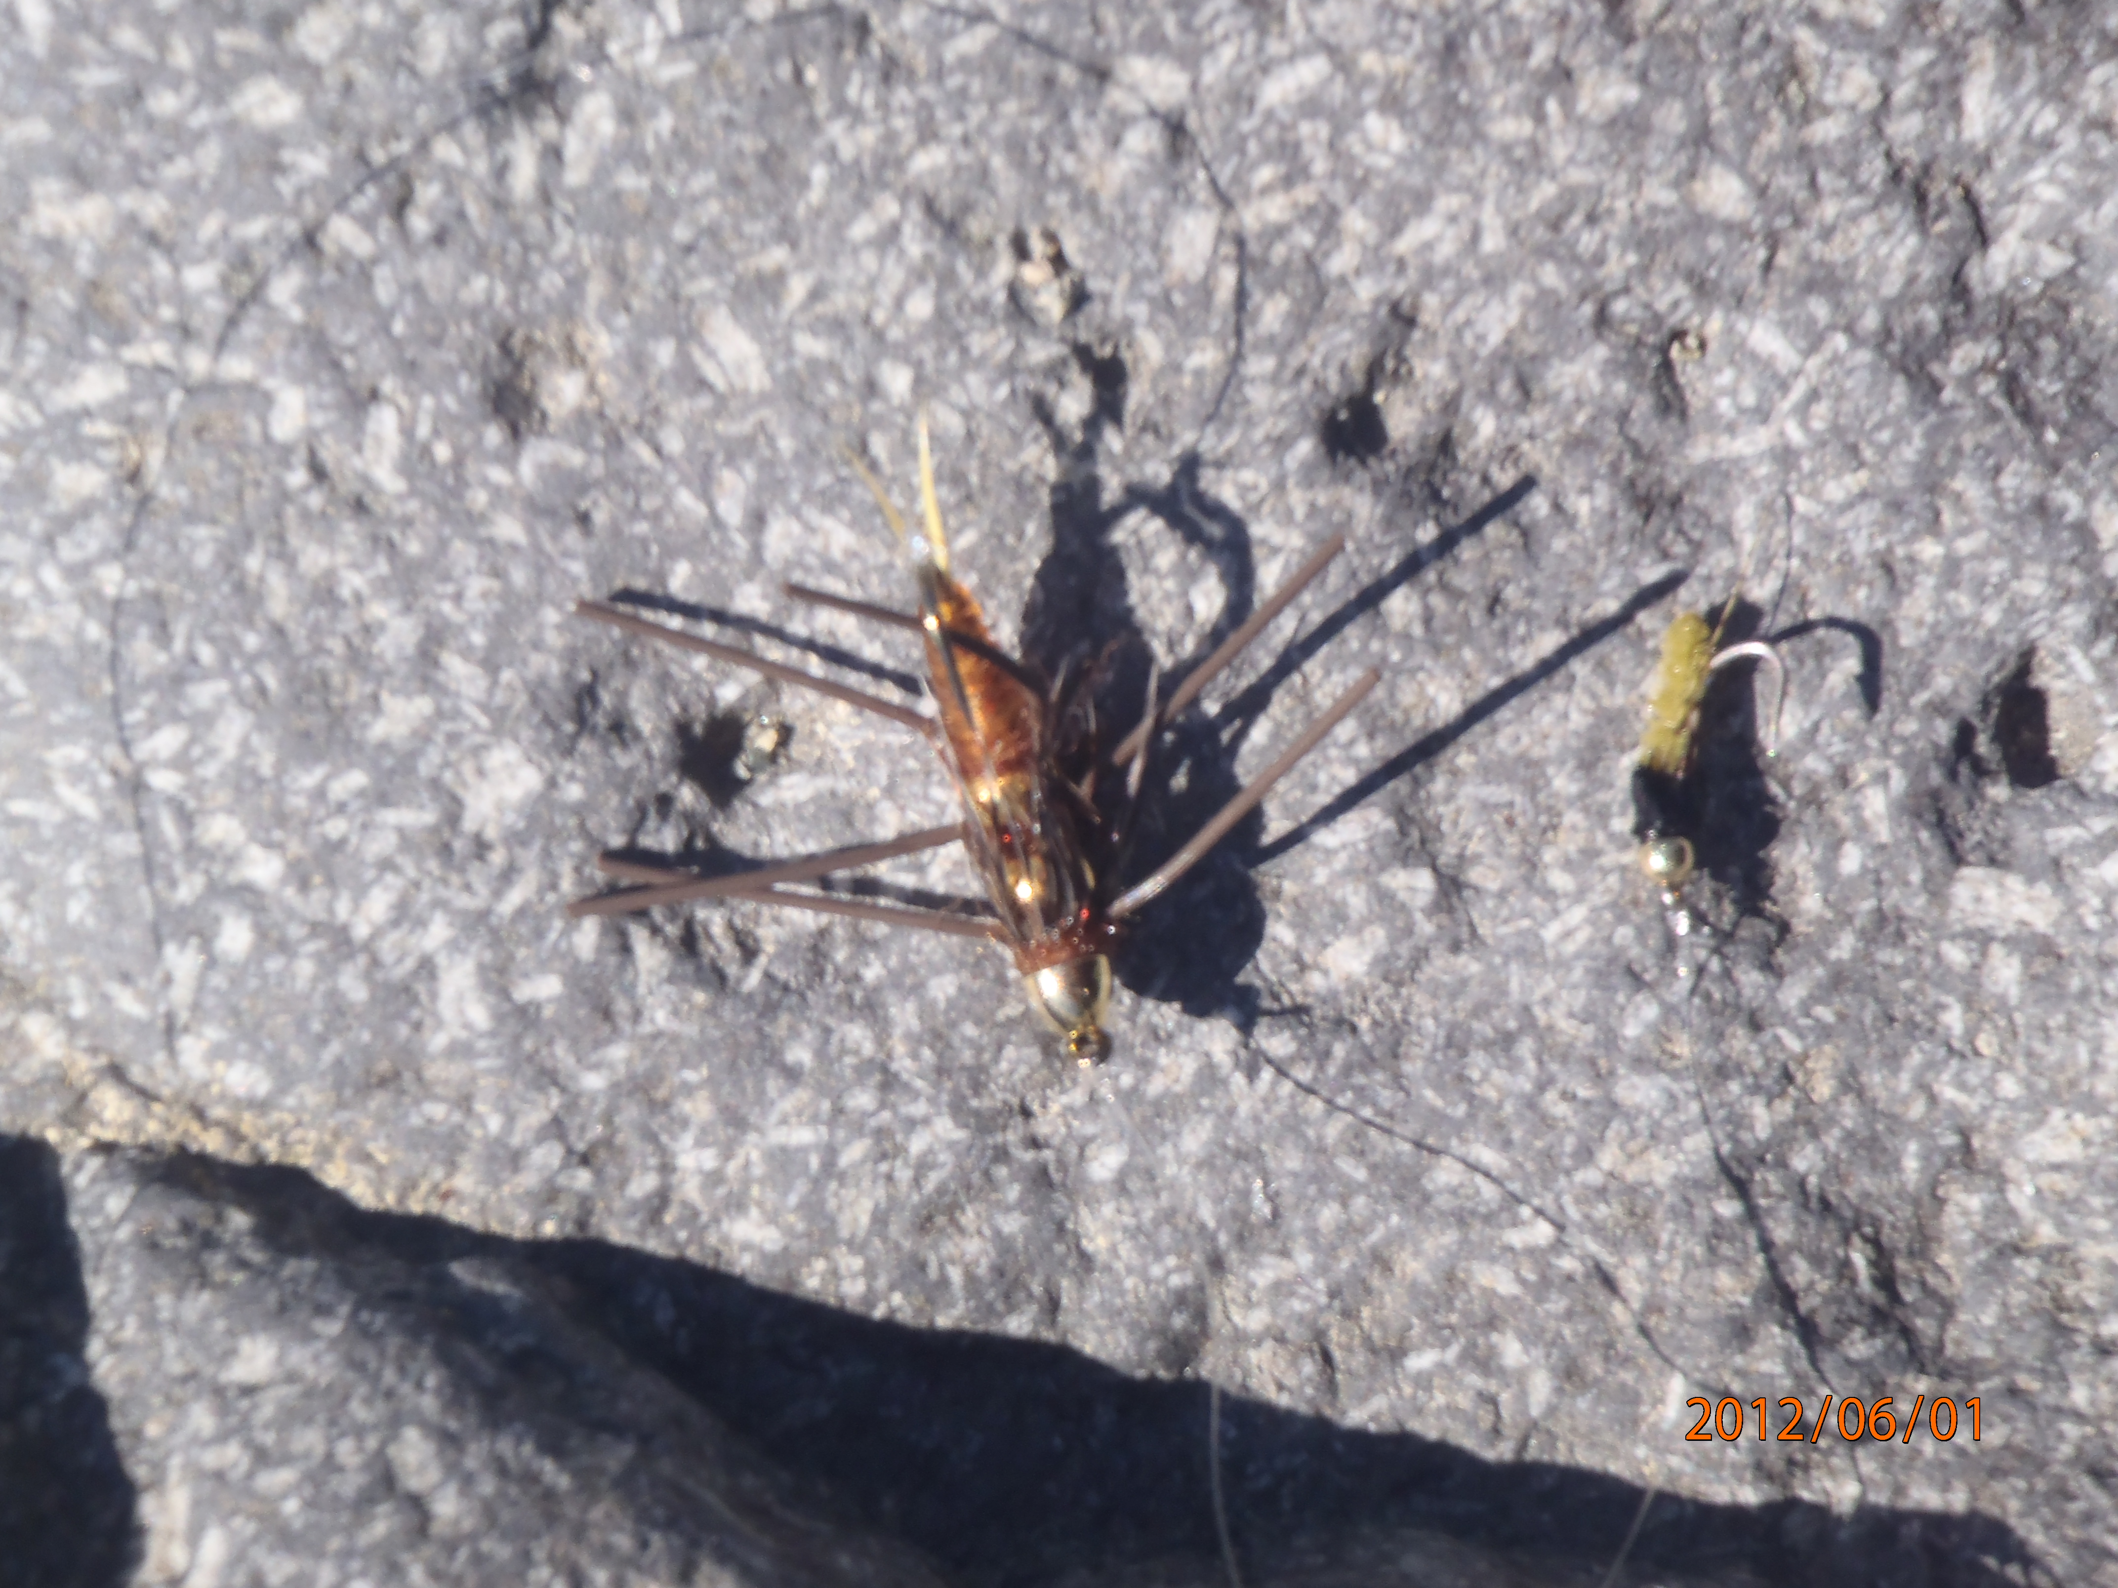
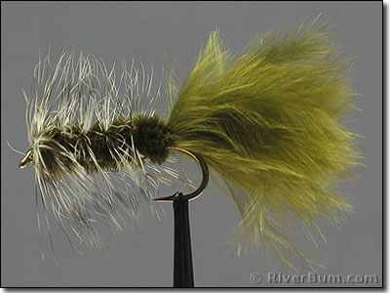
Types of Flies: Nymphs, Streamers

Slide 9
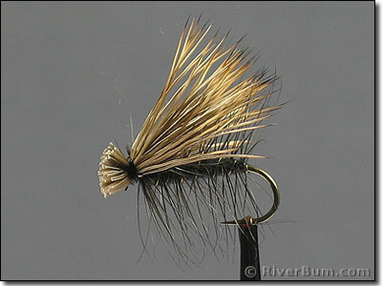
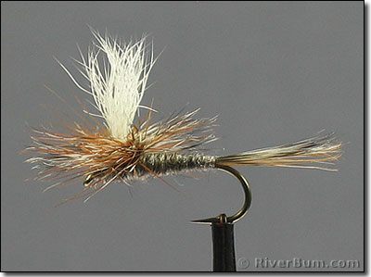
Dry Flies: Elk Hair Caddis and Parachute Adams

Slide 10
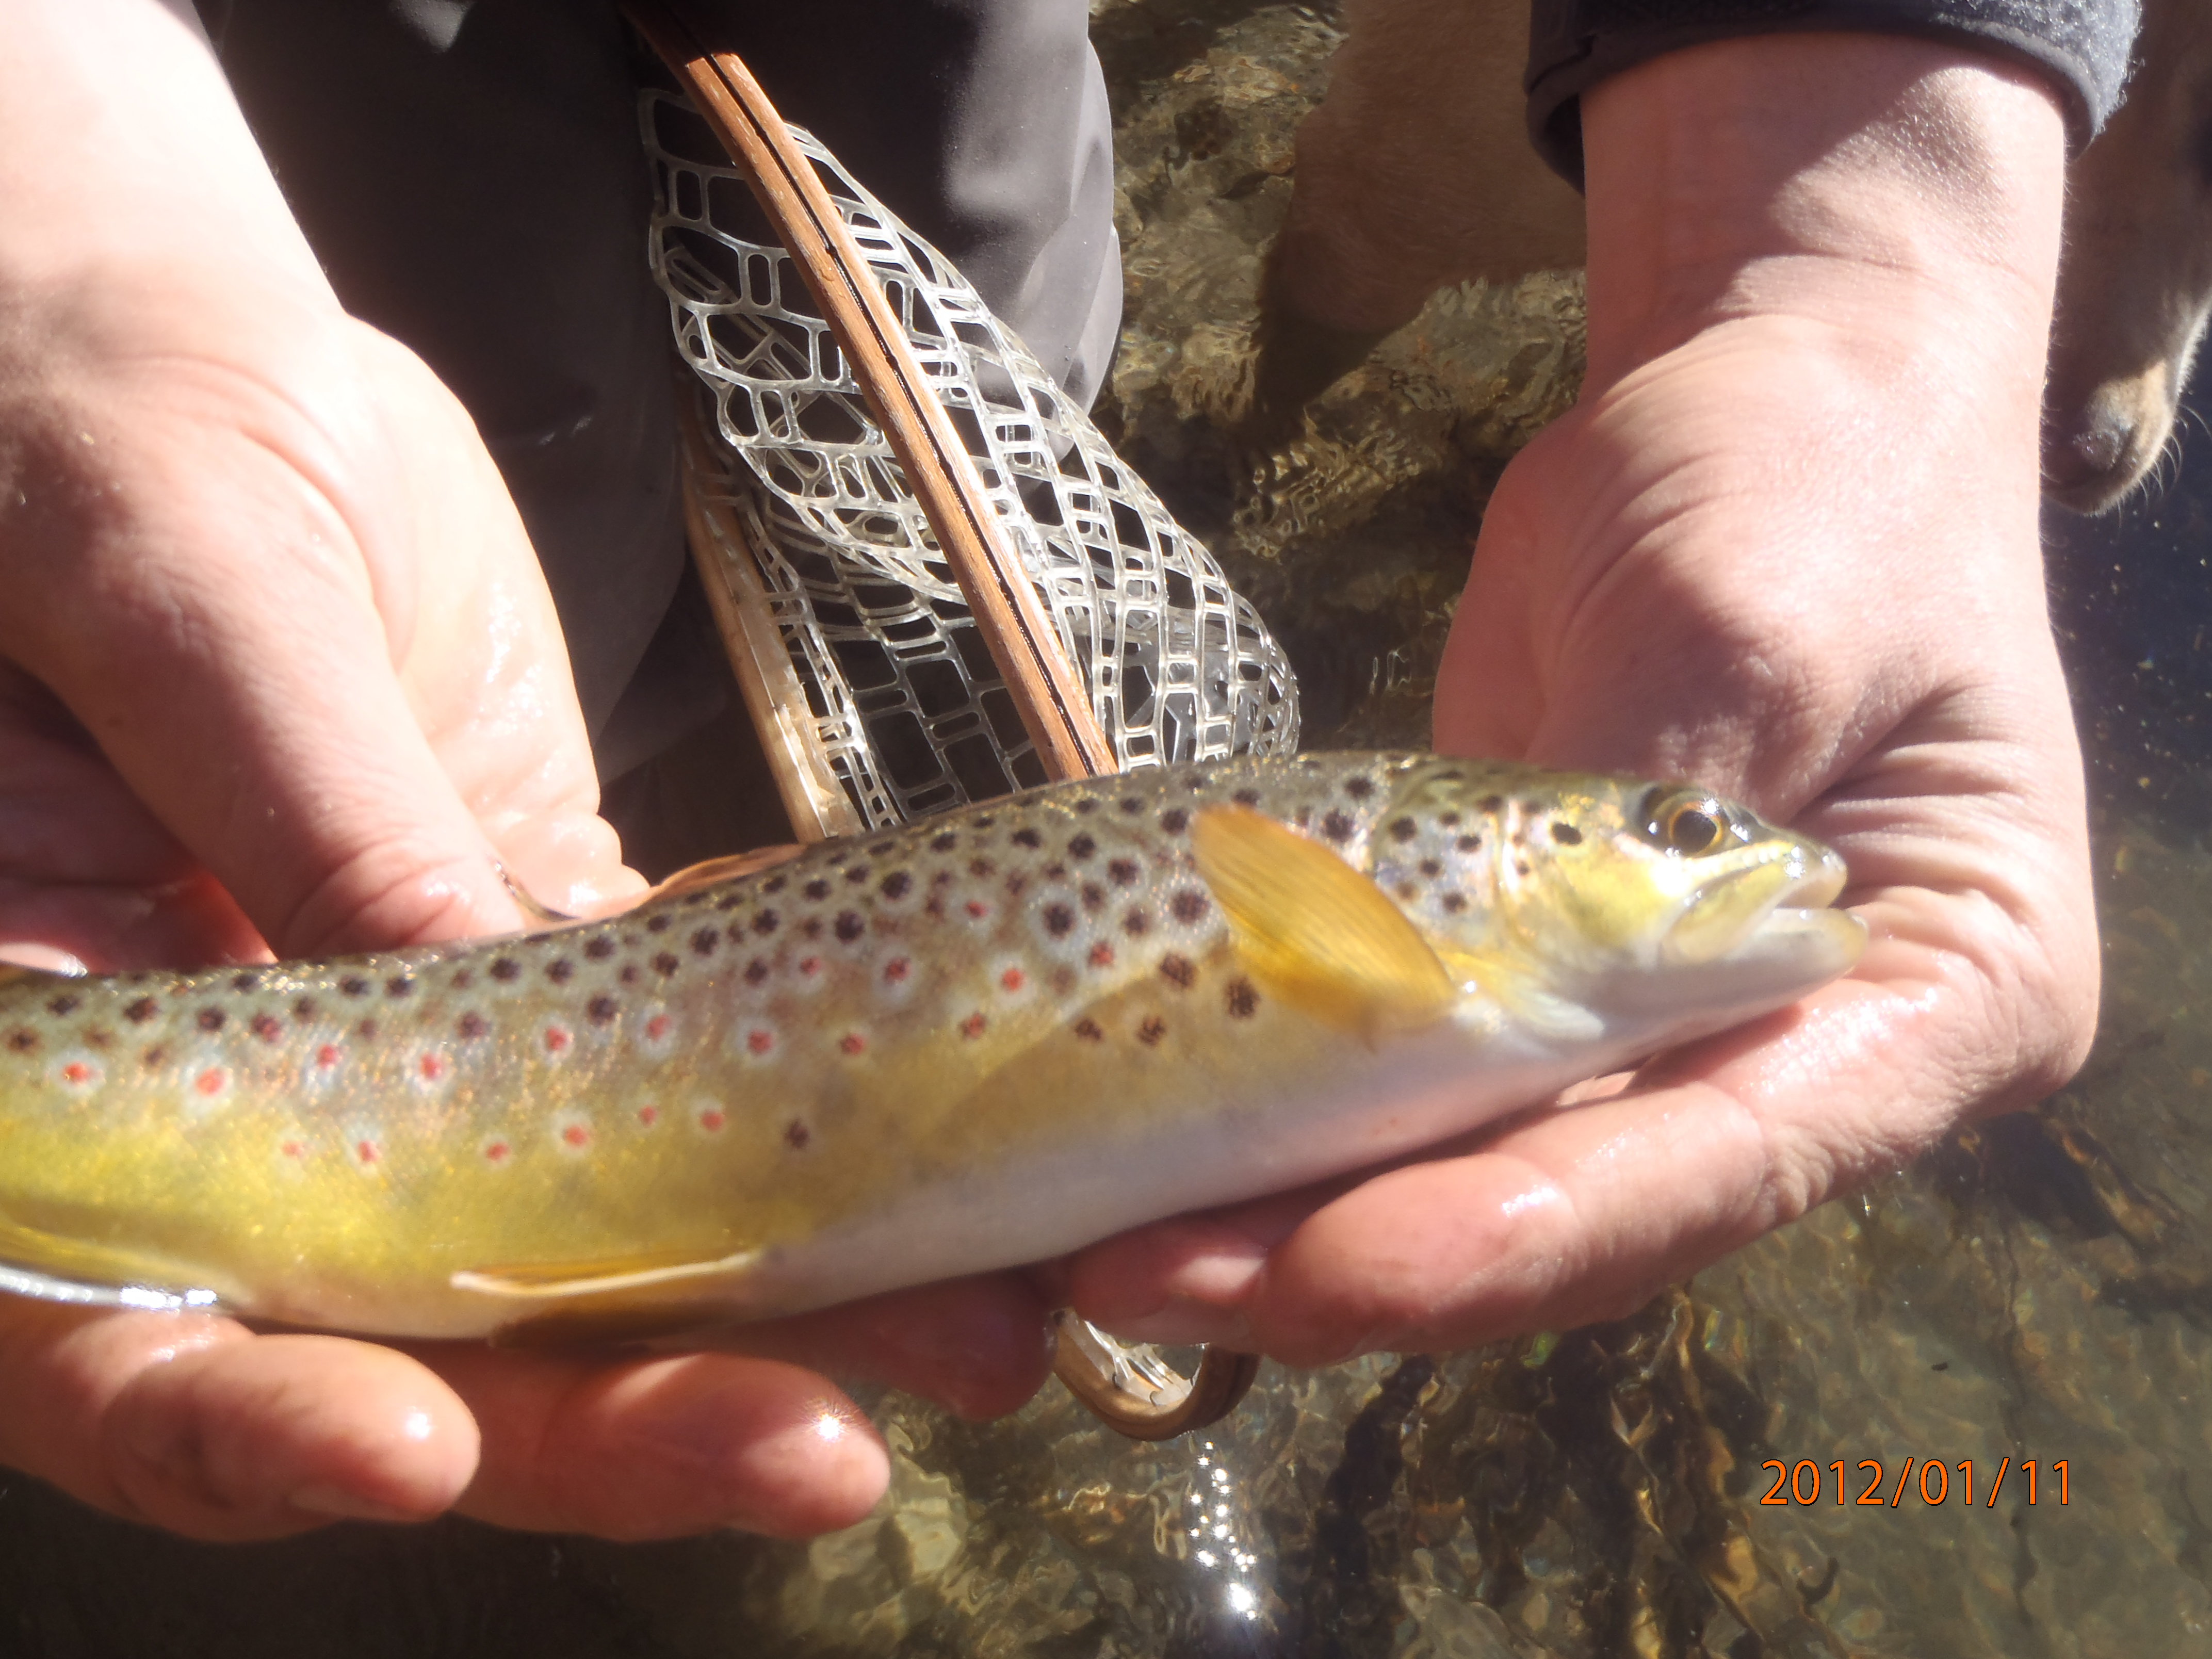
Week 3: Fishing in the Owens River, California
Some trout will be “Brown trout” largely caught by nymphing with your fly rod this time of year.

Slide 11
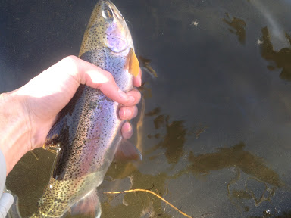
Week 3: Some Owens River fish will be native rainbow trout like this one.
This fish caught in January 2013 in the stretch of river we will be fishing by a student.

Slide 12
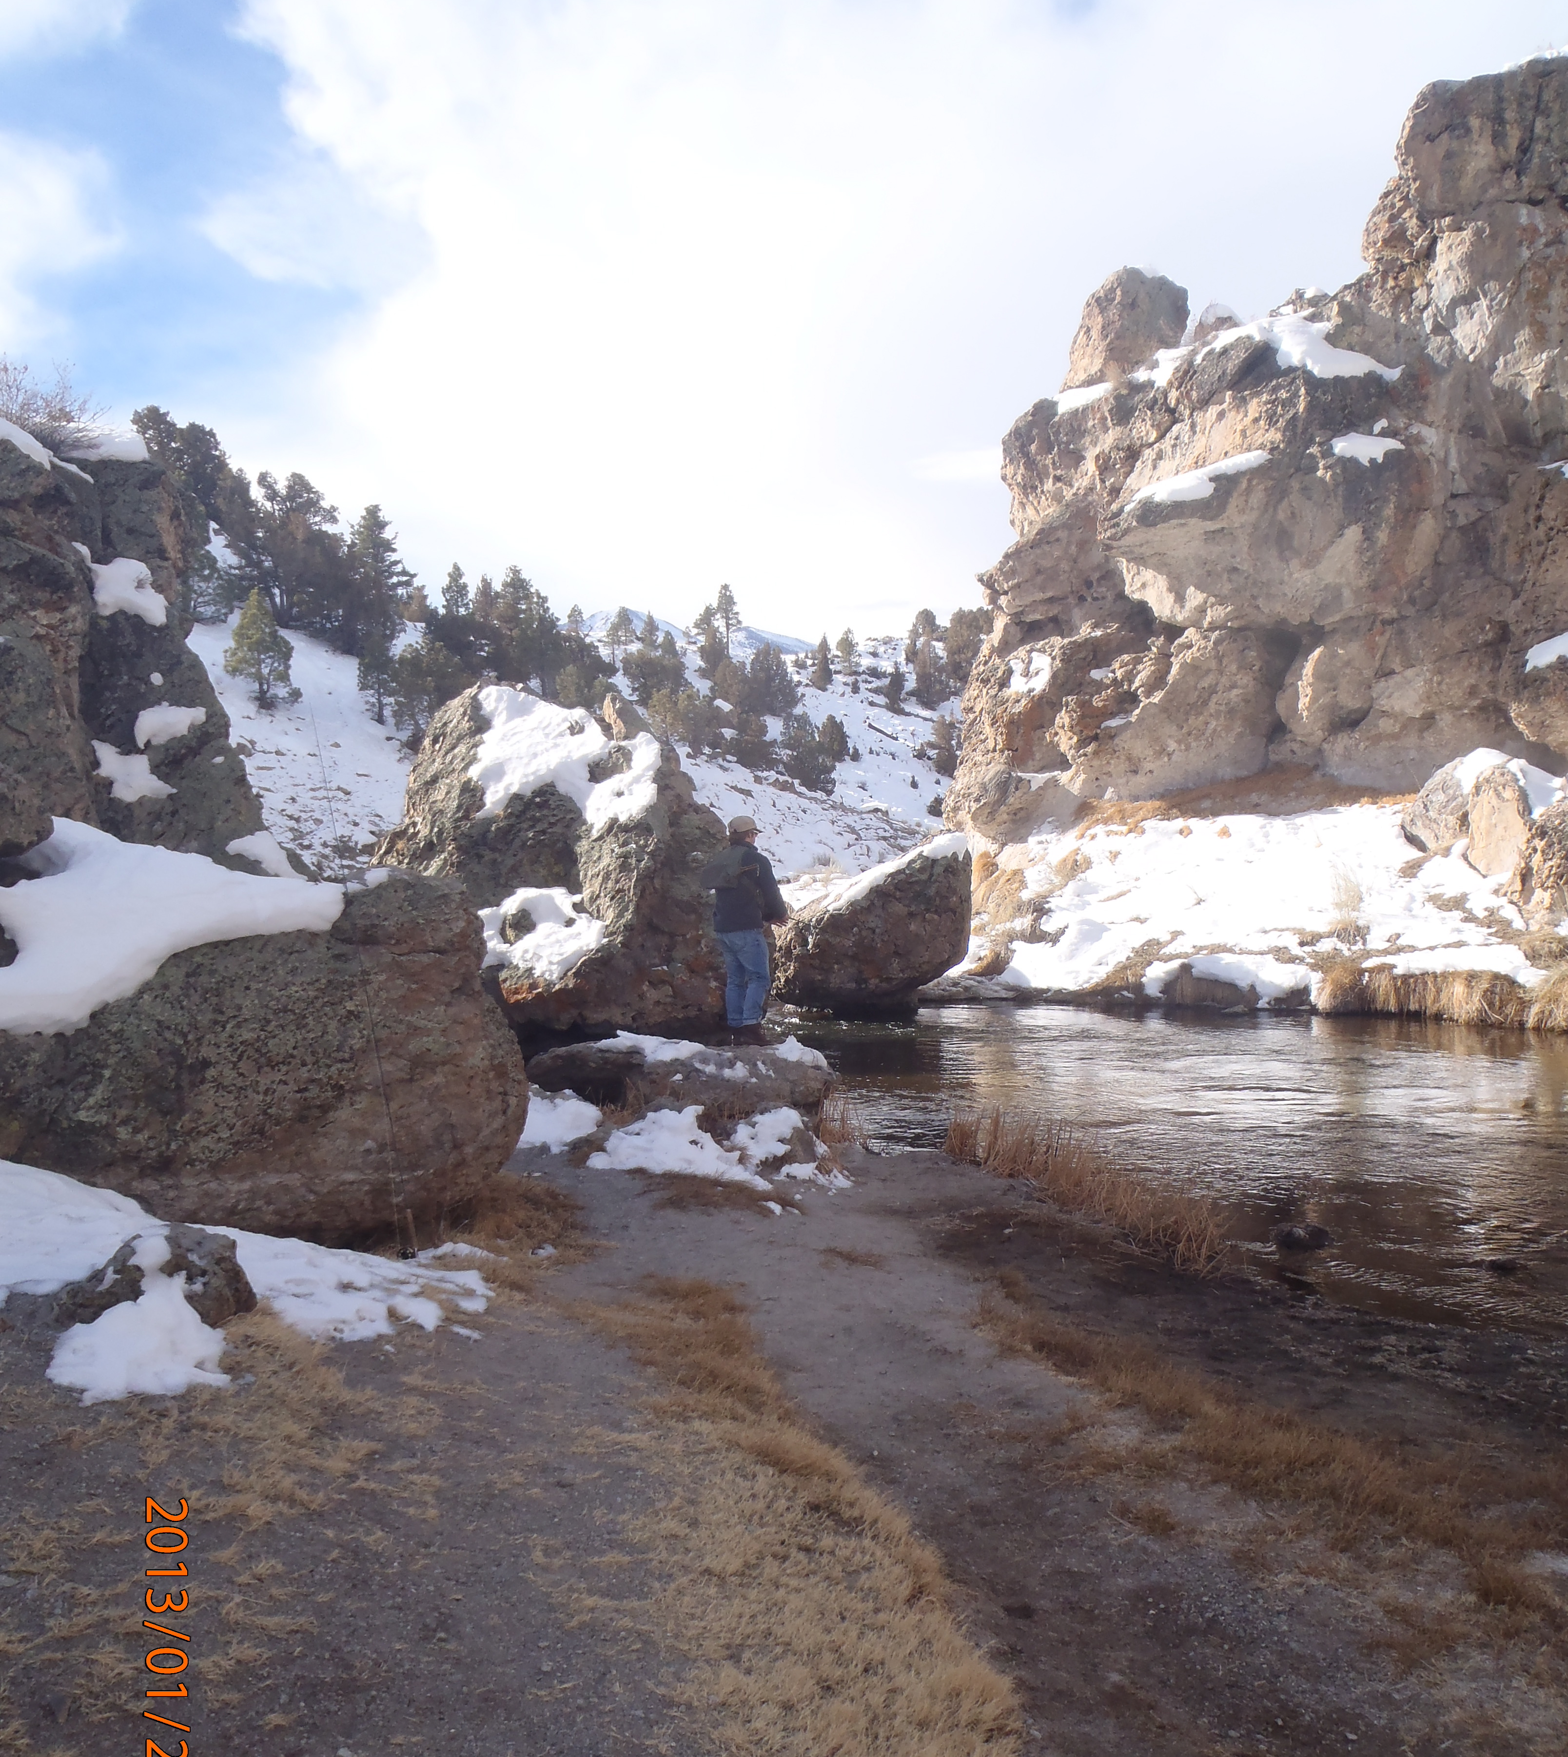
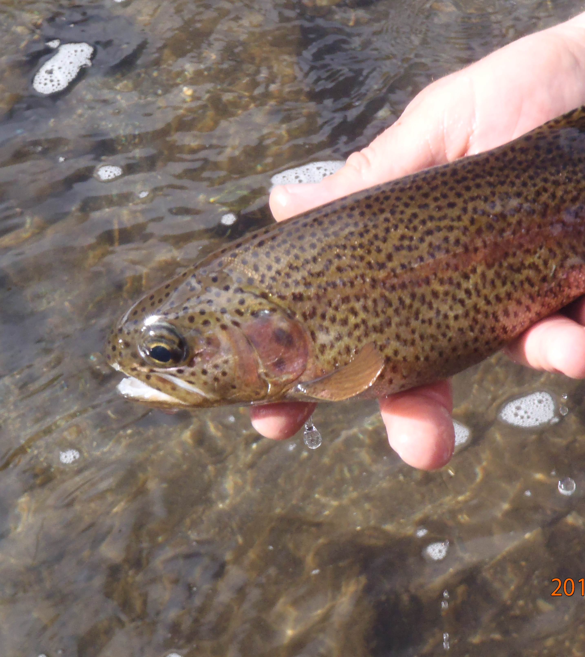
Week 3: Some Students Fished Hot Creek

Slide 13
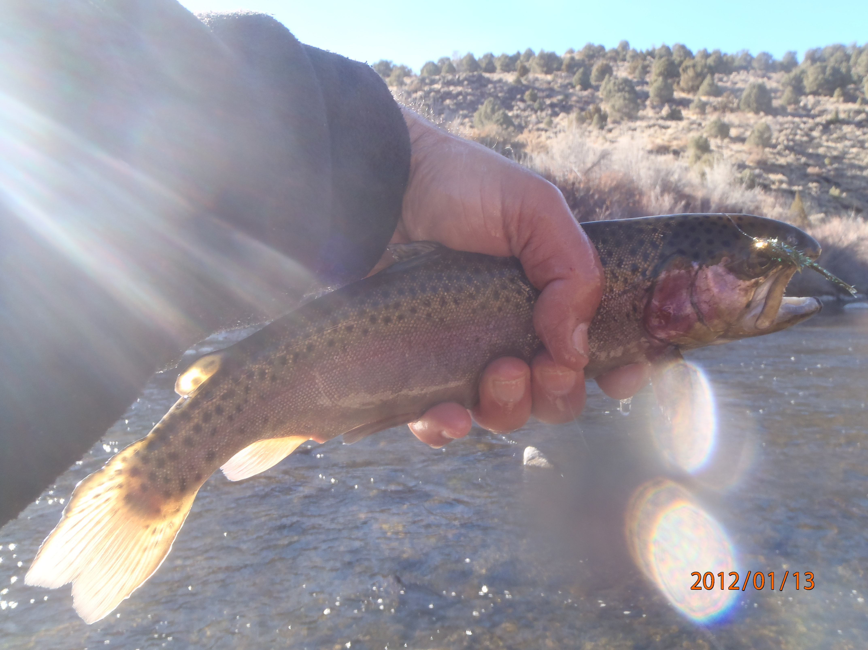
The East Walker River is also possible for the more advanced.
Caught by instructor in January 2012.

Slide 14
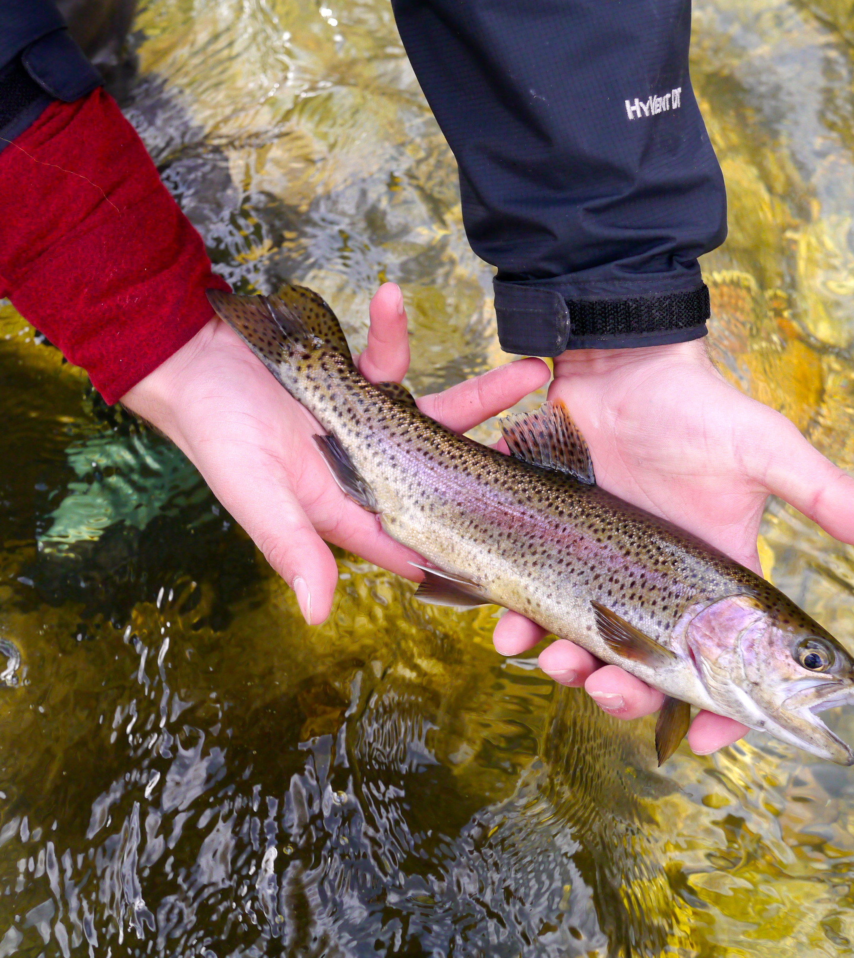
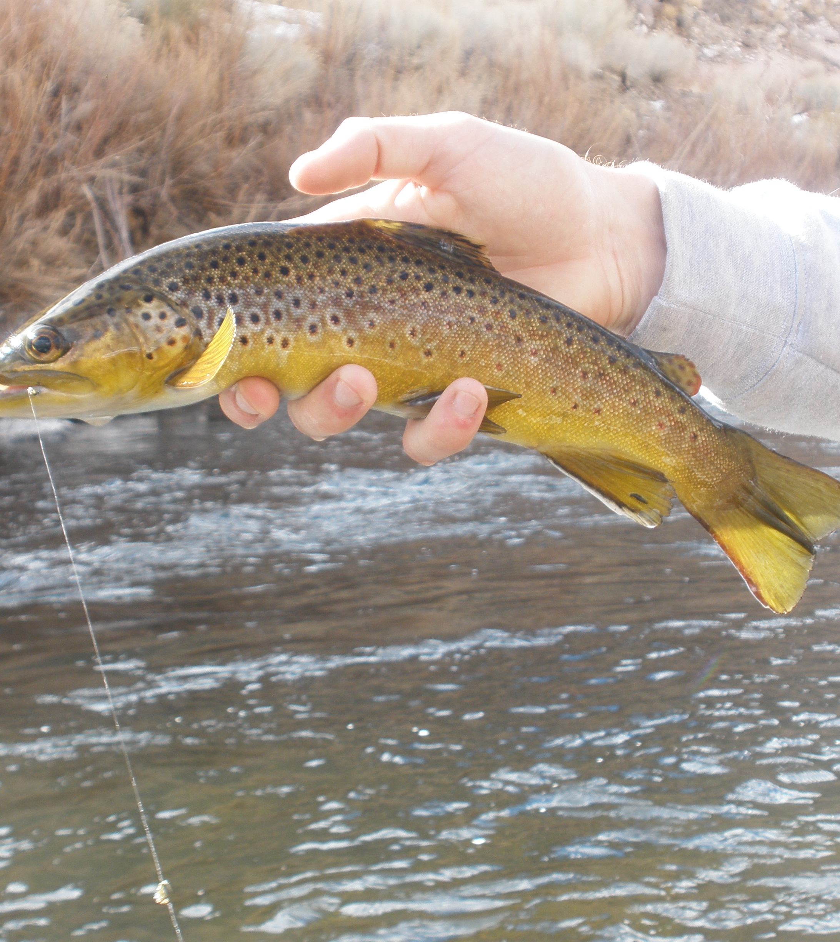
Rainbow and Brown Trout:
Caught Jan. 2013-5 by Students, Owens River

Slide 15
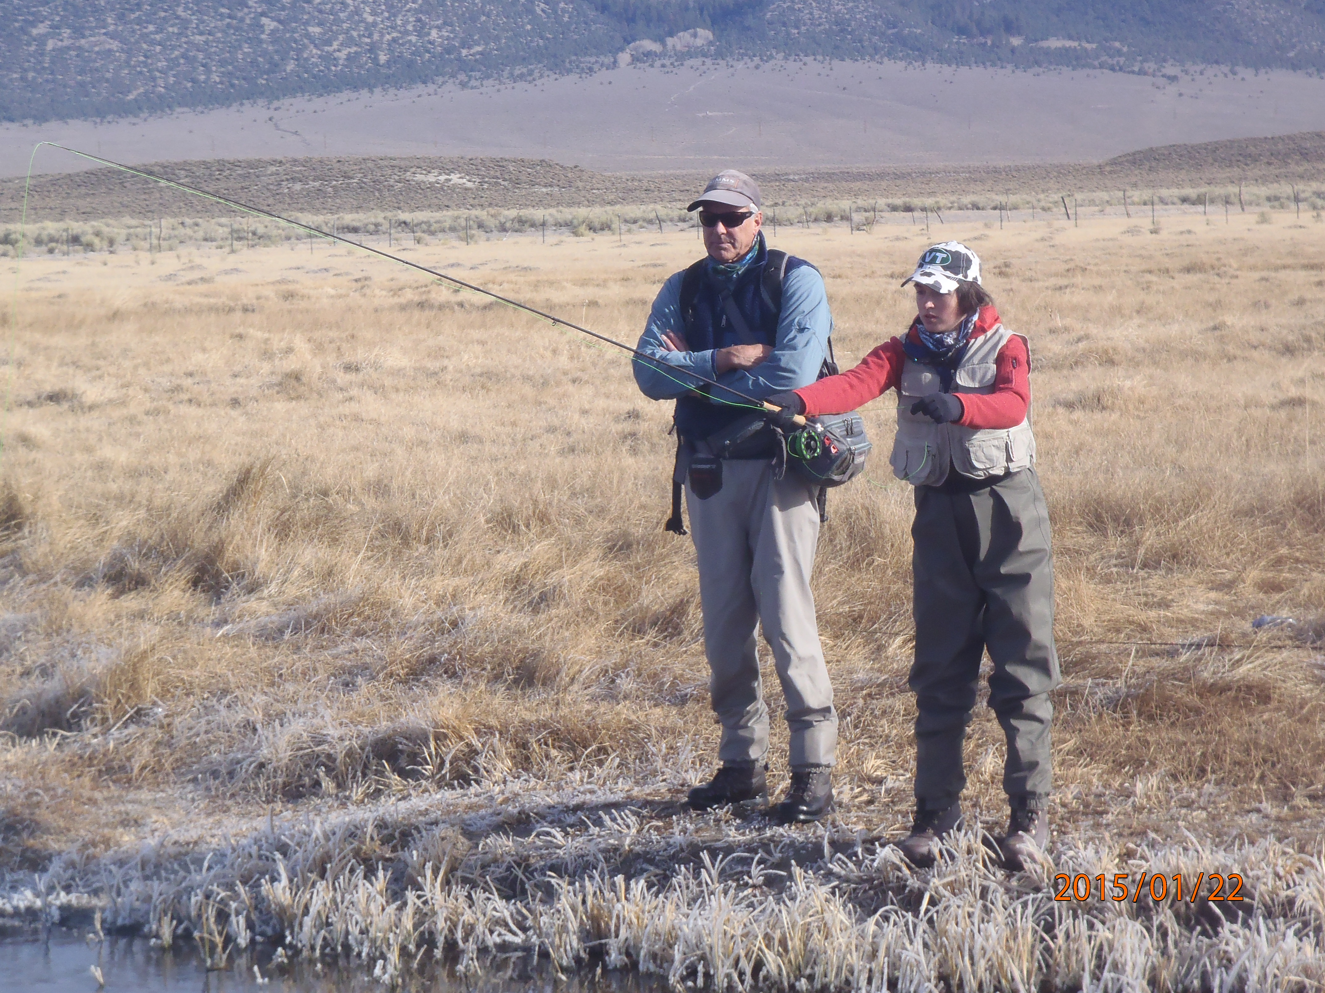
Our Fishing Guides in the Owens Valley will be led by Jim Stimson of Jim Stimson Fly Fishing
Professional guides of will guide us on the Owens River for three days. Depending on weather, an additional day will be available for fishing on our own in Bishop with the instructor’s help and the knowledge you have acquired).

Slide 16
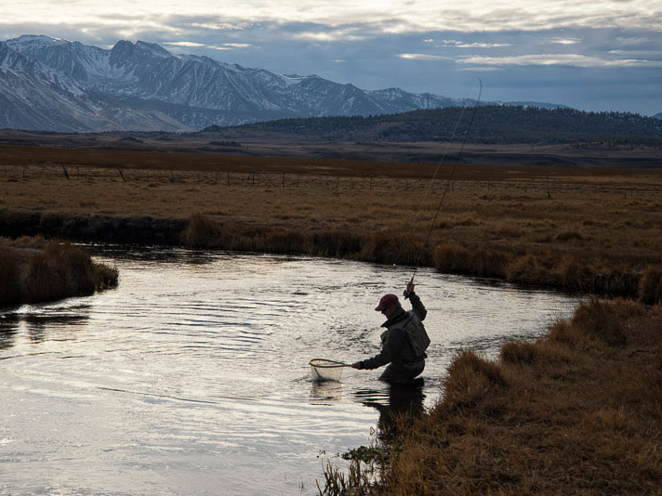
Upper Owens just before Leaving 2015
Photo by Chief Guide Jim Stimson

Slide 17
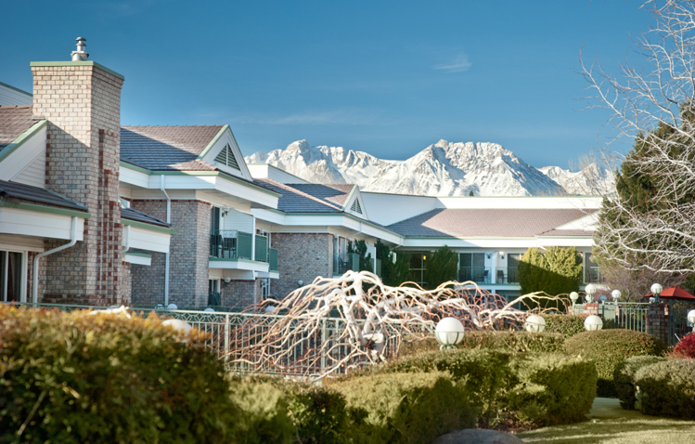
Food and Lodging in Bishop: The Creekside Inn
Motel provides complimentary and filling hot breakfast
Our Guides provide a basic lunch. Students are on there own for dinner in Bishop, a bustling town with restaurants from great Mexican fare and steakhouses to McDonalds and other fast food.
There are microwaves in the rooms and many different food choices within walking distance.
This is a dry—no alcoholic beverages—trip as students of all ages will be along.
Students admitted to the course should be committed to the outdoor ethos of fly fishing.

Slide 18
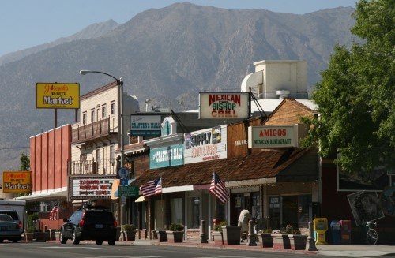
Dinner In Bishop—Choices
Astorga's Mexican Grill
2206 N. Sierra Hwy.
Bishop, CA 93514
tel:(760) 872-3849
Bar B Q Bills
187 S. Main St.
Bishop, CA 93514
tel:760-872-5535
Erick Schat's Bakkery
763 North Main Street
Bishop, CA 93514
tel:760-873-7156
Holy Smoke Texas BBQ
772 North Main Street
Bishop, CA 93514
tel:760-872-4227
Imperial Gourmet Chinese Restaurant
937 N. Main St.
Bishop, CA 93514
tel:760-872-1144
La Casita Mexican Resturant
175 S. Main St.
Bishop, CA 93514
tel:760-873-4828
McDonald's of Bishop
562 N. Main Street
Bishop, CA 93514
tel:760-872-1211
Pizza Factory
970 North Main Street
Bishop, CA 93514
tel:(760) 872-8888
Starbucks Coffee
905 N Main St
Bishop, CA 93514
tel:760) 872-6582
Mexican Food, Pizza, McDonalds, Bar B Q, Thai, Chinese and Other Food Choices Walking Distance from the Motel—Basic Lunch On River Provided by Guides.

Slide 19
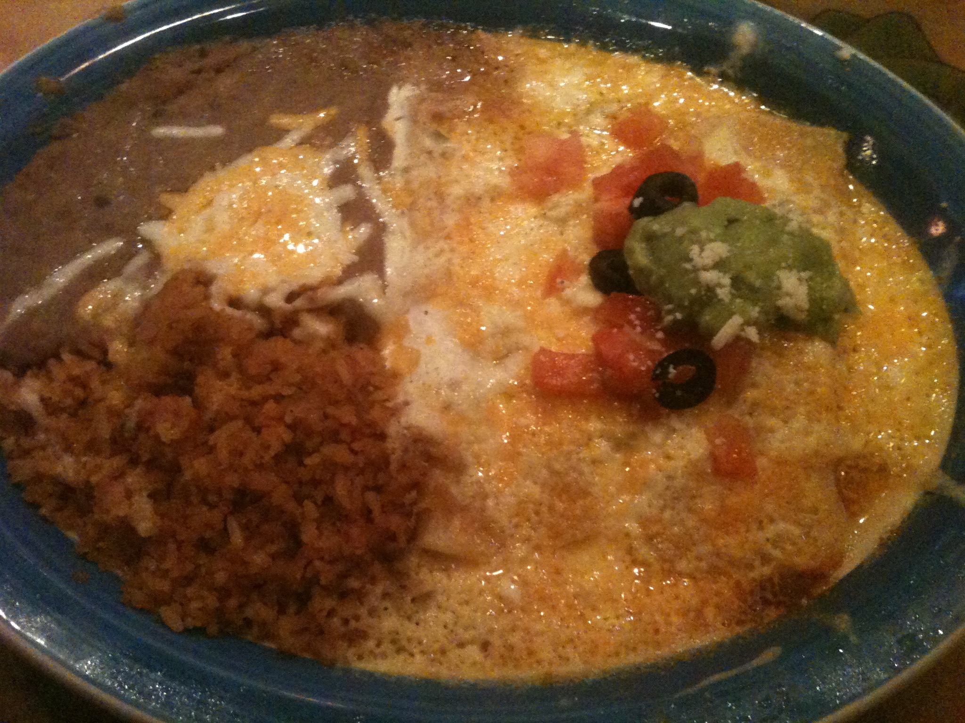
Enchiladas con Queso y Frijoles: Bishop, California
Yummy!

Slide 20
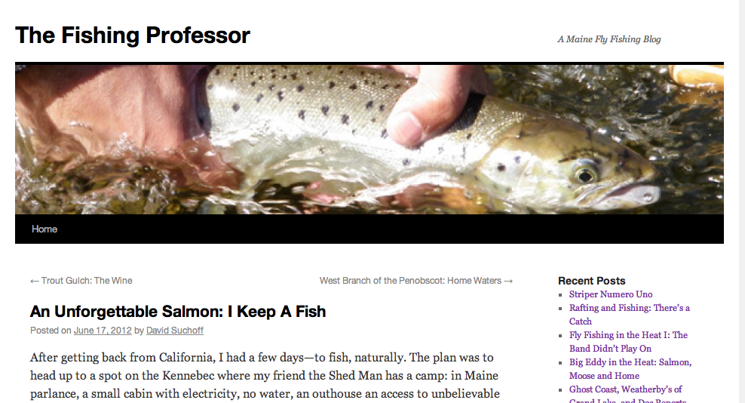
Week 4: Writing and Presenting Your Fishing Blogs

Slide 21
Gear Required
1. Borrow from Fly Fishing Club, Outing Club or friends.
2. Purchase—Needed:
A. Waders—$99.00 and up Cabellas/Beans
B. Wading Boots—$129.00 and Up
C. 5-6 Weight fly rod, reel with line:
Example: Quest II Outfit LL Bean: $139-149.00

Slide 22
Costs, Application, Deadlines
1. $2050—2500 depending on gear owned. Includes airfare, hotel, airport shuttle in CA, breakfast in CA, 3 days professional guiding on the Owens River, LL Bean fly casting instruction, fly tying material.
Incidental costs: 4 dinners in Bishop, travel to/from Logan airport, CA fishing license 3-4 days.
2. Application due Friday September 21st 5:00 PM as Word Attachment only: David.Suchoff@Colby.edu.
3. $500 Non-Refundable Deposit due at Financial Services Friday Oct. 17 2018.
4. Full Colby cost (currently $2050) due Dec. 1 2018.

Slide 23
Funding: DavisConnects
There will be limited, competitive funding available through DavisConnects: applications will be available Oct. 1, with an early decision on Oct. 5th. Go to <Colby.edu/davisconnects> for more information

