Slide 1

Lost in Translation: The Art and Craft of Translation in the Age of Artificial Intelligence
Integrating Language, Literature, and STEM Education
Per Urlaub, Massachusetts Institute of Technology
COLBY COLLEGE, April 2025

Slide 2
Outline
-Institutional Context: Language, Humanities and Liberal Arts at MIT?
-Overview of course “Lost in Translation”
-Learning outcomes
-One snapshot
-Major assignment: Translation portfolio
-Conclusion: Future directions

Slide 3
Language Education & Liberal Arts at MIT
Global Languages:
-Nine languages
-Five additional LCTLs during a January term
-Major, minors, and concentrators
-Footprint: Largest department at MIT in terms of concentrators; largest department in SHASS in terms of minors and majors
School of Humanities, Arts, and Social Science (SHASS):
-Larger footprint in UG education at MIT than many would assume…

Slide 4
Humanities Education at MIT
Two archetypes:
Purists believe the humanities are most powerful if we resist making attempts to connect our teaching with our students’ interests in STEM fields. Interdisciplinary work beyond the humanities is a thread to the unique contribution of the humanities make to our students’ education.
Pragmatists believe central insights and approaches that humanists have developed for centuries only remain relevant in the 21st century if we apply them to the analysis of the human condition in an increasingly technologized world. This work requires interdisciplinary engagement not just within, but beyond humanities fields.

Slide 5
Lost in Translation: World Literature in the Age of Artificial Intelligence
-Fall semester 2022, fall semester 2023, (spring 2026)
-All discussions and readings in English
-Prerequisite: “Basic reading competence” in at least one LOTE
-Enrollment: capped at 18 undergraduate students
-Timeframe: 12 weeks, 36 contact hours

Slide 6
Curricular Planning Grid
“Lost in Translation”
Goal Areas/”Big Issues” | Can-Do Statements | Instruction/Assignment
Translation as a Craft and Art | Students can articulate a critical appreciation of translation as a process, a vocation, and an artform. | Reading and discussion texts on the theory of translation; work on a translation portfolio
Features of Literary Discourse | Students can express a nuanced understanding of the characteristics of literary discourse as opposed to expository texts. | Work on a translation portfolio; reflective essays; work-in-progress presentations
Language & Literacy Development | Students can independently use translation tasks and reflections on translation to enhance their language and literacy competencies in a language other than English. | Work on a translation portfolio; reflective essays; work-in-progress presentations
Machine Translation and LLMs | Students can analyze the affordances and limitations of machine translation technologies and LLMs. | Readings and discussions of texts on machine translation and AI; comparative analysis of human translation and technology translation output

Slide 7
Structure of “Lost in Translation”
First half of the semester:
-Canonical classical texts in translation studies
-The big issue: Word-for-word vs sense-to-sense approaches of translation
Second half of the semester:
-Contemporary theories and debates on translation and localization
-Topics: identity, cultural appropriation…
Throughout the semester:
Reflections on the relationship of translation, translation theory, and technology

Slide 8
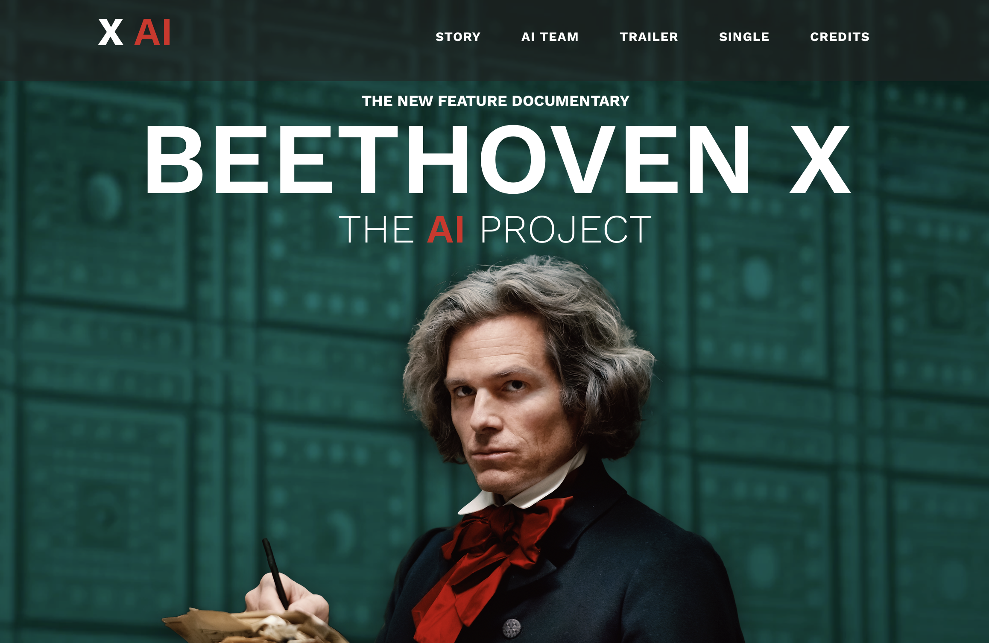
Snapshot: Luther/Beethoven/Generative AI
Martin Luther: ”Sendebrief vom Dolmetschen” / “Open Letter on Translating” (1530)
Ludwig van Beethoven: “10th Symphony”
(1827, unfinished)
Beethoven X / The AI Project: “10th Symphony”
(2022, completed)

Slide 9
Translation Portfolio, Part I
Throughout the semester: 4 translation tasks, 4 reflection essays comparing human translations with machine translation output (both Google Translate and LLMs)
Students chose language pairing and directionality of translation
Languages represented in class: English, Spanish, French, German, Chinese, Arabic, Japanese, Korean, Portuguese, Polish, Armenian

Slide 10
Translation Portfolio, Part II
Text Genre | Human Translation and Reflection | Contrastive Analysis: Human vs Machine Translation vs LLM Translation
Newspaper report (student choice) | Week 2 | Week 9
Opening paragraph of short story or novel (student choice) | Week 4 | Week 10
Song or Poem (student choice) | Week 6 | Week 11
Advertisement (provided by instructor) | Week 8 | Week 12

Slide 11

Translation Portfolio, Part III
Language Education at MIT
Humanities Education at MIT

Slide 12
Conclusion
Student perceptions
Future directions

Slide 13
Thank you!
Per Urlaub
urlaub@mit.edu

