Slide 1
Is Liberal Arts Education Compatible with Generative AI?
April, 2025, Colby College
Per Urlaub (MIT)
Eva Dessein (MIT)

Slide 2

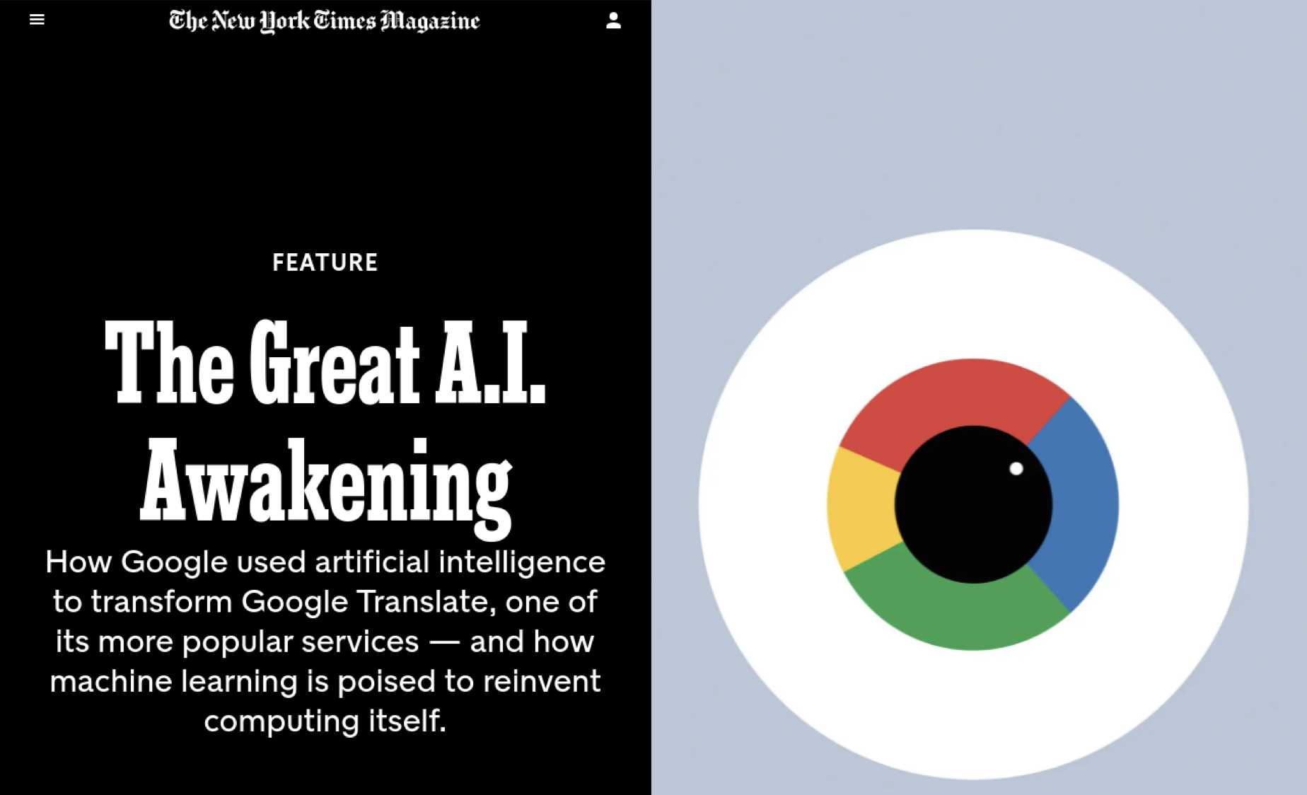
Two recent events/developments that impact our understanding of the role of technology in education:

Slide 3
Overview
Working definition: Liberal arts education
A framework to understand the affordances and limitation of AI in undergraduate education: Why and How…
Discussion on the compatibility of AI with liberal arts education

Slide 4
Liberal Arts Education, I
- Curriculum: Anchored in humanities, creative arts, social sciences, and natural sciences that expressively contrasts with educational experiences that are principally vocational, professional, or technical in nature
-Outcomes: Critical reading competencies across genre and media, inquisitive thinking, empathy for others, tolerance for ambiguity, creative expression, effective writing, and persuasive speech – and all of that preferably across several languages.

Slide 5
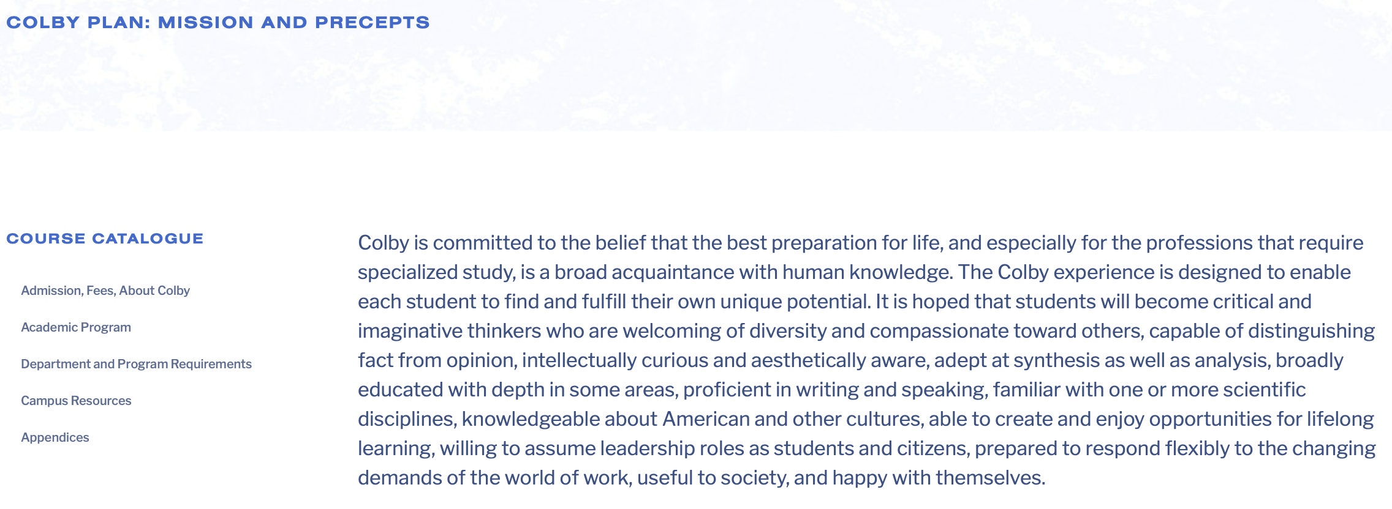
Liberal Arts Education, II
Colby is committed to the belief that the best preparation
for life […] is a broad acquaintance with human knowledge.

Slide 6
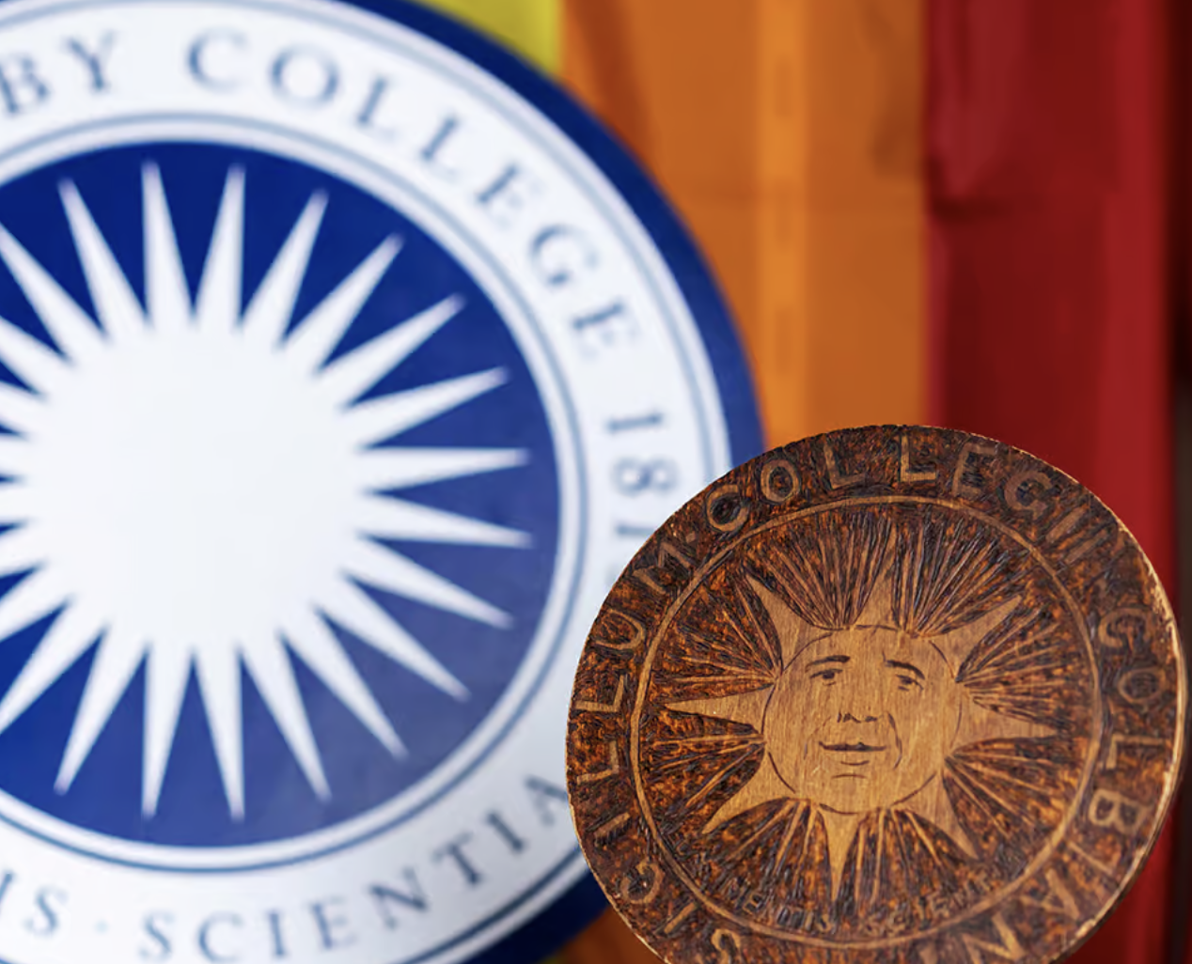
Liberal Arts Education, III

Slide 7
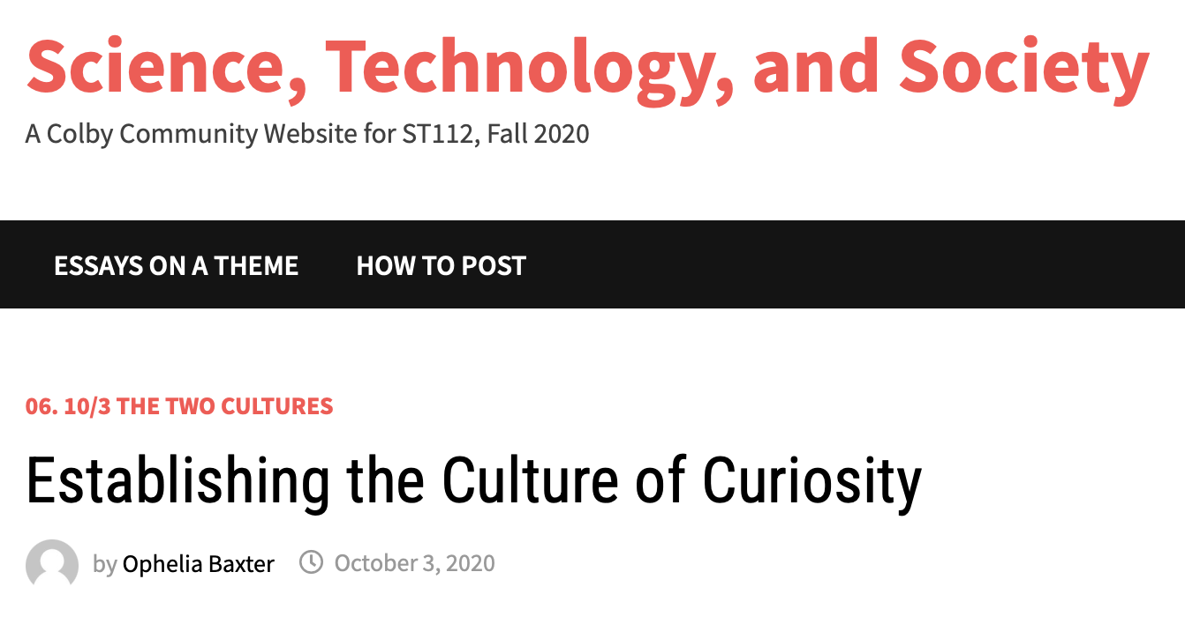
Liberal Arts Education, IV

Slide 8
The two big questions…
Why…
…should we use AI technologies in educational settings?
How…
…can we implement AI technologies in productive ways into our teaching?

Slide 9
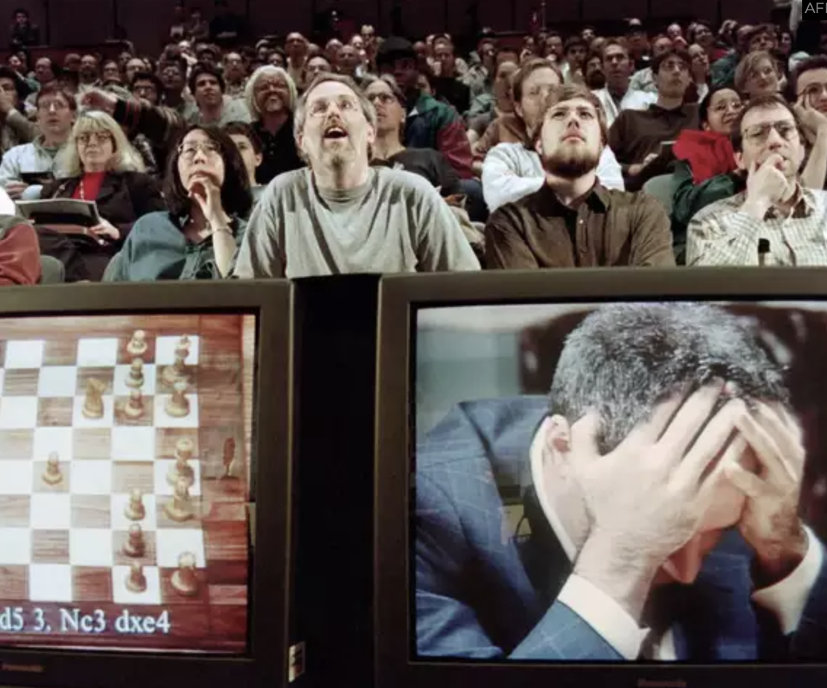
The Why-Question

Slide 10
From Competition to Collaboration
How would the world’s most powerful chess computer
hold up against a human collaborating
together with a computer?

Slide 11


Centaur Chess

Slide 12
Centaur Chess: Results
Not surprisingly, a Human+AI Centaur beats the solo
human all the time.
But — amazingly — Human+AI Centaurs routinely beat
today’s most sophisticated solo computers.

Slide 13
Implications for Language Educators
In the context of AI, consider not only the fearful “Human against Machine” narrative. Instead, focus on developing a “Human with Machine” mindset.
People become simply smarter, if they collaborate with technology effectively. Human-Machine Collaboration is as old as human civilization.
AI is not very powerful alone and not nearly as smart as a human collaborating with artificial intelligence. A mix of intuitive human intelligence and probabilities-driven artificial intelligence surpasses either one alone in the game of chess -- and in many other domains.

Slide 14

The How-Question

Slide 15
Vygotsky & Sociocultural Theory
Two Key Concepts:
Zone of Proximal Development (ZPD): Learning happens through collaboratively completing tasks that are too challenging to accomplish alone.
Scaffolding: Learning happens through guidance and interaction with an expert.
Objectives of instruction designs: We should develop learning experiences where students grow through supportive interaction over tasks that are just a little bit too hard for them to solve individually without collaboration.

Slide 16
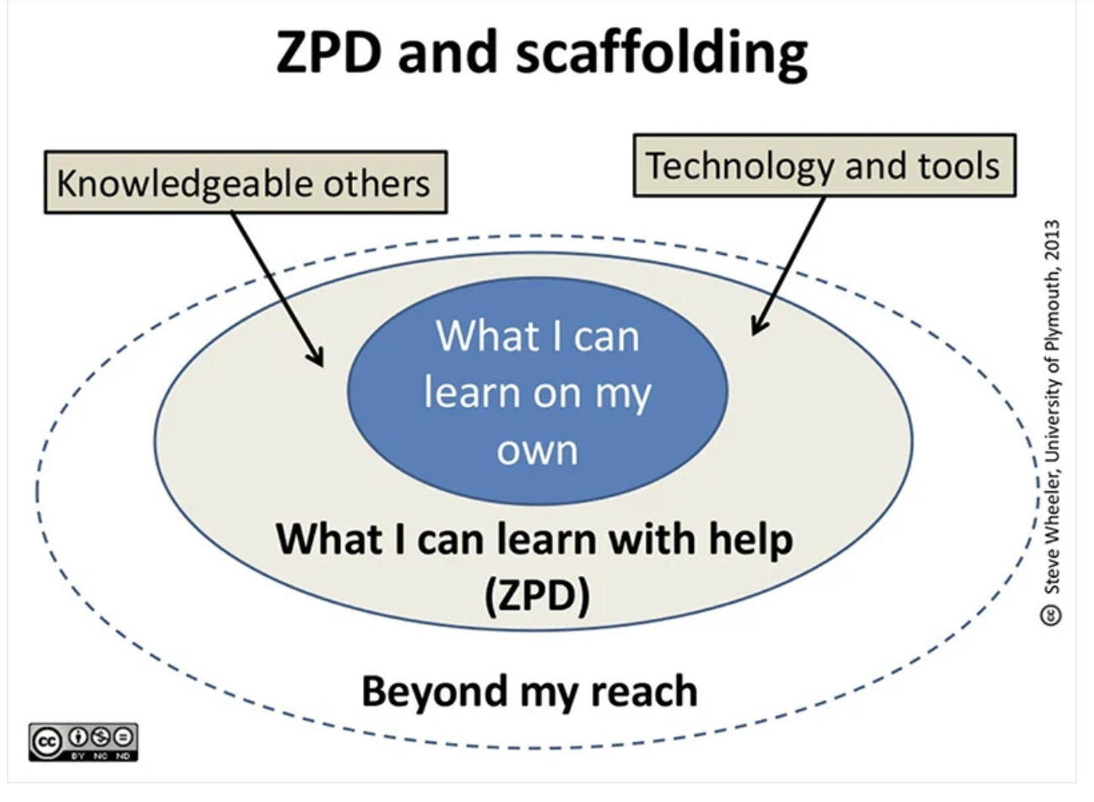
ZPD & Scaffolding: An Illustration

Slide 17
ZPD, Scaffolding, and AI
Can AI scaffold language learners in the Zone of Proximal Development? We say: Yes!
Can AI scaffold language learners in the Zone of Proximal Development as good as human teachers can? We say: Probably not!
Educators using technology in their classes should design scenarios that instrumentalize these technologies to simulate scaffolding interactions in the zone of proximal development.

Slide 18
Summary
Artificial Intelligence ≠ Human Intelligence
Technology can make us smarter, (if used intentionally).
Artificial Intelligence alone is not very intelligent, but potentially harmful, if used unsupervised by humans.
We should not just open the floodgates and allow AI in schools and classrooms, without reflecting about its role in our teaching.
Learning theory matters!

Slide 19
THANK YOU!
urlaub@mit.edu
edessein@mit.edu

