Slide 1
Ethical, Moral and Cultural Issues of AI.
AI@SLAC 2025
Fernando Nascimento
Digital and Computational Studies - Bowdoin College
fnascime@bowdoin.edu

Slide 2
4 Issues
Their Implications to SLAC
4 Examples of AI Ethics-related SLAC research/teaching

Slide 3
Four AI Ethics Issues

Slide 4
Determinism
vs.
Neutrality
1

Slide 5
Sociotechnical systems
1

Slide 6
Nothing New
vs.
Absolutely New
2

Slide 7
From Automation to Autonomy
2

Slide 8
Instrumental Goals
vs.
Intrinsic Goal
3

Slide 9
A dialectic between computational means and well-deliberated human goals.
3

Slide 10
Negative Ethics (don't do harm)
vs.
Positive Ethics (do good)
4

Slide 11
Every AI solution implements a combination of negative and positive ethical principles.
4

Slide 12
4 Examples

Slide 13
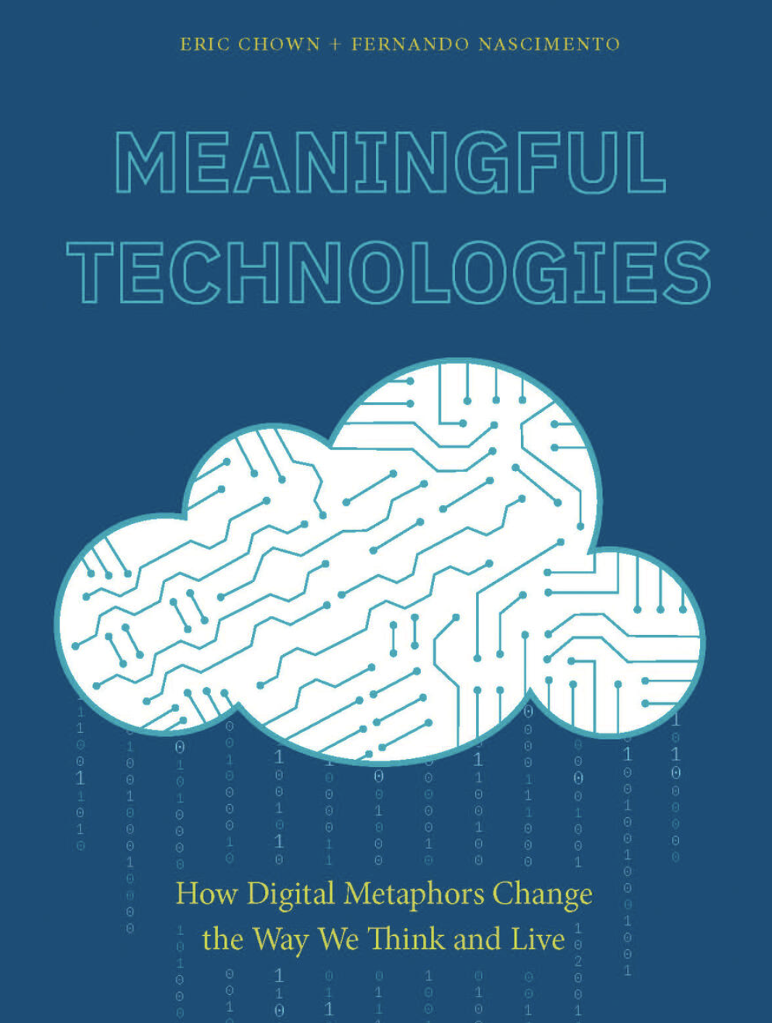
Metaphors and Meaning

Slide 14
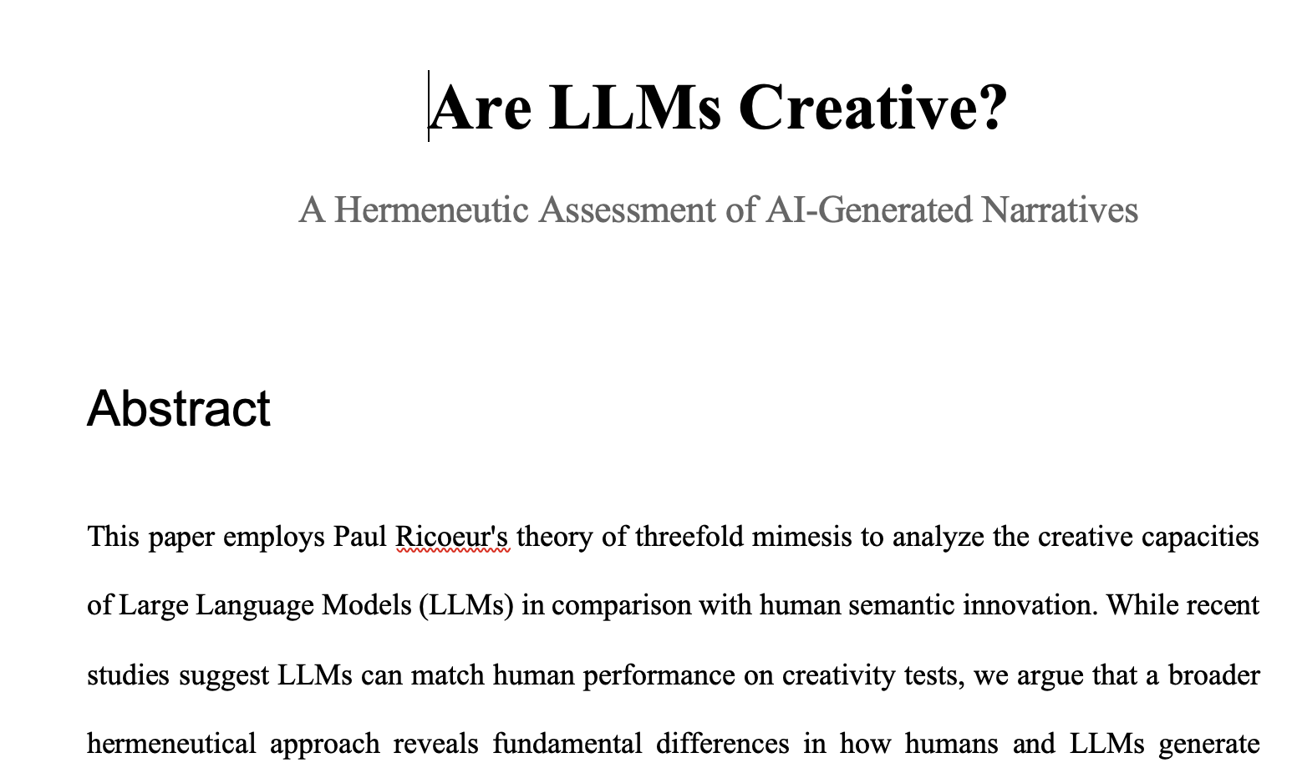
LLMs and Creativity

Slide 15

Ethical Deliberation

Slide 16
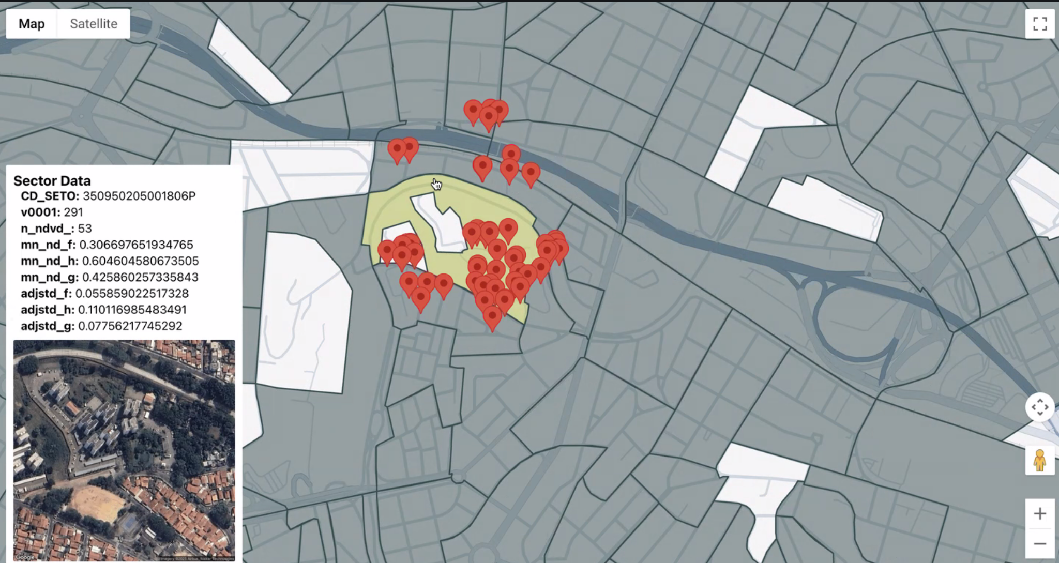
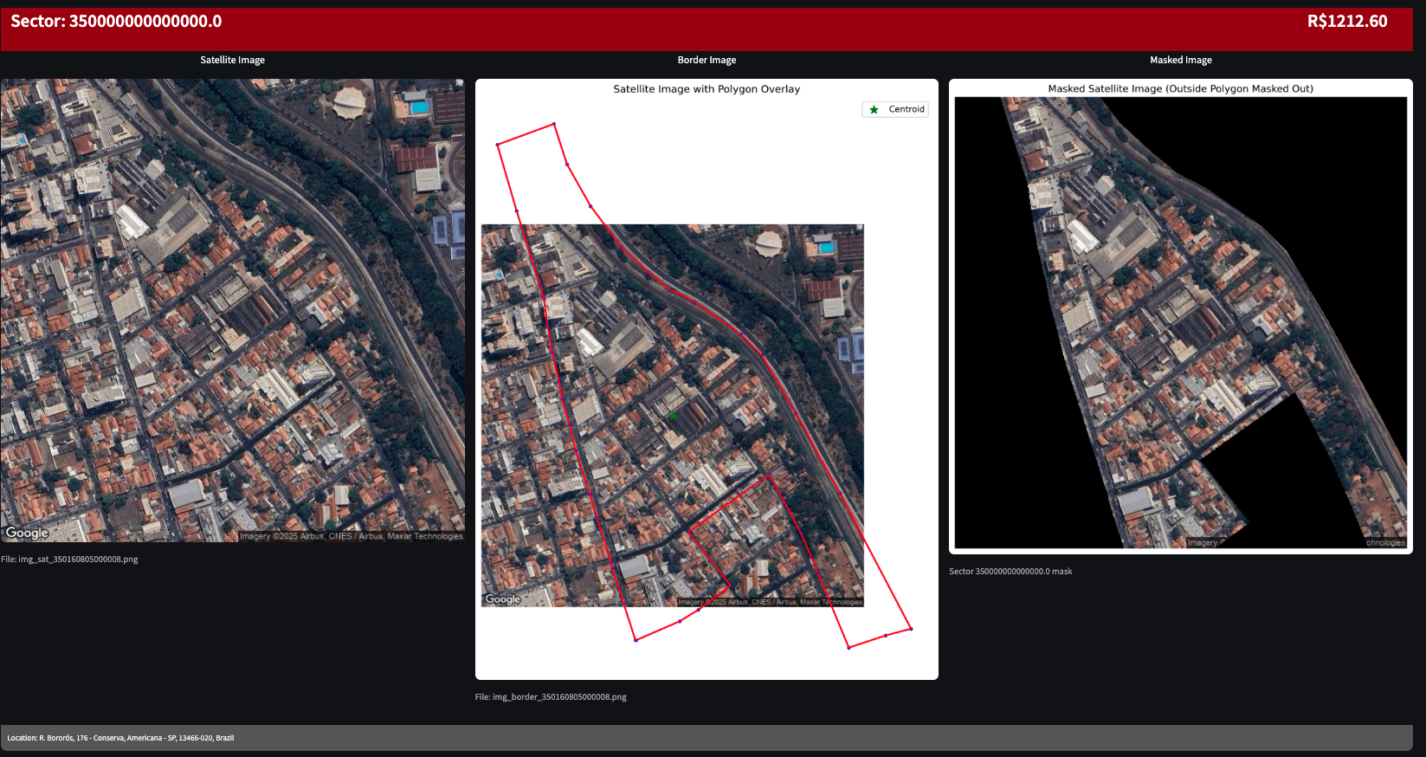
AI and Human Development

Slide 17
Thank you
Fernando Nascimento
Digital and Computational Studies - Bowdoin College
fnascime@bowdoin.edu

