Slide 1
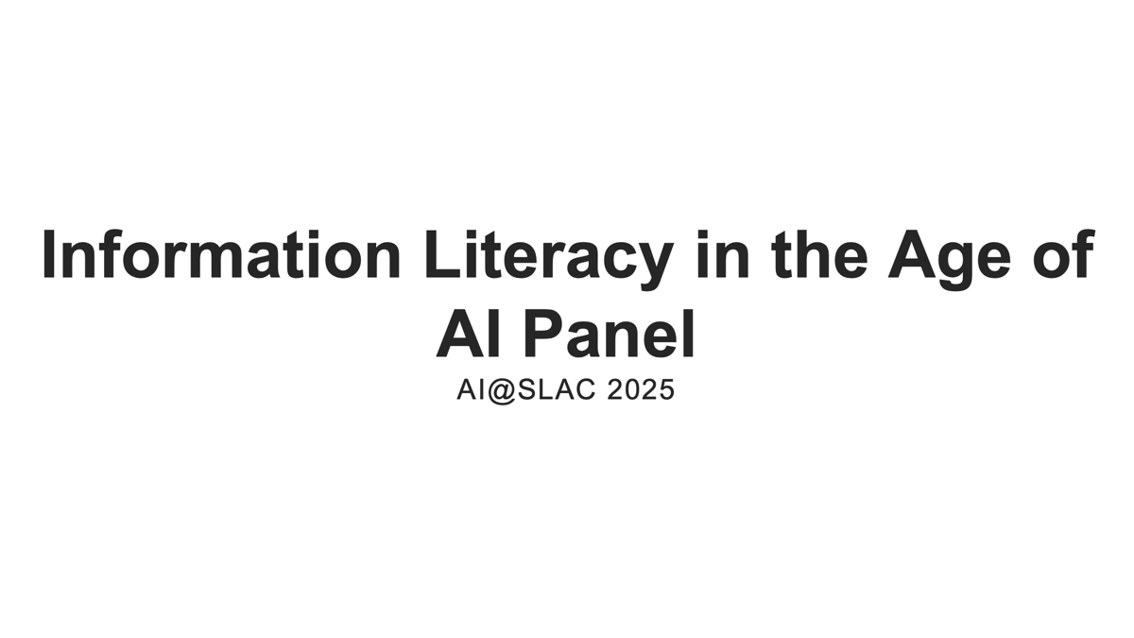

Slide 2
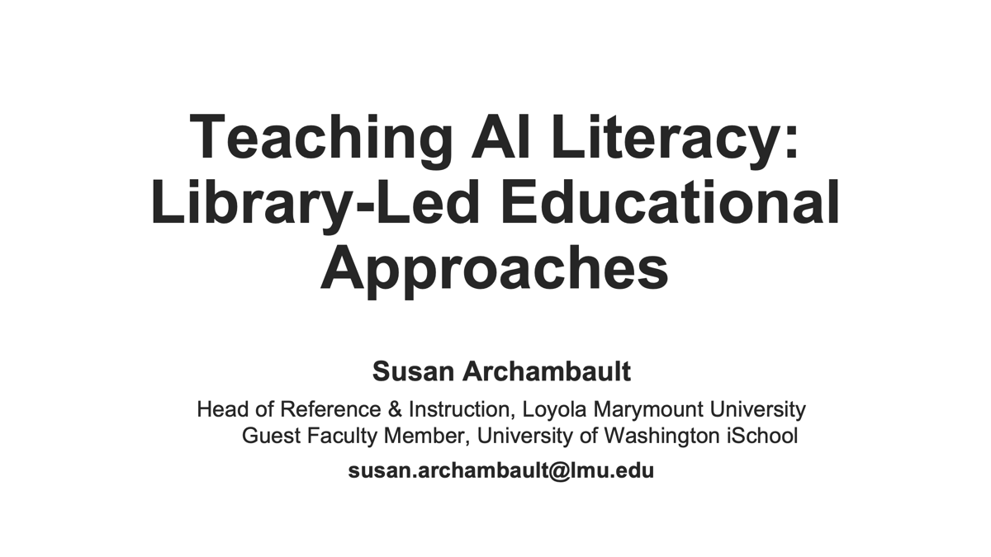

Slide 3
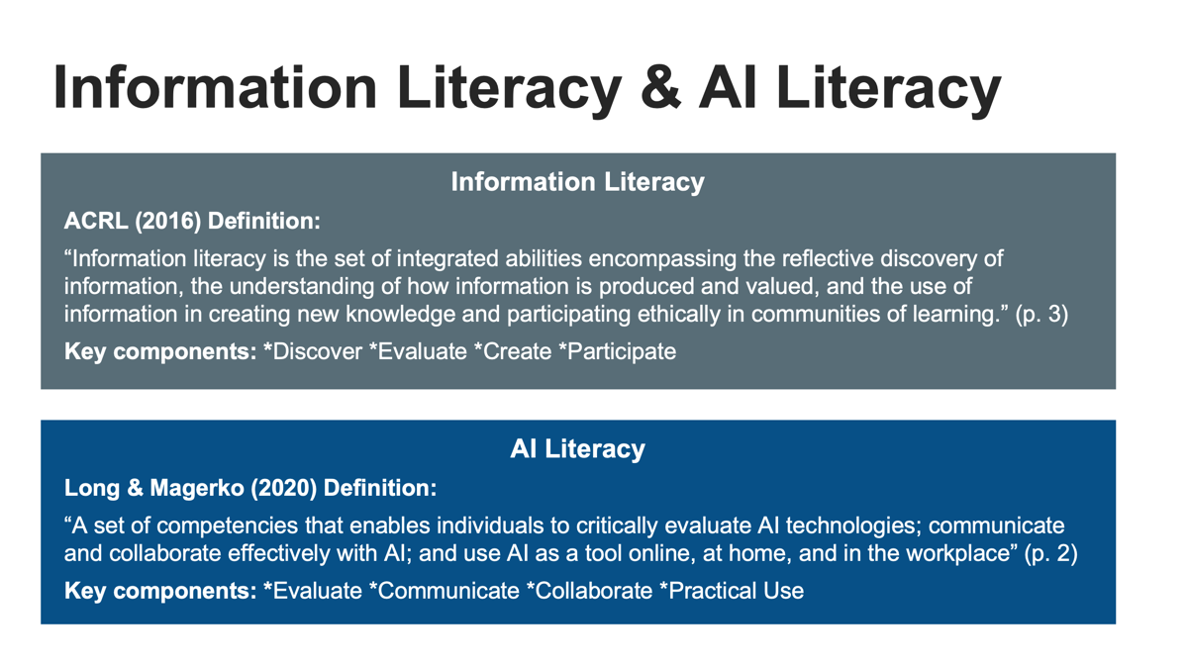

Slide 4
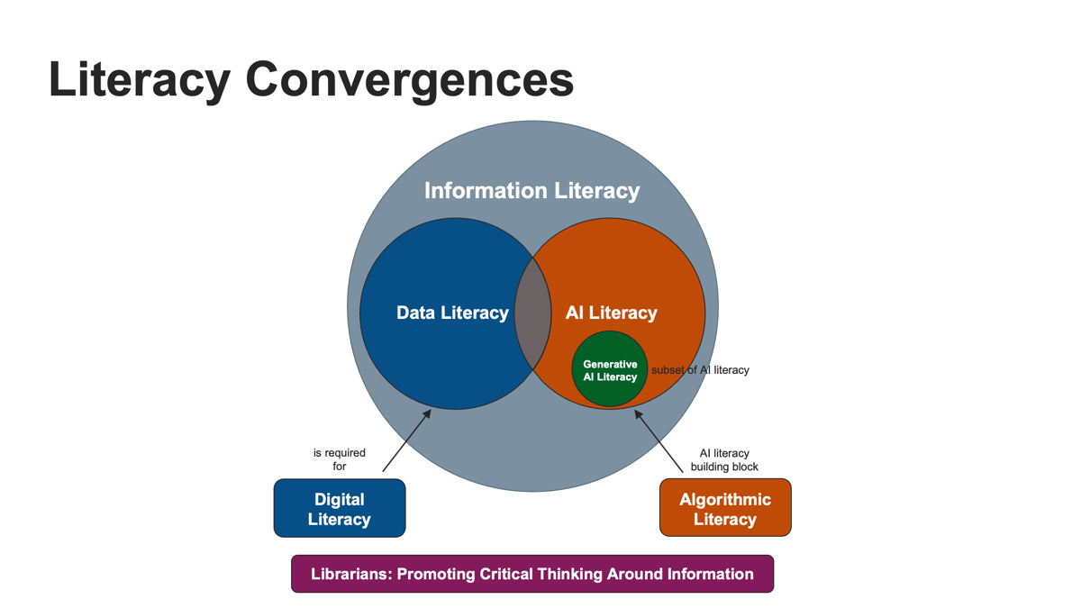

Slide 5
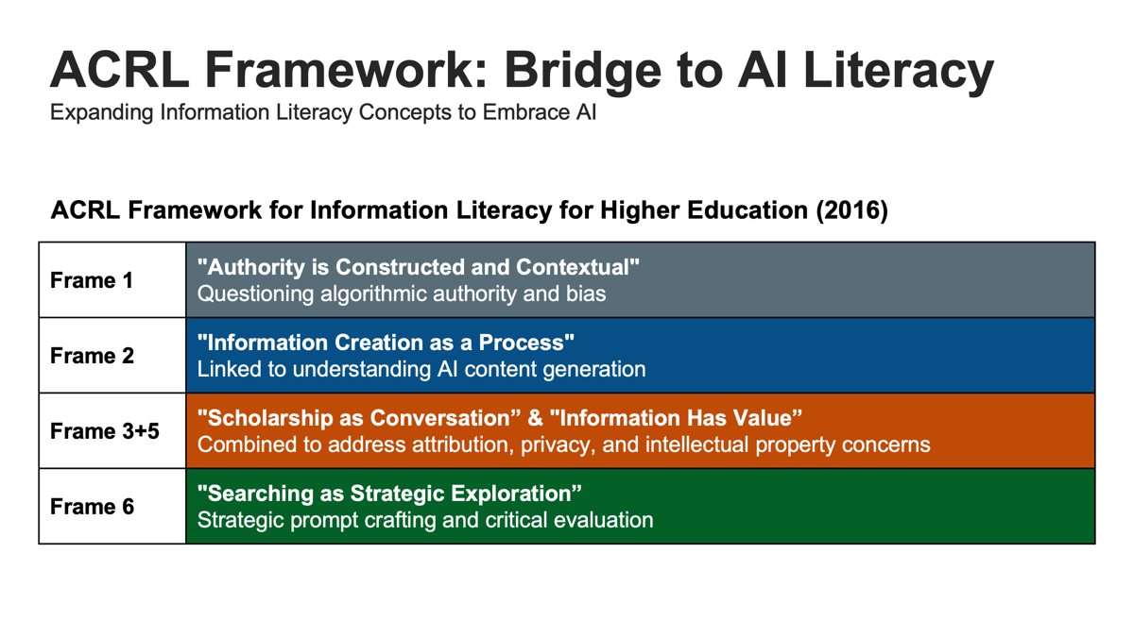

Slide 6
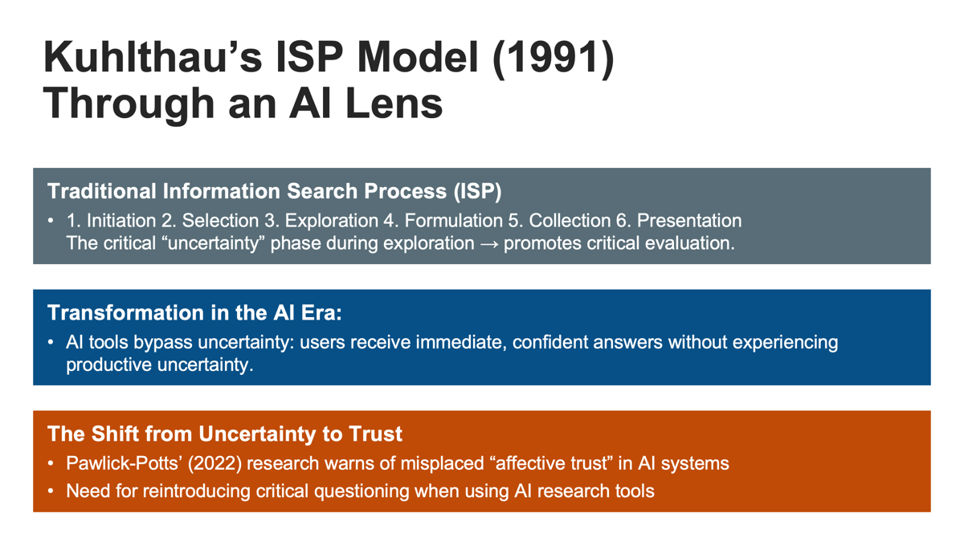

Slide 7
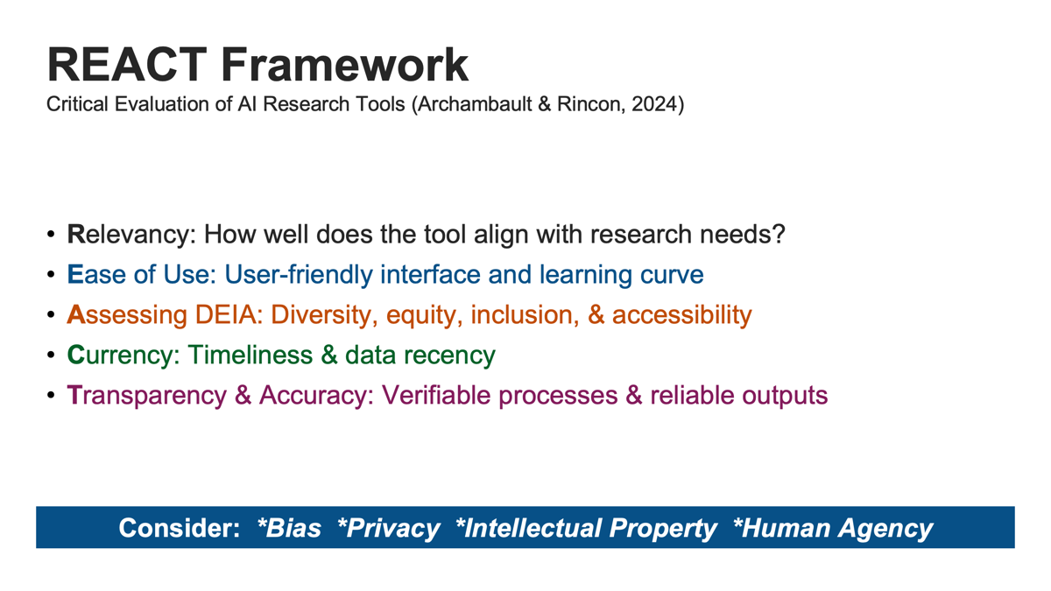

Slide 8
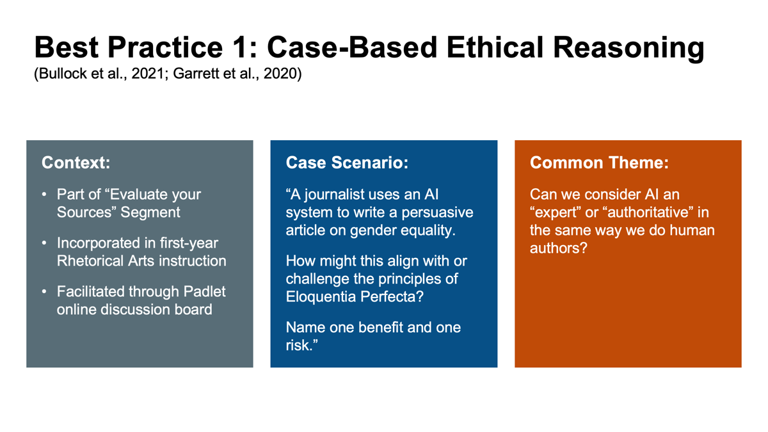

Slide 9
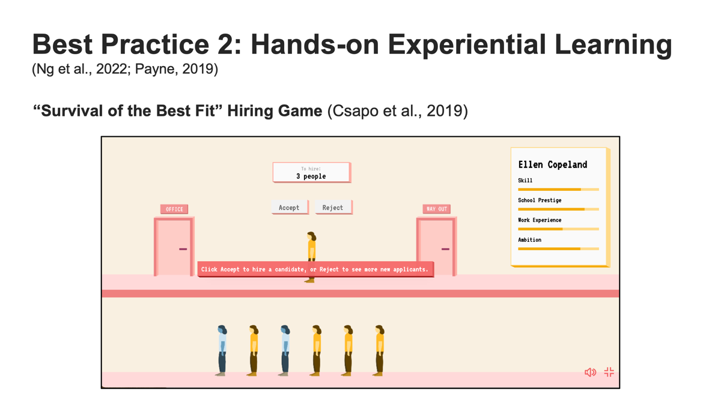

Slide 10
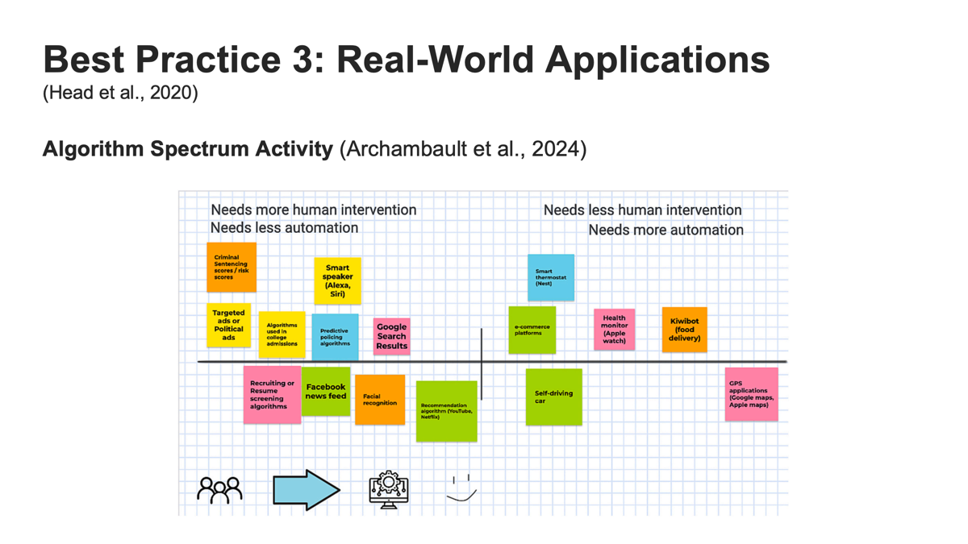

Slide 11
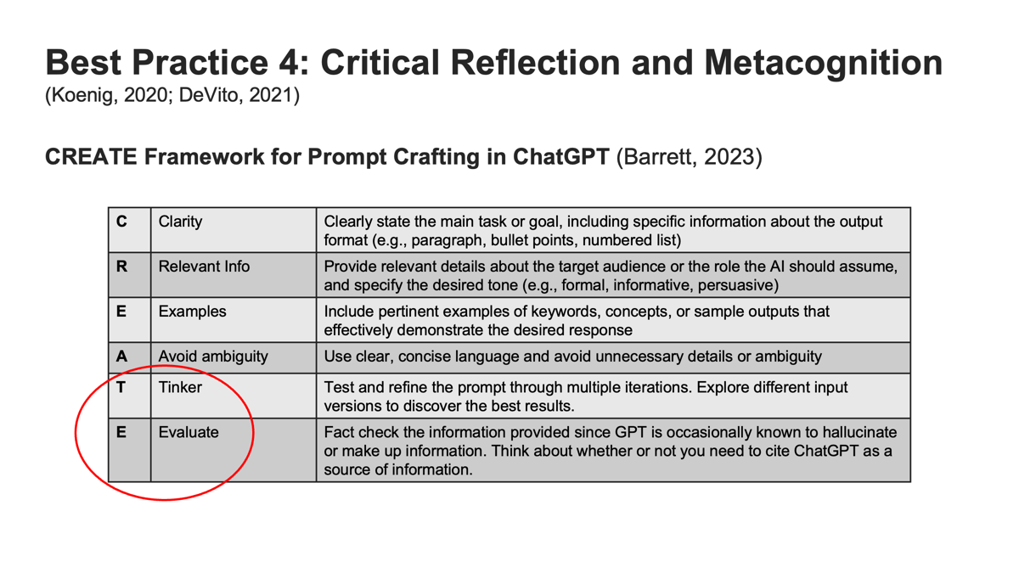

Slide 12
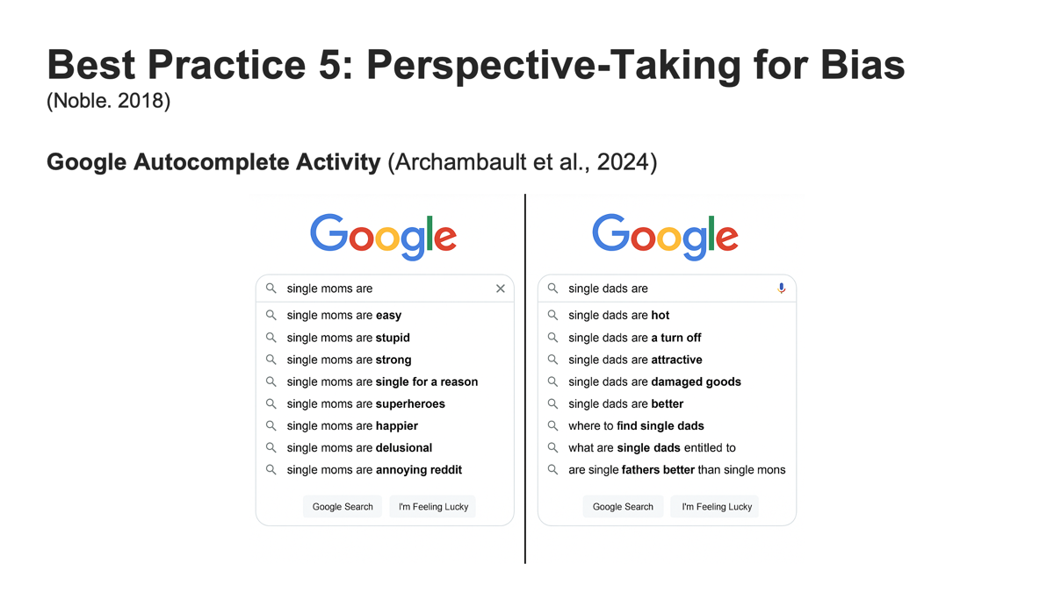

Slide 13
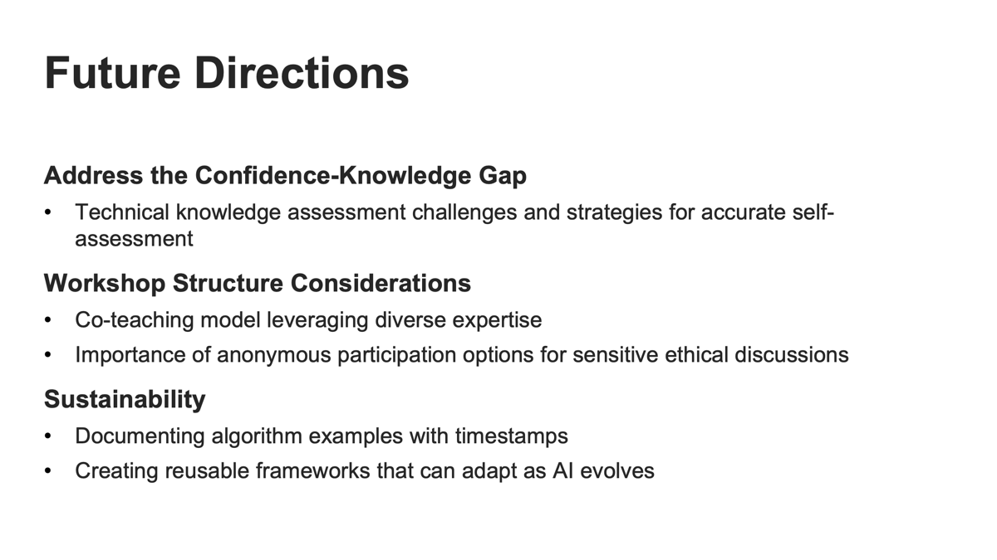

Slide 14
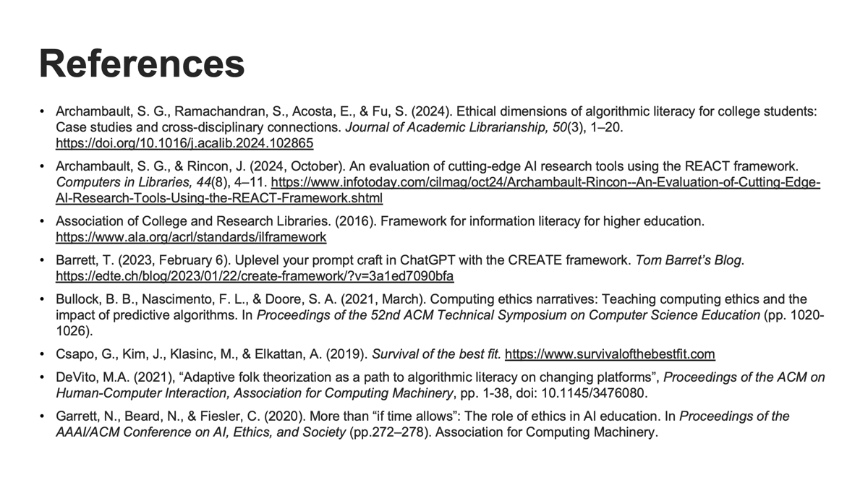

Slide 15
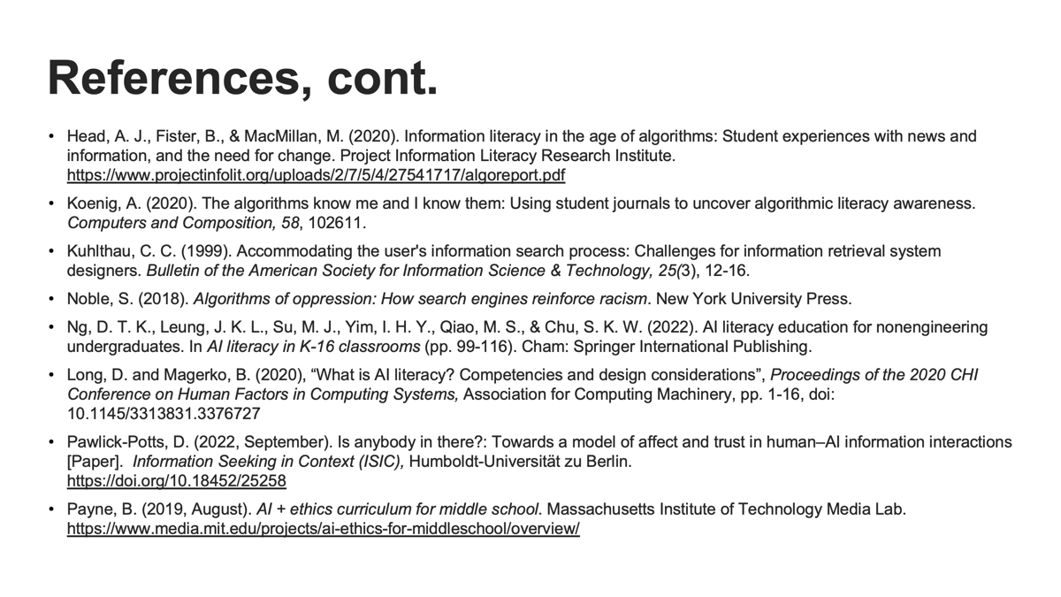

Slide 16
AI AT SMALL LIBERAL ARTS COLLEGES 2025
Libraries as AI Literacy Leaders
Structuring AI Integration in Small Liberal Arts Colleges
Jessica McCullough
Director Research Support + Curricular Technology
Connecticut College

Slide 17

Outline
Small College Libraries: Hubs of Innovation and Collaboration
The Library's Role in AI Literacy Integration
Challenges and Barriers
Connecticut College's Approach: AI@Conn
References

Slide 18
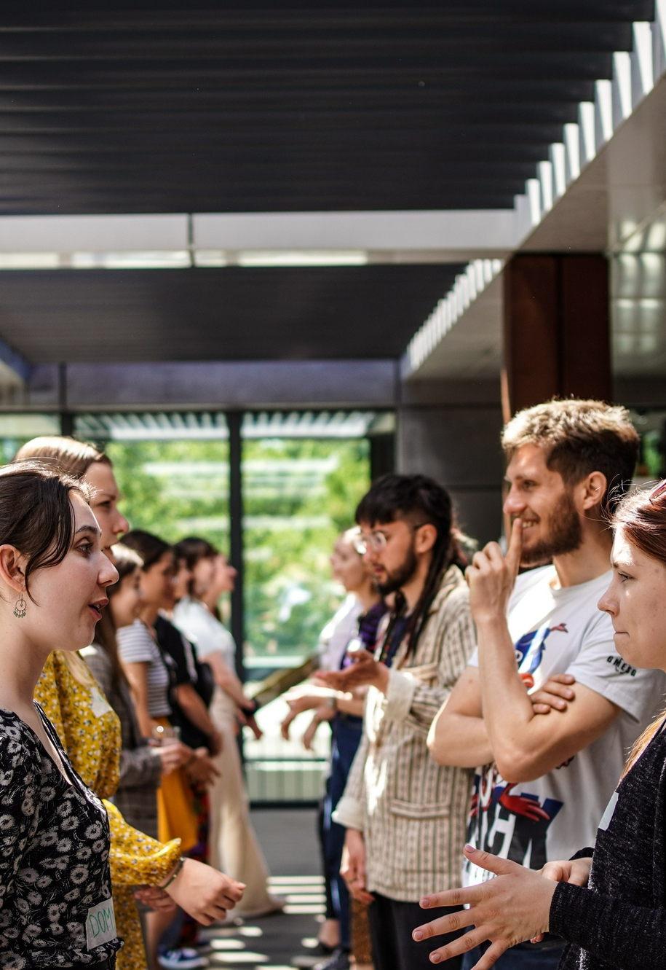
What happens in small college libraries?
Curricular Integration
Constant Change
Promote accessibility
Championing forms of literacy
Adapting services and skills to meet changing needs
Making information available and accessible to College community and beyond
Embedded into College
Trusted Intermediaries
Partnerships with student-facing offices, centers for teaching & learning
Selecting materials, tools, and systems that meet needs
Faculty research
Simplifying navigation of complex information systems and discovery tools
Committees and governance
Notes:
Call out a few specific examples:OER Programs

Slide 19
Librarian superpowers
Build and sustain trusted and respectful relationships with faculty, students, staff, administrators
Stay current with changes in information technology, publishing, digital tools
Understand the curriculum: general education and all majors/programs
Knowledge of the budgetary climate, today and tomorrow
By leveraging the relationships, expertise, and infrastructure, the college library is well-positioned to support AI literacy initiatives for the campus community.

Slide 20
How Libraries can support Campus-Wide AI Literacy
Develop and share resources and information to the campus community (LibGuides)
Craft AI-related learning experiences, assessments, and institution-specific frameworks
Strengthen or expand information literacy with AI concepts, map to general education and major curricula
Liaise with IT to enable campus-wide generative AI access
Coordinate/participate in faculty development: workshops, learning communities, interest groups
Help students navigate AI ethics, bias, and responsible use

Slide 21
Library as AI Hub: Important Considerations
Workload concerns: If AI literacy becomes a library responsibility, what do librarians stop doing to make space for this?
Institutional buy-in: Ensuring AI literacy is strategically aligned and not just an added burden on librarians.
Strategic collaboration: To ensure effective AI integration, collaborate with diverse campus stakeholders beyond the library

Slide 22

Challenges to AI Literacy

Slide 23






I don't have time while teaching to revise my curriculum.
I will not use, and will not let students use, AI due to its environmental impact
I don't know where to start.
Humanities Professor
Social Science Professor
Biology Professor
My department would like to introduce AI ethics into our curriculum.
I'm looking for access to AI tools and technology.
i think my students are cheating using AI, how can i confirm?
Art Professor
Philosophy Professor
Language Professor

Slide 24
Challenges to AI Integration
Liberal arts institutions ought to lean into these difficult discussions and complex problems
Concern that AI's growth may diminish essential human-centered "soft" skills, as well as critical thinking and problems solving skills (deskilling)
Apprehension over AI automating work, jeopardizing jobs and faculty roles, unsettling careers
Concerns about deepening the digital divide
Lack of funding/technical know-how to provide generative AI tools to the community
Skepticism about AI's accuracy, ethics, and environmental impact
Belief that AI Literacy is taught elsewhere in the curriculum or is another department's responsibility
Frustration due to the constant need to adapt to disruptive technology/events, straining workload and work-life balance
Reluctance to "share" intellectual property and novel ideas with Gen AI
Inability to keep up with the rapid pace of development

Slide 25

AI@Conn
Library & IT led 3-year funded initiative to integrate AI into Conn's curriculum
Harold F. Wiley Fellow in AI
Professional Development Workshops for Faculty
Course Development Stipends
Student-Faculty Summer Research Initiatives
Acquisition and Use of New Technologies
External Outreach and Engagement

Slide 26

Join us as we invite thought leaders, educators, and researchers to share their insights on the transformative role of AI in academia. Open to faculty, professional staff, and students, this event will be a space to collaborate, learn, and shape the future of AI in liberal arts education.
ailiberalarts.digital.conncoll.edu

Slide 27
References
Council for Independent Colleges. A playbook for encouraging safe AI use on campus.
Hibbert, M., et al. (2024). A framework for AI Literacy. EDUCAUSE.
Kassorla, M., Georgieva, M., & Papini, A. (2024). AI literacy in teaching and learning. EDUCAUSE.
Laupichler, M. et al. (2022). Artificial intelligence literacy in higher and adult education: A scoping literature review. Computers in Education: Artificial Intelligence. doi.org/10.1016/j.caeai.2022.100101
Lo, L. S. (2023). AI literacy: A guide for academic libraries. College & Research Libraries News, 84(9), 356–359. https://crln.acrl.org/index.php/crlnews/article/view/26704/34626
Mowreader, A. (2025). How librarians can engage with generative AI. Inside Higher Education.
Miltenoff. (2024). Academic Librarians in Times of AI and AI Literacy: Tasks, Responsibilities, and Leadership. The International Information & Library Review., 56(3), 296–305. https://doi.org/10.1080/10572317.2024.2381182
Rasky, E. (2024). Generative AI policy in higher education: A preliminary survey. Centre for International Governance Innovation.
Wang, H. et al. (2024). Generative AI in higher education: Seeing ChatGPT through universities' policies, resources, and guidelines. Computers in Education: Artificial Intelligence. doi.org/10.1016/j.caeai.2024.100326
Weil, D. and Forrester, J. (2024). A Road Map for Leveraging AI at a Smaller Institution. EDUCAUSE.

Slide 28
Ethical Data Toolkit
Creating an AI-Driven Knowledge Base for
Advancing Data Literacy and Data Stewardship
Kara Kugelmeyer
kara.kugelmeyer@colby.edu
Data & Science Librarian
Colby College

Slide 29

Ethical Data Toolkit (EDT)
Concept emerged from sabbatical research at the Davis Institute for AI
  “Just-in-time support”, knowledge bases enhance self-directed learning, chatbots + knowledge bases = scalable, personalized help (Ackerman et. al, 2003; Hrynaszkiewicz et al., 2021; Kester et al., 2001; Kooli, 2023)
Goals of EDT
  Respond to growing need for centralized, ethical data guidance
  Promote library expertise, support, services, and resources
  Supports interdisciplinary, data-informed liberal arts research
  Helps proactively addresses ethical concerns before they become barriers
  Models principled use of AI technologies in academic contexts
  Consolidate ethical data resources across disciplines
  Reach diverse user communities (students, faculty, staff)
  Enable approachable, scalable ethical education

Slide 30

Elements of EDT
Housed in a Google Site for intuitive access and navigation
Interactive Chatbot - DataWise
Content includes: data handbooks, governance models, data resources, research data management best practices, etc.
Instructional toolkits, templates, and lesson plans
Glossary and Citation Guidance
Connects users with library experts

Slide 31
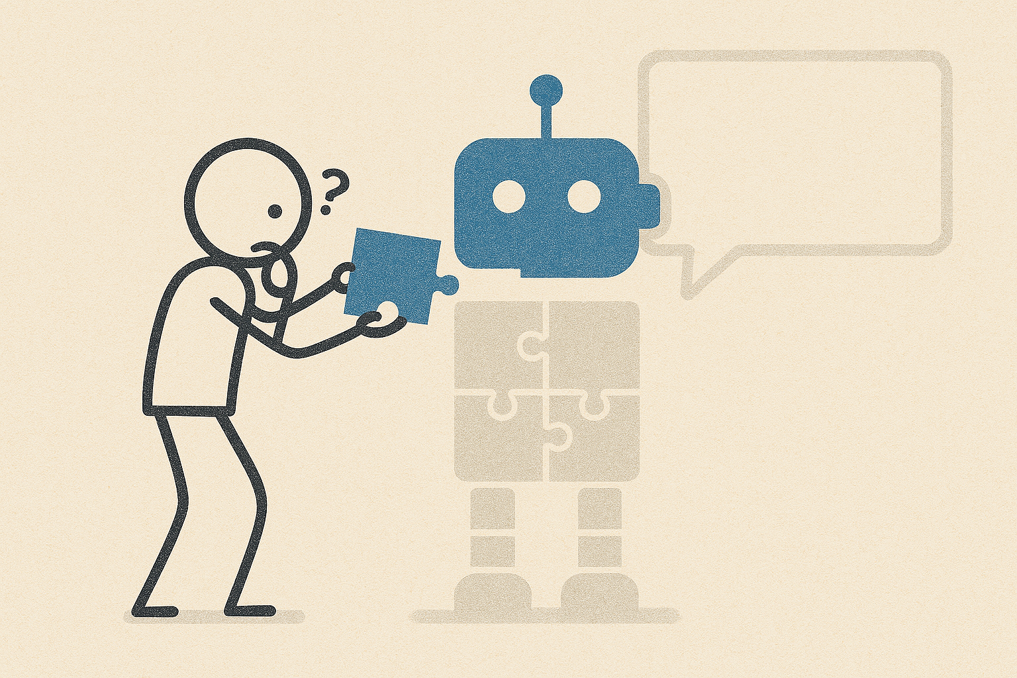
Building the AI Knowledge Base
AI Knowledge Base training materials
  Toolkit documents, example questions, online content (resources, laws, frameworks, code, etc.)
  Programming guardrails
    Respect and acknowledgement for content creation and rights
    No ingestion of data
    Privacy-by-design and transparency
    Default to contacting human
Explore various platforms and configurations
  V1: Low code= Chatbase
    Share resources on GitHub
  V2: Medium code = Secure Large Language Model with retrieval augmented generation (RAG) vector database
    Share code and resources on GitHub

Slide 32

Next Steps
Get Feedback
Start V2
Finish Google Site
  User testing
  Soft Launch
Ongoing Assessment
  Measure the Toolkit’s impact on ethical awareness and applied research practices
    Develop assessment matrix with indicators such as:
      User confidence in ethical decision-making
      Integration of EDT content into assignments or projects
      Frequency of use and repeat visits
      Faculty/staff-reported improvements in research support
    Deploy brief pre/post surveys for course integrations and one-off projects

Slide 33
References
Ackerman, M. S., & Halverson, C. (2003). Sharing expertise: The next step for knowledge management. In M. Huysman, V. Wulf, & W. Prinz (Eds.), Social capital and information technology (pp. 273–299). MIT Press. https://doi.org/10.7551/mitpress/6289.003.0015
Hrynaszkiewicz, I., Harney, J., & Cadwallader, L. (2021). A Survey of Researchers’ Needs and Priorities for Data Sharing. Data Science Journal, 20(1), 31. https://doi.org/10.5334/dsj-2021-031
Kester, L., Kirschner, P. A., van Merriënboer, J. J. G., & Baumer, A. (2001). Just-in-time information presentation and the acquisition of complex cognitive skills. Computers in Human Behavior, 17(4), 373–391. https://doi.org/10.1016/S0747-5632(01)00011-5
Kakolu, S., & Faheem, M. A. (2024). Building trust with generative AI chatbots: Exploring explainability, privacy, and user acceptance. Iconic Research And Engineering Journals, 8(3), 823-834.
Kooli, C. (2023). Chatbots in Education and Research: A Critical Examination of Ethical Implications and Solutions. Sustainability, 15(7), 5614. https://doi.org/10.3390/su15075614

